Slide 1
Getting the Word Out
Presenter’s Name(s)

Slide 2
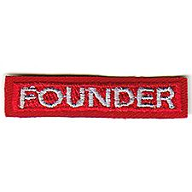

Getting the Word Out
Methods:
Calendars
Websites
Newsletters
Email
Facebook
Twitter
YouTube
Create a Communication Strategy:
For recruiting
For retention
For current members
For your officers
CREATED BY CR VENTURING, 2016

Slide 3
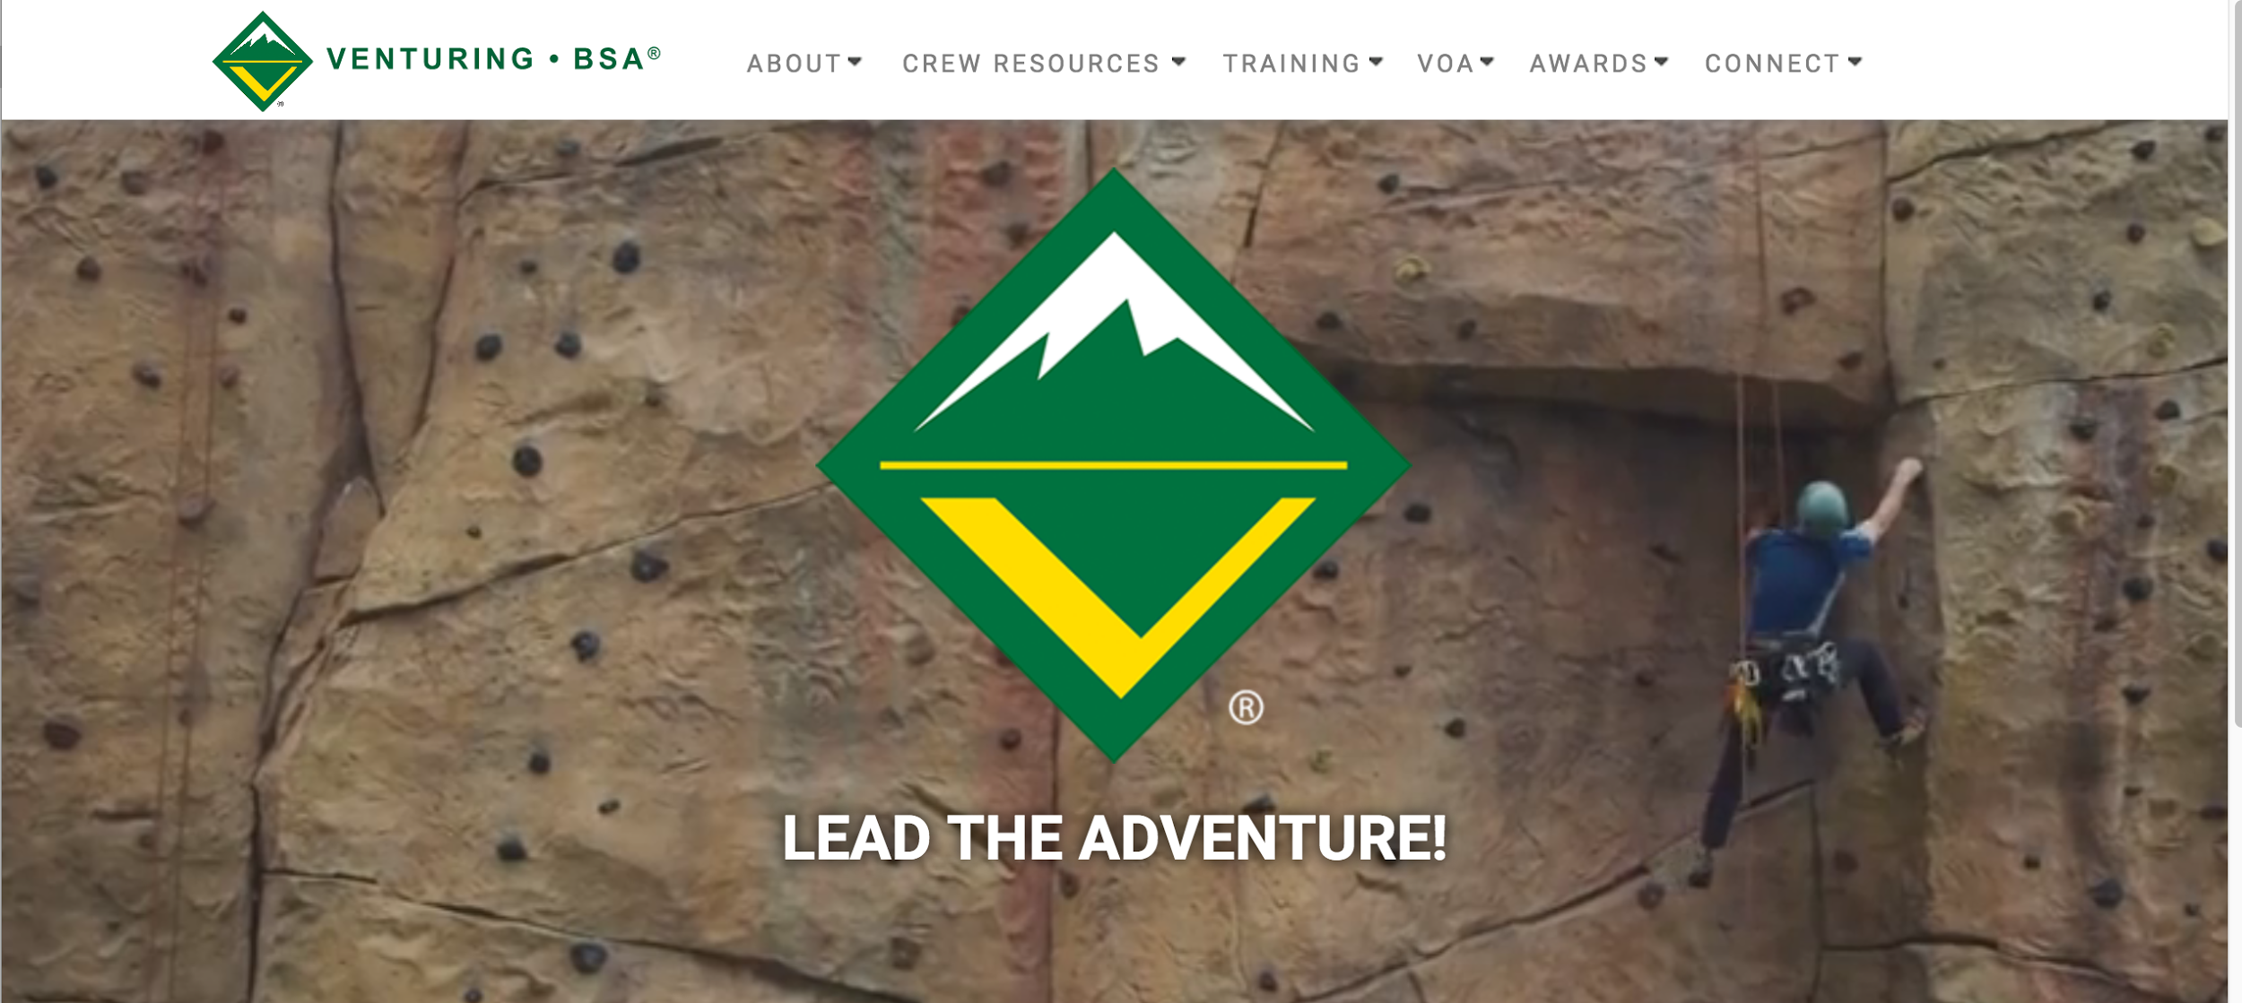
Websites
Venturing.org
  CRVenturing.org
  NERVenturing-bsa.org
  SRVenturing-bsa.org
  WRVenturing.org
Or create one of your own (with your SE’s permission)
  Google Sites, Wordpress
CREATED BY CR VENTURING, 2016

Slide 4
Council Websites
Who is the audience?
Committee & VOA members
Potential Venturers (current Scouts and not)
Advisors and other volunteers
Venturers in units
Venturers & volunteers in other councils
Everyone
CREATED BY CR VENTURING, 2016

Slide 5
Council Websites
What is the content?
About: what is Venturing / BeAScout.org
Contact: VOA / Venturing Committee
Events: calendar / links to events
Training: what is available / what is scheduled
News: newsletters / photos or stories
VOA info: committee minutes and agendas, plans, goals, etc.
CREATED BY CR VENTURING, 2016

Slide 6
Communications Strategy
… is the critical element to all aspects of your Venturing Program
When you plan fun events, service events and training events always have a communication plan
Use backdating on all your events
Write as part of the overall plan the communication messages and consider the vehicle
Created by VP Communications and Associate Advisor of Communications
  Someone else on an interim basis
Do market Venturing hard because no one else will do it
CREATED BY CR VENTURING, 2016

Slide 7
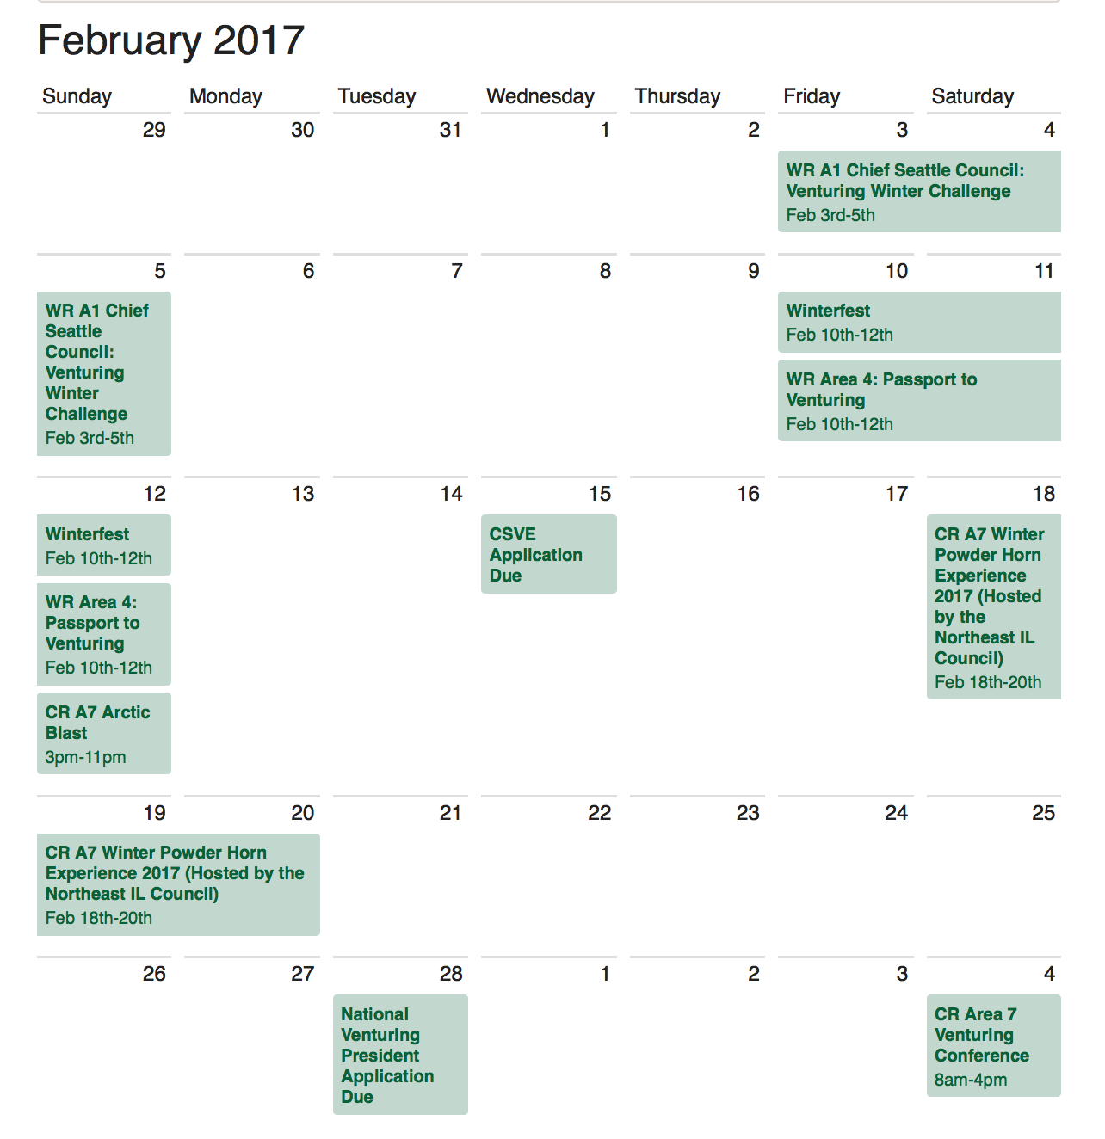
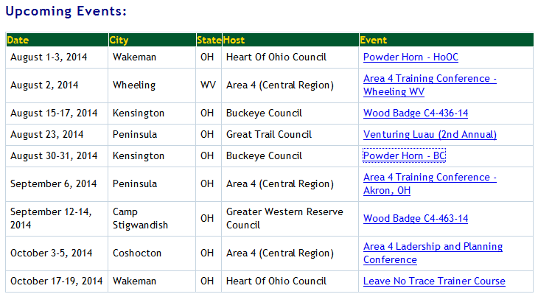
Example Calendar
CREATED BY CR VENTURING, 2016

Slide 8
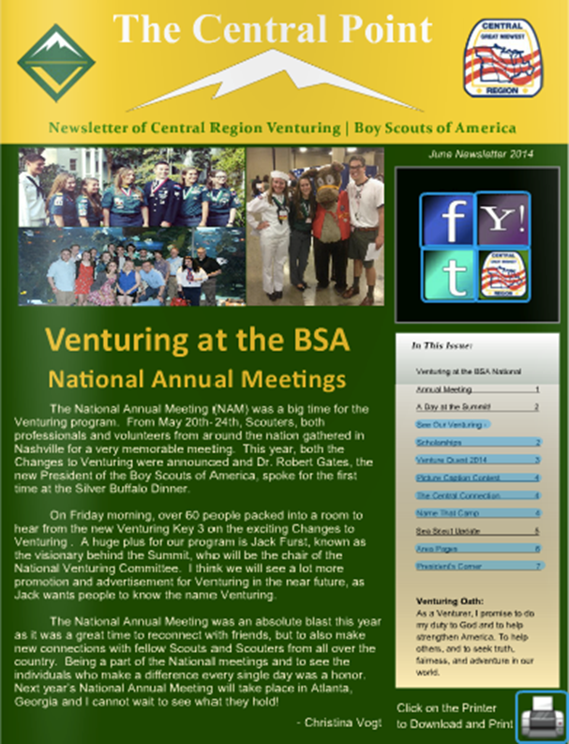
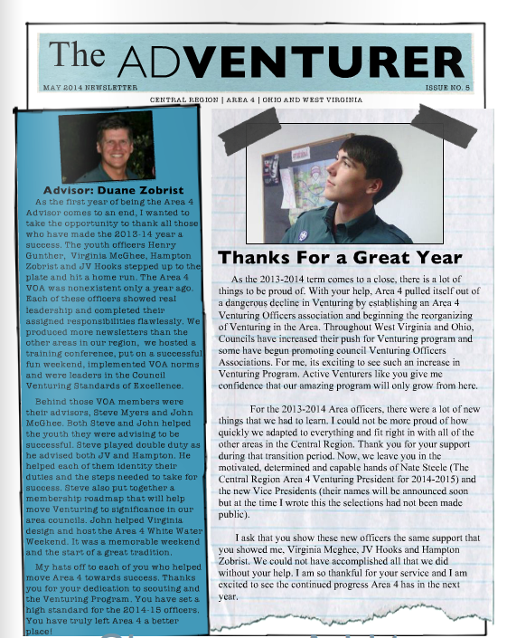
Example Newsletter
CREATED BY CR VENTURING, 2016

Slide 9

Email
Venturing Yahoo Group
  Example: http://venturinglist.com
  Thousands of members
Develop email lists within your council
Venturing committee / VOA
Crew Presidents and Advisors
All registered members
CREATED BY CR VENTURING, 2016

Slide 10

Facebook
Add friends to Group
Post often- make them relevant
  Share “Venturing, BSA” posts
Reply (comment) to questions
Live stream events
Links/Photos/Videos/Questions
Highlight your crews
Admin:
Be mindful of members’ personal safety
  Remove inappropriate posting
  Ban members
  Approve requests
CREATED BY CR VENTURING, 2016

Slide 11

Twitter
What is the purpose?
How is it used?
What should the youth officers do?
  Post to twitter your events and highlights
  Subscribe to BSA Twitter feeds and invite others to do so (@VenturingBSA)
  Retweet top stories from BSA appropriate sites
CREATED BY CR VENTURING, 2016

Slide 12

YouTube
Create a channel and post as part of your campaign
  Examples: The Central Connection, CR Area 3
  Extensive videos and webinars
  Like and Subscribe!
CREATED BY CR VENTURING, 2016

Slide 13

Texting and Calling
Groupme.com
Remind 101
Skype
Google Hangouts
Free Conference Call
CREATED BY CR VENTURING, 2016

Slide 14
Business Cards
Why have business cards?
  Market yourself and market Venturing
  Your youth are ambassadors for Venturing
  Drive interest to your website
  Peer-to-peer recruiting
  Professional appearance
Create your own at home
Order online
CREATED BY CR VENTURING, 2016

Slide 15
Set Communications Goals
No one “right” way to market
Communications, however you do it, is critical to achieving your mission
Build your Facebook group, add everyone you know interested in Venturing
Create a yahoo group for your council and add from your charters, advertise for interested people to join
Start a blog
Just do it!
CREATED BY CR VENTURING, 2016

Slide 16
Further Information
Recruiting: http://venturing.org/recruiting.html
Marketing: www.venturing.org/marketing-toolbox.html
Photos: https://scouting.webdamdb.com/bp/#/folder/600592
CREATED BY CR VENTURING, 2016

Slide 17
Questions?
Presenter’s Name(s)
Contact Information

