Slide 1
Tips for Scouting Leaders

Slide 2
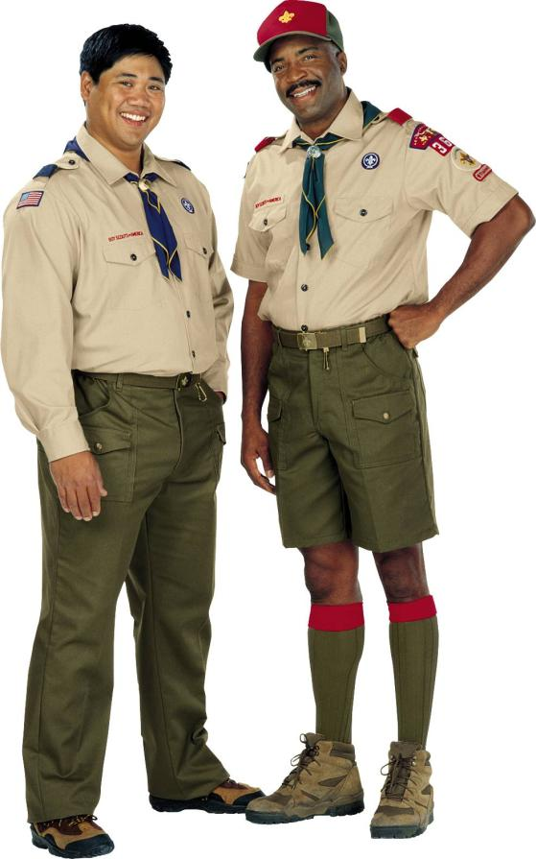
Providing Support to Youth Who Are Bullied
Notes:
Scouts and all youth who are bullied need clear messages of support from adults. Although we want youth to be strong and assertive so that they can stand up to others who bully, adults must realize that many children aren’t ready to do this.
Scout leaders can play a critical role in helping youth who are bullied, and creating a healthy, safe climate in their community.

Slide 3
Be sure to follow the BSA’s Youth Protection Policy
Notes:
Bullying can be traumatic, just as other forms of abuse can be. Follow the BSA’s Youth Protection Policy. Err on the side of offering more services, rather than fewer.
Bullying is no longer viewed as a rite of passage that all kids just have to put up with. It is a form of abuse that can cause psychological, physical, and academic problems for children who are bullied.
All persons involved in Scouting shall report to local authorities any good-faith suspicion or belief that any child is or has been physically or sexually abused, physically or emotionally neglected, exposed to any form of violence or threat, exposed to any form of sexual exploitation, including the possession, manufacture, or distribution of child pornography, online solicitation, enticement, or showing of obscene material. You may not abdicate this reporting responsibility to any other person.
Ensure the child is in a safe environment.
In cases of child abuse or medical emergencies, call 911 immediately. In addition, if the suspected abuse is in the Scout's home or family, you are required to contact the local child abuse hotline.
Notify the Scout executive or his/her designee.

Slide 4
What is Bullying?
Notes:
Bullying is aggressive behavior that is intentional and that involves an imbalance of power or strength. Typically, it is repeated over time. A child who is being bullied has a hard time defending himself or herself.
Bullying can take many forms such as: hitting or punching (physical bullying); teasing or name calling (verbal bullying); intimidation through gestures or social exclusion (nonverbal bullying or emotional bullying); and sending insulting messages by e-mail or social networks (cyber bullying).

Slide 5
Prevalence
Notes:
Studies show that between 15-25% of U.S. students are bullied with some frequency (“sometimes or more often”) while 15-20% report that they bully others with some frequency.
Recent statistics show that while school violence has declined 4% during the past several years, the incidence of behaviors such as bullying, has increased 5%.
Bullying has been identified as a major concern by schools across the U.S.
In surveys of 3rd-8th graders in 14 Massachusetts schools, nearly half who had been frequently bullied reported that the bullying had lasted six months or longer
Research indicates that children with disabilities or special needs may be at a higher risk of being bullied than other children

Slide 6
Consequences
Notes:
Stresses of being bullied can interfere with student's engagement and learning in school
Children and youth who are bullied are more likely than other children to be depressed, lonely, anxious, have low self-esteem, feel unwell, and think about suicide
Students who are bullied may fear going to school, using the bathroom, and riding on the school bus
In a survey of 3rd-8th graders in 14 Massachusetts schools, more than 14% reported that they were often afraid of being bullied
Research shows that bullying can be a sign of other serious antisocial and/or violent behavior. Children and youth who frequently bully their peers are more likely than others to get into frequent fights, be injured in a fight, vandalize or steal property, drink alcohol, smoke, be truant from school, drop out of school, and carry a weapon
Bullying also has an impact on other students at school who are bystanders to bullying. Bullying creates a climate of fear and disrespect in schools and has a negative impact on student learning

Slide 7
Adult Response
Notes:
Adults are often unaware of bullying problems
In one study, 70% of teachers believed that teachers intervene “almost always” in bullying situations; only 25% of students
agreed with this assessment
25% of teachers see nothing wrong with bullying or putdowns and consequently intervene in only 4% of bullying incidents
Students often feel that adult intervention is infrequent and unhelpful and they often fear that telling adults will only bring more harassment from bullies
In a survey of students in 14 elementary and middle schools in Massachusetts, more than 30% believed that adults did little or nothing to help in bullying incidents

Slide 8
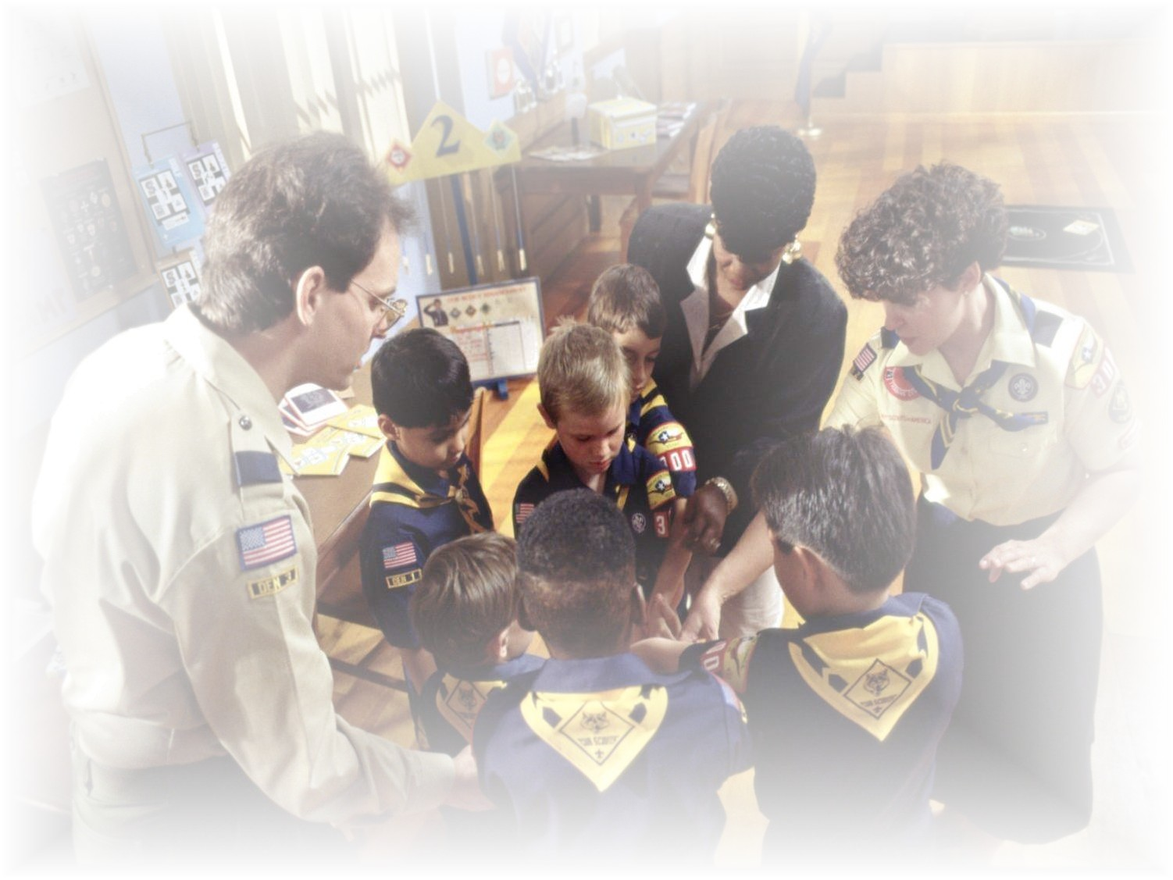
How can you help?
Notes:
How can you help a Scout or other child who is bullied?

Slide 9
Don’t do further damage
Notes:
Don’t do further damage by lending too much support in public. Youth are concerned about what their peer group sees and knows. It may be more helpful to lend your supportive words and gestures in another way.

Slide 10
Spend time with the Scout
Notes:
Spend time with the Scout. Learn about what’s been going on. Listen. Get the facts (who, what, when, where, how) and assess the Scout’s feelings about the bullying. Is this the first time they’ve been hurt by bullying, or is this something that’s been going on for a while? Recognize that this discussion may be difficult for the Scout. Tell him or her that you are sorry about what happened. Assure the Scout that it’s not his or her fault.

Slide 11
Praise the Scout
Notes:
Praise the Scout for their courage to discuss bullying incidents with you. Explain how helpful they are being by providing this important information, not only for themselves, but also for other youth too.

Slide 12
Help the Scout Feel Safe
Notes:
Ask the Scout what he needs to feel safe. Those who are bullied may feel powerless, scared, and helpless. Give this Scout a voice. Follow through to grant their requests, when possible.
Emphasize the confidential nature of your discussion, and be clear about who will and will not be given this information. Get additional facts about the incident(s) from other adults or Scouts, so the bullied Scout doesn’t feel they will be easily identified as the sole reporter of the abuse. Protect the Scout in conversations with the bully. Don’t reveal their identity, if possible. Rather, explain that you’ve learned about the bullying from a number of sources, including other adults.

Slide 13
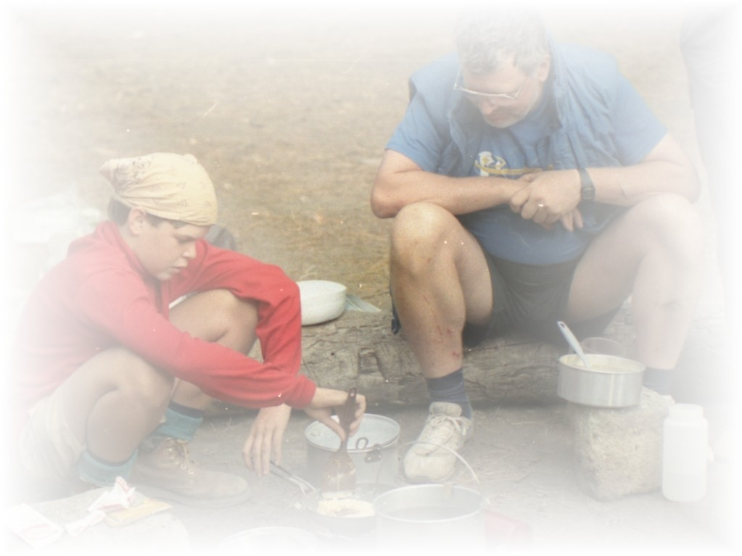
Communicate
Communicate
Notes:
Communicate with other leaders about the bullying incident. Other adults who have contact with the Scout who was bullied can also lend support and assistance. Ask them to continue their observations to be sure that the bullying has stopped. Also encourage them to communicate progress or further incidents to all the appropriate adult leaders.

Slide 14
Communicate
Don’t force a meeting
Notes:
Don’t force a meeting between the Scout who is bullied and the bully. Such meetings can cause much further harm. Forced apologies don’t help.

Slide 15
Communicate
Provide Information
Notes:
Provide as much information as you can about what your "next steps" are. Information is helpful for the Scout who is bullied to regain a sense of safety and control. Urge the Scout to report any further incidents of bullying, involving the same or different youth.

Slide 16
Encourage and support the Scout
Encourage and Support
Notes:
Encourage and support the Scout who is bullied in making friends. One of the most important bullying prevention tools is helping each Scout to have a good friend to be with and talk to.

Slide 17
Encourage and support the Scout
Parents
Notes:
Explore how the Scout’s parents may be of support to the Scout. Many youth keep incidents of bullying to themselves and don’t tell their parents. Explain that if their parents know, more support may be available. Talk with parents, if appropriate, about your concerns.

Slide 18
Encourage and support the Scout
Follow Up
Notes:
Make sure you follow up with a Scout who has been bullied. Let the Scout know that you are a resource and that you plan to "check in" with them in 2-3 days, and beyond.

Slide 19
Remember
To help other people at all times…
And
A Scout is Helpful, Friendly, Courteous, and Kind
Notes:
Remember, part of the oath we take as Scouts is “To help other people at all times…”
And we pledge, among other things, that “A Scout is Helpful, Friendly, Courteous, and Kind”

