Slide 1
Traveling Overseas with Scouts
Tips, Advice, and Resources for Leaders

Slide 2
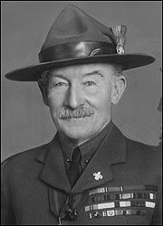
AGENDA
Introduction
Why Do IT?
Planning & Logistics
Safety & Security
Health & Medical
Top Ten

Slide 3
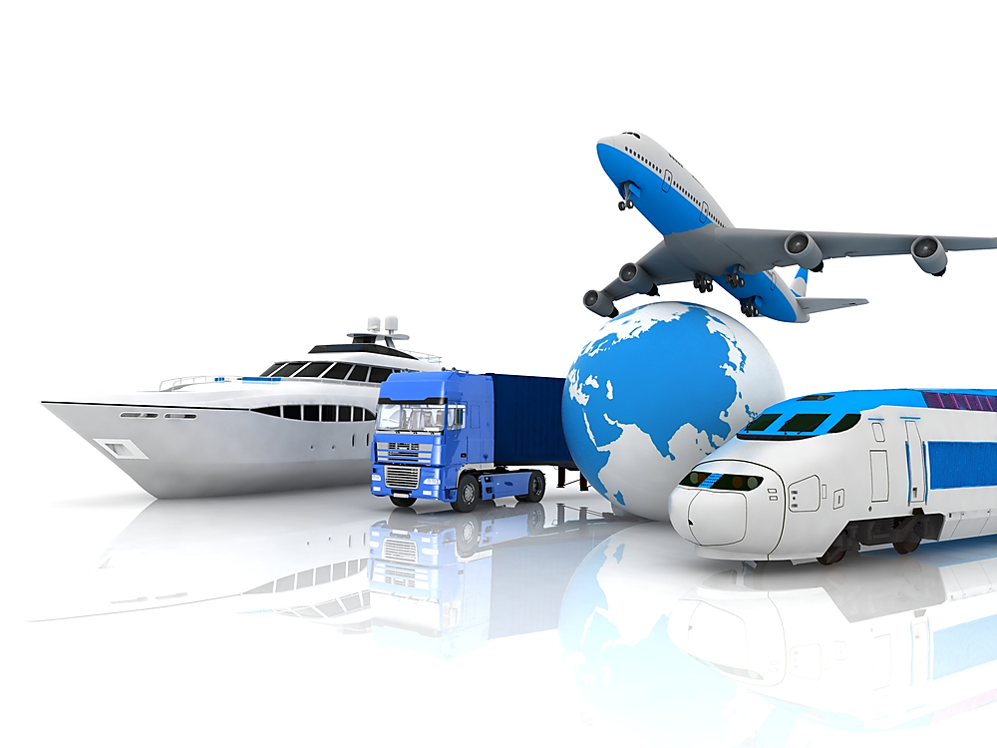
Why travel overseas ?? Why Do it? What do scouts get from it?
Overseas Travel

Slide 4
Why Do IT?
International Experience … First Timers!
Multi-Cultural, Multi-Ethnic, Multi-Language Experience
Live the Dream of Baden-Powell
A world brotherhood of Scouts
Because … IT IS FUN !!!

Slide 5
Planning & logistics
Overseas Travel

Slide 6
Step 1: Research
Research & Educate
Internet travel sites
Travel Books: Frommers, Lonely Planet, Fodor's
Word of Mouth
Book stores: Barnes & Noble
Understand the culture, rules, regulations, norms
Tours: www.viator.com
Planning & Logistics
Notes:
Listen to the youth.

Slide 7
Step 2: Recon
Do a RECON TRIP
Plan a trip to the intended destination
Select group of adults
Itinerary should reflect Scout’s itinerary
Take notes, ask questions, take tours
Post trip analysis: Lessons Learned
Planning & Logistics

Slide 8
Step 3: Plan Your Trip
Don’t Do It By Yourself - GET HELP!
Planning, Logistics, Health & Safety, Security/Insurance, Banker
Planning: Answer these questions
When are we going?
Where are we going
What are we going to do?
How will we get there?
How will we pay for the trip?
How many can we take?
Who is going… Who is QUALIFED to go?
How we will TRAIN for this trip?
Planning & Logistics

Slide 9
Step 4: Safety & Security
Ask yourself, are there:
Incidents of international or indigenous terrorism
Occasional strikes, protests, and public demonstrations, drug wars, human trafficking
Political discourse
Remain vigilant … head on a swivel
Do not travel alone … BUDDY SYSTEM ALWAYS!
Know where the closest US Embassy is located
Safety & Security

Slide 10
Step 4: Safety & Security
Travel warnings & alerts
Sent via email and text
Register your travel itinerary
Local embassy knows where you are
Enroll - http://step.state.gov/step
Safety & Security

Slide 11
Step 5: What to Pack / What to Bring
Select the appropriate clothing, gear, equipment
EagleCreek.com
www.eaglecreek.com/travel-tips-packing-lists
Packing checklists for travel
Pre-departure & home checklist
Travel Health
Travel Gear
Travel accessories
Toiletries
Planning & Logistics

Slide 12
Patrol exercise
You have minutes to Plan a Trip

Slide 13
Patrol Exercise: Destinations
Kandersteg Intl Scout Centre, Switzerland
Muxbal Scout Camp, Guatemala City
London, England
Cairo Intl Scout Centre, Egypt
Castle Saunderson Scout Camp, Ireland
Leaves & Lizards Arenal Volcano Lodge, Costa Rica
7-Day Hawaiian Island Hopping Cruise
Chateau Jambville Scout Centre, outside Paris

Slide 14
Top ten keys to success
Overseas Travel

Slide 15
1. Make a plan
“There are no planned failures, just failures to plan.

Slide 16
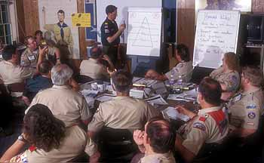
2. Build a team
“Use a Team of Volunteers”

Slide 17
3. Research and educate
“Build a Knowledge Bank”

Slide 18
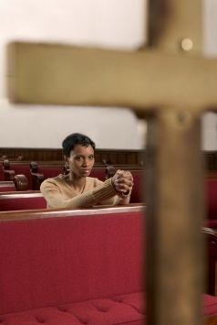
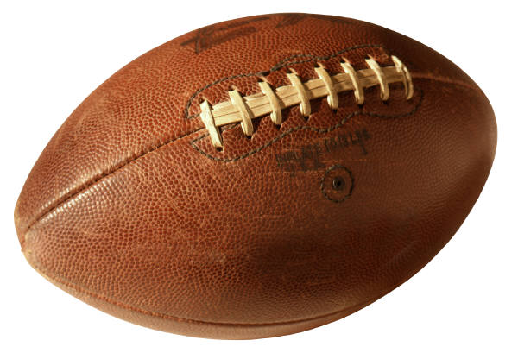
4. Know your customers!
“Understand your parents, Scouts; their needs, habits”

Slide 19
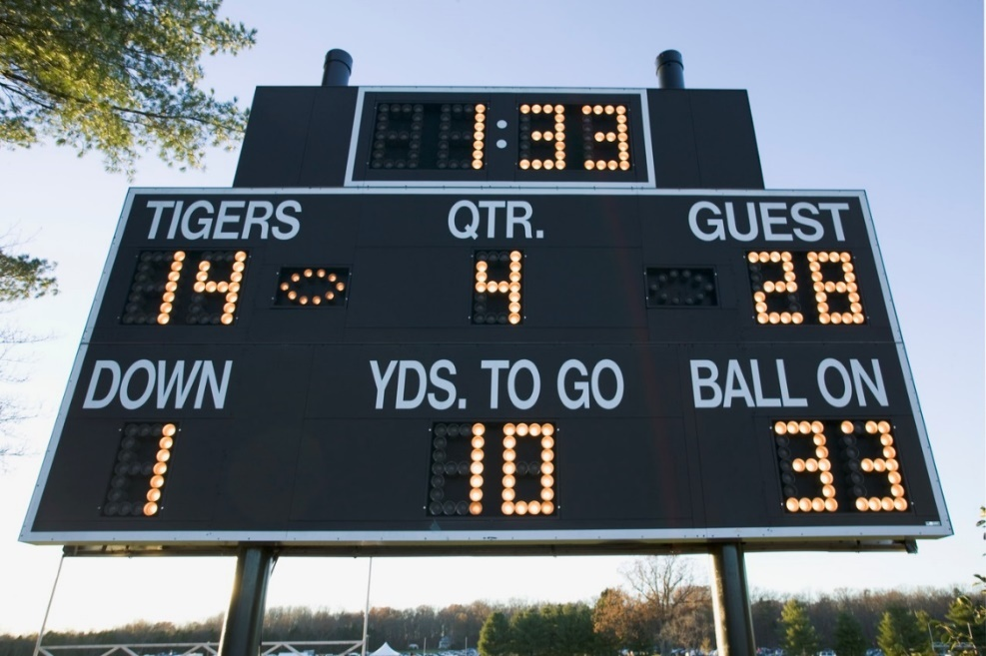
5. Track your progress
1. Measure 2. Benchmark
3. Improve
4. Repeat

Slide 20
6. Communicate
“Communicate, Communicate, Communicate”

Slide 21
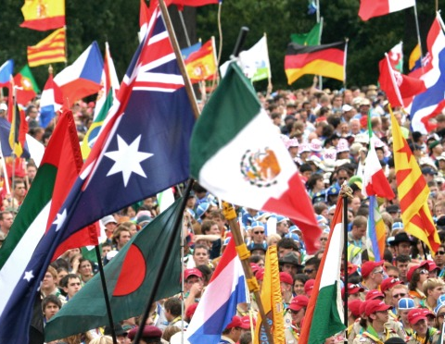
7. Promote & Advertise
“Build the Bandwagon!”
Notes:
Build the bandwagon. Public relations campaigns
can be an extraordinarily successful way to drive
membership. People like to be part of a growing,
successful organization. Press releases celebrating growth
milestones and other achievements are a great way to tap
into this desire

Slide 22
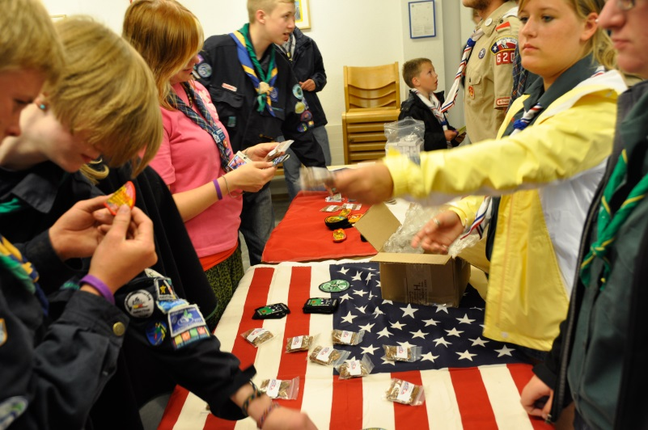
8. Deliver on what you PROMISE
“If YOU build it,
THEY will come”

Slide 23
9. The old ways may not work
“Out of the box thinking”

Slide 24
10. Never stop
“Never stop promoting your trip”

Slide 25
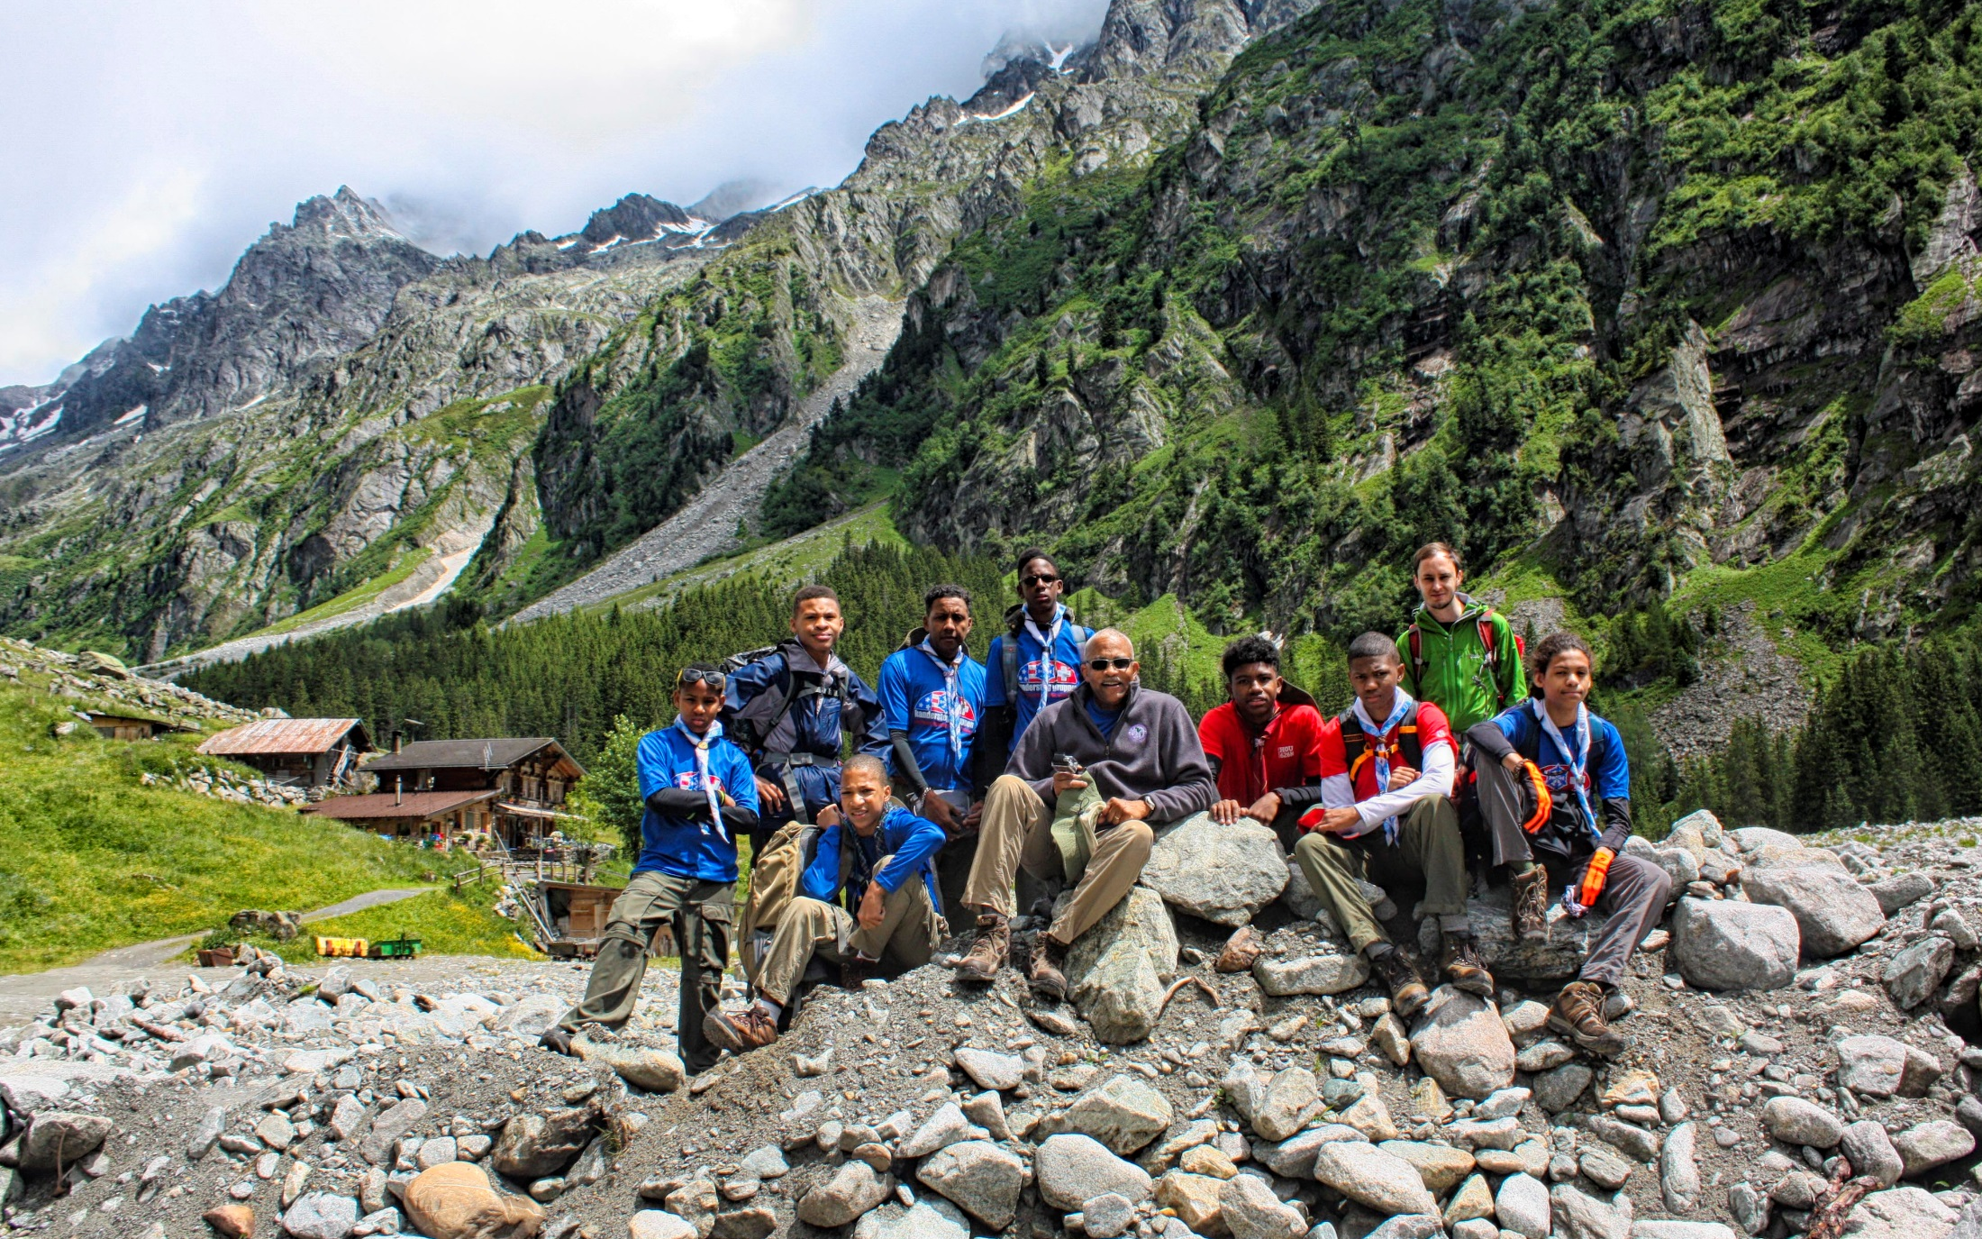
QUESTIONS?

Slide 26
Thank You
Ron Thomas
txsuperscout@gmail.com
713-205-2425

Slide 27
SCOUTS
Creating a Better World

