Slide 1
TODAY’S ADVANCEMENT
National Advancement Program Team
Expiration Date
This presentation is not to be used after January 31, 2025
Notes:
Suggested timing for day-long advancement education presentation (Instructors may adjust based on interests and needs of the group being instructed.)
number of *.ppt pages Recommended presentation Time pages Allotment
Sections 1 & 2 Welcome & Intro. Material 6 15 min.
Section 3 Responsibilities of Committees 6 20 min.
Section 4 Section 4 of GTA 16 1.0 hour
Section 5 Advancement in Camp 3 15 min.
Section 6 Internet Advancement 2 15 min.
Section 7 Merit Badges 27 1.0 hour
Section 8 Boards of Review 9 40 min
Section 8 Appeals 3 15 min.
Section 8 Venturing & Sea Scout Boards 6 20 min.
Section 9 Eagle Application 1 10 min.
Section 9 Eagle Service Project 10 40 min.
Section 9 Eagle Workbook 3 15 min.
Section 9 Eagle Project Coach 2 15 min.
Section 9 Fundraising 4 10 min.
Section 9 Other Eagle Project Issues 5 10 min.
Section 9 Time Extension 3 10 min.
Section 10 Special considerations 5 20 min.
Section 11 & Quote Appendix & finish 2_______ 5 min.
113 7.0 hours
Module outline for day-long advancement education presentation (Instructors may pull out modules to fit needs and time available for groups being instructed)
PowerPoint GTA Title
Slide No. Section No. of Slides
1 Cover Slide
2 1.0.0.0 Introduction
3 1.0.2.0 Introduction
4 Mandated and Recommended Practices
5 2.0.0.0 What is Advancement?
6 2.0.0.0 Advancement Defined
7 3.0.0.1 Council Advancement Committee, slide a
8 3.0.0.1 Council Advancement Committee, slide b
9 3.0.0.2 District Advancement Committee
10 3.0.0.3 Unit Advancement Responsibilities
11 3.0.0.5 Building Advancement Committee
12 3.0.0.6 Advancement Education, slide a
13 3.0.0.6 Advancement Education, slide b
14 4.0.0.0 Mechanics of Advancement
15 4.1.0.0 - 4.1.1.5 Cub Scouts
16 4.2.0.0 Scouts
17 4.2.3.0 Reasonable Expectations
18 4.2.3.1 Active Participation
19 Example of Active Participation
20 4.2.3.2 Demonstrate Scout Spirit
21 4.2.3.3 Service Projects
22 4.2.3.4 Positions of Responsibility, slide a
23 4.2.3.4.3 Positions of Responsibility, slide b
24 4.2.3.4.4 Positions of Responsibility, slide c
25 4.2.3.4.5 Positions of Responsibility, slide d
26 4.2.3.4.5 Positions of Responsibility, slide e
27 4.2.3.6 Single Activity for Multiple Requirements
28 4.3.0.0 Venturing
29 4.4.0.0 Sea Scouts
30 5.0.1.0 Advancement In Camp, slide a
31 5.0.1.0 Advancement In Camp, slide b
32 5.0.1.0 Advancement In Camp, slide c
33 6.0.0.0 Electronic Advancement Reporting
34 6.0.0.1 Benefits of Electronic Advancement
35 7.0.0.0 Merit Badge Program, Intro slide w/ badges
36 7.0.0.0 Merit Badge Policies
37 Merit Badge Sections
38 Merit Badge Sections Specifics
39 Merit Badge Folklore, Intro slide w/ badges
40-41 7.0.1.4 True or False? Counselor limitations
42-43 7.0.1.4 True or False? Number of badges a counselor may counsel
44-45 7.0.1.4 True or False? Number of badges a counselor may counsel with any 1 scout.
46-47 7.0.2.3 True or False? Counselors must be approved by District/Council Adv. Comm
48-49 7.0.1.1 True or False? SMs are not automatically approved as MB counselors
50-51 7.0.3.2 True or False? Group instructions is acceptable but should be “balanced”
52-53 7.0.3.2 True or False? Group Testing is NOT ACCEPTABLE for MBs
54-55 7.0.3.1 True or False? Youth Protection – 3rd person present may be a youth.
56-57 7.0.3.3 True or False? Partials have no time limit except the age of 18.
58-59 7.0.4.7 True or False? Limited Recourse provision for merit badges
60-61 7.0.4.4 True or False? Scouts may not begin work on discontinued merit badges
62 8.0.0.2 Boards of Review
63 8.0.0.3 Composition of BOR
64 8.0.0.4 BOR Uniform
65 8.0.1.0-8.0.1.1 Conducting the BOR
66 8.0.1.4-8.0.1.5 BOR Decisions
67 8.0.1.6 BOR/Videoconferencing
68 8.0.3.0 Eagle Scout BOR
69 8.0.3.1 Eagle Scout BOR After Age 18
70 8.0.3.2 Eagle Scout BOR Under Disputed Circumstances
71 8.0.4.0 Appeals
72 8.0.4.1 Processing An Appeal
73 8.0.4.1 Appeal Board
74 8.0.5.0 Venturing BOR
75 8.0.6.0 Discovery & Pathfinder
76 8.0.7.0 Summit Award
77 4.4.2.0 Sea Scout Bridge of Review
78 4.4.2.4 Apprentice through Able
79 4.4.2.5 Quartermaster
80 9.0.1.1 - 9.0.1.10 Eagle Rank Application
81 9.0.2.0 Eagle Scout Service Project - Requirement 5
82 9.0.2.1 Eagle Candidate Expectations, slide a
83 9.0.2.1 Eagle Candidate Expectations, slide b
84 9.0.2.2 "While a Life Scout"
85 9.0.2.3 "Plan, Develop…"
86 9.0.2.4 "Give Leadership to Others…"
87 9.0.2.5 "Helpful to Any Religious Institution, Any School or Any Community" slide a
88 9.0.2.5 "Helpful to Any Religious Institution, Any School or Any Community" slide b
89 9.0.2.6 "Benefiting an Organization Other Than Scouting"
90 9.0.2.7 "Proposal Must Be Approved…Before You Start"
91 9.0.2.8 Eagle Scout Service Project Workbook, slide a
92 9.0.2.8 Eagle Scout Service Project Workbook, slide b
93 9.0.2.8 How To Use Workbook
94 9.0.2.9 Eagle Scout Service Project Coach, slide a
95 9.0.2.9 Eagle Scout Service Project Coach, slide b
96 9.0.2.10 Fundraising, slide a
97 9.0.2.10 Fundraising, slide b
98 9.0.2.10 Fundraising, slide c
99 9.0.2.10 Fundraising Application
100 9.0.2.11 Routine Labor
101 9.0.2.12 Common Misconceptions
102 9.0.2.13 Eagle Project - Evaluating the Project, slide a
103 9.0.2.13 Eagle Project - Evaluating the Project, slide b
104 9.0.2.13 Eagle Project - Evaluating the Project, slide c
105 9.0.4.0 Time Extension for Earning Eagle, slide a
106 9.0.4.0 Time Extension for Earning Eagle, slide b
107 9.0.4.1 Extension Request
108 10.0.0.0 Special Needs
109 10.1.0.0 Registration Beyond Age of Eligibility
110 10.1.0.2 How To Register Beyond Age of Eligibility, slide a
111 10.1.0.2 How To Register Beyond Age of Eligibility, slide b
112 10.2.0.0 Advancement Flexibility
113 11.0.0.0 Appendix
114 Baden Powell Quote

Slide 2
Introduction 1.0.0.0
Current edition of Guide To Advancement (GTA) is the authoritative and official source for BSA advancement.
Learn more about it at: www.scouting.org/GuideTo Advancement.
The online version is available for download at www.scouting.org/Advancement.
Guide to Safe Scouting applies to all advancement-related activities.
Notes:
Online Version www.scouting.org/scoutsource/GuideToAdvancement.aspx
There are more frequent updates here, also the guide is searchable and provides active links to other documents.
PDF Version www.scouting.org/scoutsource/BoyScouts/AdvancementandAwards/resources.aspx
*

Slide 3
Introduction 1.0.2.0
If you have advancement questions:
First: Consult the Guide to Advancement, Advancement News, or scouting.org.
Second: Contact district/council advancement administrators.
Finally: Contact National Advancement Program Team at advancement.team@scouting.org.
Notes:
*

Slide 4
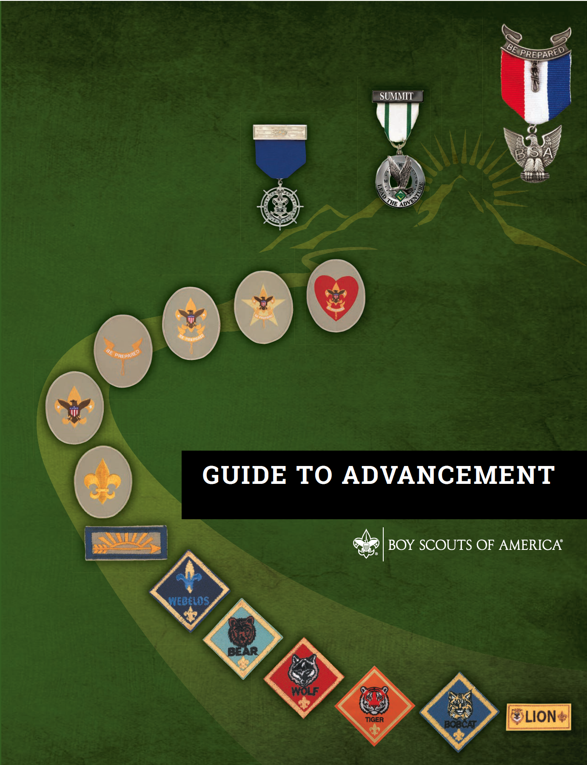
Mandated Procedures and Recommended Practices
“No council, committee, district, unit, or individual has the authority to add to, or subtract from, advancement requirements.”
Must or shall = mandated
Should = recommended
May or can = flexibility
Notes:
Be sure to have the current version of the GTA
No council, committee, district, unit or individual has the authority to add to, or subtract from, advancement requirements.
Some limited exceptions involving youth members with disabilities – 10.0.0.0.
Emphasize the must, should, can, etc.
*

Slide 5
What Is Advancement? 2.0.0.0
“Advancement is the process by which youth members of the Boy Scouts of America progress from rank to rank.”
Notes:
This is a statement of ‘truth’, thus no real discussion is needed here.
*

Slide 6
Advancement Defined 2.0.0.0
A method of Scouting
Experiential learning
Personal growth
Success is achieved when we fulfill the BSA Mission statement.
Notes:
The Scout program and advancement is based on education!
Advancement is only one of eight methods and thus is not an end in itself, but a means to an end.
Experiential learning is based on the doing of activities that are the natural outcome of a units well-rounded program.
The goal is total well - rounded development of the youth who then are able to exhibit responsibility, self-reliance, and caring for themselves and others.
Review the BSA Mission statement, on the inside cover of the GTA, briefly with attendees.
*

Slide 7
Council Advancement Committee 3.0.0.1
Establish objectives, goals, and action plans.
Guide district advancement committees.
Determine council advancement calendar.
Hold advancement activities and training.
Establish outdoor advancement policies.
Oversee the merit badge program.
Notes:
This is a partial list of possible duties. For a complete list see section 3 in the GTA.
Review each of these points very briefly and answer any questions.
*

Slide 8
Council Advancement Committee 3.0.0.1
Promote use of electronic advancement reporting.
Establish local procedures for Eagle, Summit, and Quartermaster service projects.
Handle appeals and time-extension requests.
Determine local procedures for special needs.
Present, process and promote special awards.
Notes:
Review each of these points very briefly and answer any questions.
*

Slide 9
District Advancement Committee 3.0.0.2
The advancement chair reports to district chair.
District committee duties are similar to the council advancement committee.
The committee works to strengthen units by:
Assisting unit commissioners.
Serving as a roundtable resource.
Providing advancement reports.
Visiting and mentoring units.
Visiting boards of review.
Notes:
Review this slide very briefly.
This is a very abbreviated list. Much more depth is available in section 3 of the GTA.
*

Slide 10
Unit Advancement Responsibilities 3.0.0.3
The unit advancement coordinator, with assistance as needed, supports the unit’s advancement program. Duties may include the following:
Supporting the unit leader’s vision for advancement.
Educating parents, guardians, and unit leadership.
Ensuring that Scouts advance in a timely manner.
Arranging for boards of review.
Obtaining and presenting recognition items.
Communicating rank advancement procedures.
Reporting all advancements in a timely manner.
Notes:
Briefly review the points on this slide and then suggest that the unit coordinators might be members of the district advancement committee.
*

Slide 11
Building Advancement Committees 3.0.0.5
To accomplish responsibilities, committees should be well-staffed and organized. Functions to consider:
Volunteerism
Technological reporting support
Advancement training & events
Eagle, Summit & Quartermaster issues
Awards and recognition
Merit badge & STEM support
Camping and outdoor coordination
Notes:
This is a simple list of possible functions to consider. The GTA actually lists 12 possible functions for positions for a council or district committee to consider.
Volunteerism function addresses recruiting committee members who represent a breadth of experience in all Scouting programs.
Technological reporting support provides units with the education and training needed to successfully use the BSA’s internet portal for advancement. Providing Internet Advancement/ScoutBook support to units is another important function aspect of this function.
Advancement training and events ensures active training of advancement administrators and other adult leaders at all levels of Scouting, ranging from district advancement committee members to unit-level advancement coordinators.
Eagle, Summit and Quartermaster issues function is responsible for ensuring that all national and local council procedures are properly followed involving these ranks and awards.
Awards and recognition is responsible for promoting and presenting non-advancement recognitions such as meritorious , training, leadership, conservation, and similar awards.
Merit Badge, STEM & Super Nova support ensures that there are sufficient, approved merit badge counselors, and in some cases super nova mentors, to support local programs.
Camping and outdoor coordination works with the council’s camping and outdoors committee to ensure that the Cub Scouting, Scouting, Venturing, and Sea Scouting outdoor programs are rich in advancement opportunities and that they comply with national camp and advancement standards as found in the Guide to Advancement and National Camp Accreditation Program Guide.
For more information about what these and other functions might entail see the PowerPoint presentation: "Building Effective Advancement Committees" that is posted on the Advancement Resources web page at www.scouting.org/advancement/general resources/advancement education
*

Slide 12
Mechanics of Advancement 4.0.0.0
Cub Scouts BSA
Scouts BSA
Venturing BSA
Sea Scouts BSA
Notes:
Each of these are discussed in successive slides
*

Slide 13
Cub Scouts 4.1.0.0 - 4.1.1.4
Advancement is the focus of the den meeting program.
The standard is “Do Your Best.”
Lion is the first rank for kindergarten aged Scouts.
Bobcat rank is earned first for all the remaining ranks.
No ranks are earned retroactively.
Notes:
Cub Scouts use the Scout Oath. Their advancement work is based on a series of Adventures that are intended to promote learning by doing and FUN.
Point out that this is not a training on the Cub Scout Program, so if further information is required those interested should consult the “Cub Scout Leader Book”, the respective rank handbook, the May-June edition of Scouting Magazine, or the national website page at https://www.scouting.org/programs/cub-scouts/
*

Slide 14
Scouts 4.2.0.0
Reasonable Expectations
Active Participation
Scout Spirit
Service Projects
Positions of Responsibility
Notes:
Each of these points is discussed in the next series of slides.
*

Slide 15
Reasonable Expectations 4.2.3.0
“Reasonable” and “within reason” help the unit gauge the fairness of expectations in relation to:
A Scout’s level of activity.
Whether a Scout has fulfilled their position of responsibility.
Notes:
Reasonable suggests that the unit has some general ‘rules’ by which Scouts are to operate. If a Scout is able to achieve these then all is well. If not, there must be some accommodation for the youth to which the leader and the Scout have agreed. Such issues might relate to other activities that the Scout is involved in that may occasionally interfere with scout activities.
*

Slide 16
Active Participation 4.2.3.1
“Active” should be measured by IMPACT.
Three tests should be applied:
Scout is registered.
Scout is in good standing with the unit.
Scout meets unit’s reasonable expectations; or, if not, a lesser level of activity is explained.
Notes:
Registered means with the BSA
In good standing means he or she hasn’t been dismissed
This point is discussed in detail in the GTA
*

Slide 17
Example
Jill Scout is:
A Star Scout
An assistant senior patrol leader in troop
A sophomore in high school
An Order of the Arrow lodge officer
A high school tennis team starter
A youth group leader in her church
At her board of review for Life, Jill indicates she has not been able to attend all troop outings. Should the board consider her “active”?
Notes:
The answer is ‘of course”! Because the Scout is an active participant in many community activities and clearly is achieving the Mission/Vision of the BSA.
*

Slide 18
Demonstrate Scout Spirit 4.2.3.2
The Scouting ideals are found in the Scout Oath, Law, slogan, and motto.
Members who live these ideals daily have Scout spirit.
Scout spirit is measured by how a Scout lives…
NOT by the number of meetings or outings attended.
Notes:
*
This might generate some minor discussion, but don’t be distracted by any disagreement.

Slide 19
Service Projects 4.2.3.3
They should be a regular part of the program in every unit!
They must be executed and approved as written in the requirements.
Time spent on an Eagle project qualifies.
All national safety standards apply.
Notes:
Service projects will be discussed in more detail later, so don’t get bogged down here.
*

Slide 20
Positions of Responsibility 4.2.3.4
Service is required for a period of months.
Positions must be chosen from the list specific to the appropriate rank.
Substitute: A unit leader-assigned leadership project is allowed for Star and Life ranks.
Multiple positions used for total time requirement is acceptable.
Service needs not to be consecutive.
Unit expectations should be met
Notes:
If a youth has been properly mentored about their position role, through their unit, through ILST or other appropriate orientation, and their time is successfully served, the objective has been reached.
However, if there are issues related to their performance and it becomes clear that they not been properly oriented or mentored, it is unacceptable to allow the Scout to do the time and then not approve their service.
This concept is further developed in the next few slides.
Multiple okay, but not counted concurrently. IE, if you are both PL and ASPL from Jan 01 to March 31, that counts as 3 months of POR, not 6.
*

Slide 21
Positions of Responsibility 4.2.3.4.3
“When a Scout assumes a position of responsibility, something related to the desired results must happen.”
Where there are unit expectations…
the Scout satisfies the requirement if – within reason, and based on their skill set – they meet those expectations.
Notes:
Here are two important concepts related to positions of responsibility.
*

Slide 22
Positions of Responsibility 4.2.3.4.4
Where there are no unit expectations…
the Scout satisfies requirement if:
The unit leader and the Scout work out the responsibilities the Scout is to fulfill.
Must maintain position’s purpose/difficulty.
OR if the Scout determines what should be done:
Must make reasonable effort.
Must not be held to unestablished expectations.
Notes:
*

Slide 23
Positions of Responsibility 4.2.3.4.5
If responsibilities are not met:
Communicate early to the Scout.
Seek constructive results.
Encourage Scout to succeed.
Address situation(s) promptly.
Remove the Scout if performance does not improve.
Time already served must be counted.
Notes:
*

Slide 24
Positions of Responsibility 4.2.3.4.5
If Scout disagrees:
Consider: Are the expectations unreasonable or not clearly conveyed to the youth?
Discuss with leaders, and parents.
Scouts must be granted a board of review if they believe they have satisfied the requirements.
Notes:
*

Slide 25
Single Activity for Multiple Requirements 4.2.3.6
Single activity fulfilling more than one requirement:
Two requirements match exactly, and the same basic intent exists.
For safety-related requirements, the Scout must remember previous information learned.
Beware of requirements that appear to align, but in fact differ in required outcome.
Remember the purpose of the advancement experience.
Notes:
Occasionally, it may be appropriate for a Scout to apply what was done to meet one requirement toward
the completion of another. This is rare. In deciding whether to allow this consider the items above.

Slide 26
Venturing 4.3.0.0
Areas of Emphasis
Adventure, Leadership, Personal Growth, Service
Awards
Advancement track: Venturing, Discovery, Pathfinder, and Summit Awards
Other awards: Ranger, Quest, and TRUST
Summit Award service project
Time extensions for Summit Award
Notes:
Information about boards of review will be covered later in the presentation.
Must use the Venturing Summit Award Service Project Workbook.
The project must be different from one that is used to fulfill requirements for the Eagle Scout rank, the
Sea Scout Quartermaster rank, or the Girl Scout Gold Award.
Time extensions are available, but rarely granted.
*

Slide 27
Sea Scouts 4.4.0.0
Ranks
Apprentice, Ordinary, Able, Quartermaster
Quartermaster service project
Time extensions for Quartermaster
Notes:
Information about bridges of review will be covered later in the presentation.
Must use the Quartermaster Leadership Service Project Workbook, No. 420-011.
A youth’s Quartermaster, Eagle, or Summit Award service project must not be the same project;
Time extensions are available, but rarely granted.

Slide 28
Advancement in Camps 5.0.1.0
Council advancement committee:
Establishes camp advancement protocol.
Collaborates with camp/camping committee.
Schedules compliance visitations.
Approves MB counselors.
Trains camp staff and MB counselors.
Establishes counselor qualification.
Notes:
Procedures for advancement in camp are established by the council advancement committee in compliance with
national procedures, and under the direction of the council executive board. The camp director and program
director, and the committee responsible for camp program, should be included in the process.
*

Slide 29
Advancement in Camps 5.0.1.0
Council advancement committee:
Assists with development of lesson plans and protocol.
Establishes a process for approving pre-camp work and partials.
Develops procedures for approving Scout, Tenderfoot, Second Class and First Class programs.
Establishes record-keeping practices that facilitate accurate reporting to unit leadership.
Notes:
Review each item above very briefly.
*

Slide 30
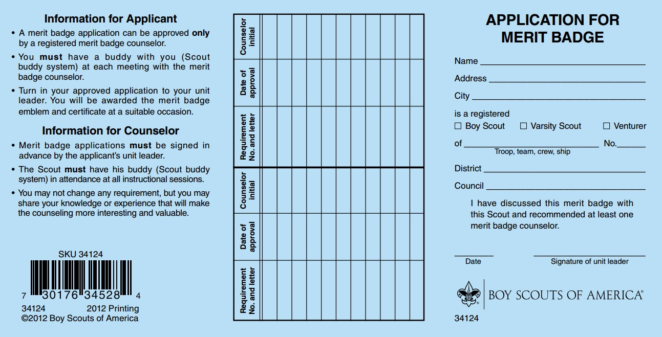
Advancement in Camps 5.0.1.0
Group instruction is acceptable.
There are no exceptions for camps to the national advancement policies.
“Blue cards” are the nationally
recognized merit badge record,
but alternative documentation may be accepted. (7.0.0.2)
Notes:
Group instruction is almost always necessary in a camp setting, however EACH Scout MUST complete EACH requirement as written in the BSA documents.
Camps MAY NOT alter requirements to fit time tables or create short cuts because of large class sizes.
Reporting is always an issue at camps. The official BSA reporting device for Merit Badges is the ‘blue card’, but alternative forms of documentation may be accepted.
*

Slide 31
Electronic Advancement Reporting 6.0.0.0
Reporting of advancement is required.
Scoutbook electronic advancement reporting makes it simple.
Goal is 100% unit participation.
Notes:
*

Slide 32
Benefits of Electronic Advancement Reporting 6.0.0.1
Intuitive interface for volunteers.
Helps local councils certify Eagle applications.
Records advancements in accordance with BSA rules.
Supports national data analysis.
Supports Journey to Excellence.
Involves youth and adult leaders directly in the process
Notes:
*

Slide 33
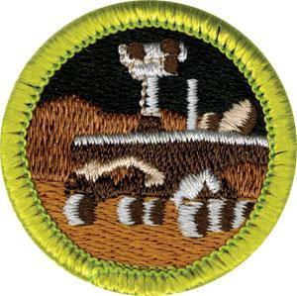
Merit Badge Program 7.0.0.0
Notes:
*

Slide 34
Merit Badge Policies
A Scout may work on any merit badge at any time.
The unit leader discusses the merit badge with the Scout.
A Scout may begin work on a merit badge before contacting a counselor.
Merit badge counselors must be registered and approved by the council.
The official merit badge application is the “blue card.”
Notes:
These points just need to be reviewed quickly and move on.
*

Slide 35
Merit Badge Sections
Topics
GTA Reference
About Merit Badge Counselors
Merit Badge Counselor Lists
Process of Counseling
Merit Badge Miscellany
7.0.1.0
7.0.2.0
7.0.3.0
7.0.4.0
Notes:
*

Slide 36
Merit Badge Section Specifics
• Training for Counselors – 7.0.1.6.
• Responsibility for maintaining lists – 7.0.2.1
• Group Instruction – 7.0.3.2
• New or Revising Merit Badges – 7.0.4.1 & 7.0.4.2
Send comments/suggestions to: merit.badge@scouting.org
Charging Fees – 7.0.4.10.
Notes:
*

Slide 37
Merit Badge Folklore
Notes:
*
This slide is an introduction to the next series of slides that deal with several miscellaneous Merit Badge myths and persistent sources of miss-understanding.

Slide 38
True or False?
The BSA does not place any limits on which Scouts an approved merit badge counselor may counsel.
Notes:
*

Slide 39
True or False?
The BSA does not place any limits on which Scouts an approved merit badge counselor may counsel.
True. An approved merit badge counselor may counsel any Scout, including their own son, daughter, ward, or relative. (7.0.1.4)
Notes:
*
If a Scout is earning too many Merit Badges from one counselor, the unit leader may place a limit on how many can be earned from one counselor as long as the same limit is applied to all Scouts.

Slide 40
True or False?
A merit badge counselor may counsel up to six merit badges.
Notes:
*

Slide 41
True or False?
A merit badge counselor may counsel up to six merit badges.
False. The National Council places no limit on the number of merit badges. However, the counselor MUST be approved in each subject. (7.0.1.4)
Notes:
*
The council can set a local procedure about how many MB a counselor may counsel, but that must be consistently enforced.

Slide 42
True or False?
Counselors may counsel no more than five merit badges with the same Scout.
Notes:
*

Slide 43
True or False?
Counselors may counsel no more than five merit badges with the same Scout.
False. The National Council places no limit on the number of badges that a counselor may counsel with one Scout. (7.0.1.4)
Notes:
*
The council can establish procedures that define a specific number as to how many MB’s a Scout can take from the same counselor, but the process must be consistently applied.
Same for units.

Slide 44
True or False?
A counselor who only works with a single unit does not need district/council advancement committee approval.
Notes:
*

Slide 45
True or False?
A counselor who only works with a single unit does not need district/council advancement committee approval.
False. Though a merit badge counselor may limit their service to a single unit, they must still be registered and approved by the district/council (7.0.2.3).
Notes:
*

Slide 46
True or False?
Scoutmasters are automatically approved to serve as merit badge counselors.
Notes:
*

Slide 47
True or False?
Scoutmasters are automatically approved to serve as merit badge counselors.
False. Scoutmasters must be approved to serve as merit badge counselors just like everyone else. (7.0.1.1)
Notes:
*

Slide 48
True or False?
Other than summer camp, group instruction for merit badges is not allowed.
Notes:
*

Slide 49
True or False?
Other than summer camp, group instruction for merit badges is not allowed.
False. Group instruction is acceptable, but should be balanced to afford the Scout more individual adult interaction. (7.0.3.2)
See the Merit Badge Group Instruction Guide
http://www.scouting.org/filestore/pdf/512-066_WEB.pdf
Notes:
*

Slide 50
True or False?
When merit badge counseling is done with a large group, it is acceptable to do group testing.
Notes:
*

Slide 51
True or False?
When merit badge counseling is done with a large group, it is acceptable to do group testing.
False. All Scouts are actually and personally tested individually. Group testing is NOT acceptable. (7.0.3.2)
Notes:
*

Slide 52
True or False?
Youth Protection and two-deep leadership policies require a merit badge counselor to always have another adult present during counseling sessions.
Notes:
*

Slide 53
True or False?
Youth Protection and two-deep leadership policies require a merit badge counselor to always have another adult present during counseling sessions.
True. Two registered adult leaders 21 years of age or over are required at all Scouting activities, including meetings and merit badge counseling sessions. A registered female adult leader over 21 must be present for any activity involving female youth. (7.0.3.1)
Notes:
*
The current policies regarding youth protection are found in the Guide to Safe Scouting (https://www.scouting.org/health-and-safety/gss/gss01/). Merit badge counseling has been revised to allow the second adult to be the parent of the Scout, even if they are not a registered adult leader.
See the FAQ’s at https://www.scouting.org/health-and-safety/yp-faqs/#as.
Q: The Barriers to Abuse say that there must be two registered adults present for all Scouting activities and meetings. Does that include merit badge counseling? Fund-raising events?
A. Yes. However, the parent or legal guardian of the Scout may serve as the second adult. This parent or legal guardian does not have to be a registered leader.

Slide 54
True or False?
A merit badge “partial” expires six months after the badge work was begun.
Notes:
*

Slide 55
True or False?
A merit badge “partial” expires six months after the badge work was begun.
False. Partials have no expiration except the Scout’s 18th birthday. (7.0.3.3)
Notes:
*

Slide 56
True or False?
If, from time to time, it becomes plainly evident that a youth could not have actually and personally fulfilled requirements for a merit badge as written, even though signed by a counselor, there is no recourse.
Notes:
*

Slide 57
True or False?
If, from time to time, it becomes plainly evident that a youth could not have actually and personally fulfilled requirements for a merit badge as written, even though signed by a counselor, there is no recourse.
False. Under the Limited Recourse provision it would be understood that the badge is not “taken away”, because it was never actually earned. (7.0.4.7)
Notes:
*

Slide 58
True or False?
Scouts may begin work on discontinued merit badges if they start within six months of the date the badge was discontinued.
Notes:
*

Slide 59
True or False?
Scouts may begin work on discontinued merit badges if they start within six months of the date the badge was discontinued.
False. Scouts may not begin work on discontinued merit badges – ever. (7.0.4.4)
Notes:
*
They may continue working on a merit badge they have started before it was discontinued.

Slide 60
Boards of Review 8.0.0.2
A board of review must be granted when requirements are met or when the Scout believes they completed the requirements.
We must not expect the Scout to request or organize the board of review.
We must not defer the Scout.
We must not ask the Scout to exceed requirements.
Notes:
A BOR is a guaranteed right if a Scout believes they have fulfilled the necessary requirements. That a Scout gets a board does not guarantee that they will be approved.
*

Slide 61
Composition of the Board of Review 8.0.0.3
Composed of three to six members at least 21 years of age.
Unit leaders and assistants shall not serve on a board for a Scout in their unit.
A parent or guardian shall not serve on a board for his or her own son.
The candidate, parent, or guardian shall not select members of the board.
Notes:
*

Slide 62
Board of Review Uniform 8.0.0.4
Full field uniform is preferred.
The board cannot reject Scouts if they:
Wear as much of the uniform as they own;
Wear their uniform as correctly as possible;
Wear their uniform per unit practice; or
Has no uniform, but dresses neatly, cleanly, and appropriately according to their means.
Notes:
These points speak for themselves. Review and move on.
*

Slide 63
Conducting the Board of Review 8.0.1.0 - 8.0.1.1
Participation of the unit leader, parents or guardians is restricted.
The board is not a retest.
The board is not a challenge to Scout’s knowledge.
Focus on the Scout’s journey.
Do not expect perfection.
Be positive.
Notes:
*
If parents challenge their exclusion from the board room and insist on being present, they must be allowed in as observers who sit in the back of the room, but have no role in the board. However, they must be counseled that their presence can change the discussion dynamics and can change how their Scout addresses questions, and that the opportunity to further self-reliance and courage may be lessened.

Slide 64
Board of Review Decisions 8.0.1.4 - 8.0.1.5
Unanimous approval is required to advance.
If no unanimous approval:
Do not disclose specifics to Scout.
Only discuss areas requiring improvement. This must be done verbally and in writing.
The board of review may be adjourned and reconvened at a later date.
Notes:
*
If it is determined that a Scout can complete necessary requirements before their 18th birthday and just needs some additional time to do so, the board can adjourn and reconvene at a later date as long as the youth agrees to the conditions. If candidate does not agree, the board must make a decision at that time.

Slide 65
Boards of Review through Videoconferencing 8.0.1.6
Boards of review are meant to be face-to-face, personal experiences.
However,
From time to time it may be physically impossible due to time or distance.
In these rare cases a videoconference may be held but must be conducted according to specific requirements.
Notes:
In reference to the last point on this slide it is important to review points 1-6 in section 8.0.1.6. If time is available in the session then do this. If not, refer the participants to these points and move on.

Slide 66
Eagle Scout Board of Review 8.0.3.0
May be conducted at the unit, district, or council level – the council determines the method(s).
Shall have no fewer than three and no more than six members.
Shall not occur until after the application has been verified.
Must not be postponed due to
unresponsive references.
Should last no more than 30-45 minutes.
Notes:
The points on this slide are very clear but may be further clarified if needed.
*

Slide 67
Eagle Scout Boards of Review After 18 8.0.3.1
Within 24 months: No approval needed.
>24 months: A Belated Rank Application (11.3.0.0) must be completed and reviewed.
Notes:
*
For the council approval beyond 3 months the candidate needs to attach to the application a letter explaining the delay. However, regardless of the reason for the delay, a board of review shall not be denied (8.0.0.2)
For a delay beyond 6 months the candidate must file a letter with the national office explaining the reasons for the delay. This is processed through the local council and sent to the national office with a position statement by the Scout Executive or the council advancement committee.

Slide 68
Eagle Scout Board of Review Under Disputed Circumstances 8.0.3.2
Conducted by district or council – should be held when:
Requirement completion is disputed.
Unit leader or unit committee does not sign application.
Unit leader conference is denied.
Unit leader or project beneficiary does not approve acceptable project.
It is believed a unit board will not be fair.
Notes:
Though it should be rare, such a request may be denied if it is deemed frivolous, or concerns about the units inability to conduct a fair hearing are deemed invalid.
A unit Leader conference cannot be denied (GTA 4.2.3.5)
Procedures for a board of review under disputed circumstances are the same as for any Eagle Scout board.
Videoconferencing for this type of board follows the same process as outlined in section 8.0.1.6
*

Slide 69
Appeals 8.0.4.0
Lower ranks are not appealable.
Star and Life ranks are appealed to the district or local council.
The National Council reviews appeals only for the Eagle Scout and Quartermaster ranks, and the Summit Award.
Notes:
Procedures for the Quartermaster rank appeal can be found in the GTA 4.4.2.8. The Summit Award appeal procedures can be found in the GTA 8.0.5.5, which points to the Eagle Scout rank appeal procedures in the GTA topics 8.0.4.0 to 8.0.4.2.
*

Slide 70
Processing an Appeal 8.0.4.1
Scout, parent, or guardian submits a letter of appeal to the council.
Letter is routed to the council advancement committee.
The council advancement committee coordinates.
Unit appeals to district (recommended).
District appeals to council (recommended).
Council appeals to national (required).
Notes:
*
Appeals do not apply to project proposals, lower ranks, or palms.

Slide 71
Appeal Board 8.0.4.1
District: Chair/staff advisor selects.
Council: Chair/staff advisor selects.
Odd Number: Three or five.
A non-voting chair is optional.
The council appeals coordinator may attend.
Normally, no others attend.
Notes:
This is not another board of review and focuses specifically on the issues that brought about the rejection at the lower level. A majority vote is sufficient for a decision.
A decision in favor of the Scout at any level of the process is final.
*

Slide 72
Venturing Boards of Review 8.0.5.0
Apply only to Discovery, Pathfinder and Summit awards.
The board of review is conducted after the Advisor conference.
Majority vote is sufficient for a decision.
Notes:
*

Slide 73
Particulars for Discovery and Pathfinder 8.0.6.0
The board is chaired by the crew president.
The chair appoints other crew board members.
Two adults registered with the crew must be present as non-voting members.
The board of review should take about 30 minutes.
The crew advisor and associate advisors may be in attendance as non-members and serve as one or both of the registered adults.
The Venturer’s parents or guardian and relatives should not be in attendance in any capacity.
Notes:
A board membership of three, the chair and two members, is considered most appropriate.
*

Slide 74
Particulars for the Summit Award 8.0.7.0
Board must consist of at least five but no more than six members.
At least half of the members must be Venturers.
The chair is an adult who is at least 21 and Venturing certified.
The board must include at least one adult in addition to the chair.
The board may last up to 45 minutes.
If there is a denial, an appeal follows the same procedures as for an Eagle candidate.
A board under disputed circumstances is available for the Summit Award.
Notes:
The crew advisor and associate advisor, parents/guardians, or relatives of the Venturer shall not be members of the Summit board of review.

Slide 75
Sea Scout Bridge of Review 4.4.2.0
• All Sea Scout ranks require a bridge of review.
The bridge of review is conducted after the Skipper conference.
Unanimous agreement is necessary for approval.

Slide 76
Particulars for Apprentice through Able 4.4.2.4
The bridge is chaired by the Boatswain.
The bridge is made up of three to six members of the quarterdeck or ship committee.
The bridge should take no longer than 30 minutes.
Skippers and mates may not serve on a bridge of review for a Scout in their own ship.
Parents or guardians may not serve on a bridge of review for their own child.

Slide 77
Particulars for Quartermaster 4.4.2.5
Includes the same items listed in the previous slide for Apprentice through Able.
Otherwise it is identical to Eagle boards.
18th birthday replaced by 21st birthday.
Completed Quartermaster applications are sent to the National Service Center for processing.
Disputed circumstances are initiated as outlined for Eagle Scout candidates in 8.0.3.2.
Only the Quartermaster rank may be appealed to the National Advancement Program Team.

Slide 78
Eagle Rank Application
Requirement
Reference
Complete all requirements
Service project workbook
Complete application
Obtain signatures
Submit application
Application verified/BOR
References contacted
BOR returns app to council
Council sends to national
National returns credentials
9.0.1.1
9.0.1.2
9.0.1.3
9.0.1.4
9.0.1.5
9.0.1.6
9.0.1.7
9.0.1.8
9.0.1.9
9.0.1.10
Notes:
This slide is for use in doing a quick review of the steps to follow in fulfilling the application process.
The service project workbook is covered in depth in following slides.
Be sure to point out the importance of fully completing the CURRENT Eagle Scout Rank Application: including obtaining necessary signatures and submitting the application in a timely manner. The issue of obtaining references is often cloudy to some and can be clarified by referencing section 9.0.1.7 as necessary.
*

Slide 79
Eagle Scout Service Project 9.0.2.0
“While a Life Scout, plan, develop, and give leadership to others in a service project helpful to any religious institution, any school, or your community. (The project must benefit an organization other than the Boy Scouts of America.)
A project proposal must be approved by the organization benefiting from the effort, your Scoutmaster and unit committee, and the council or district before you start. You must use the Eagle Scout Service Project Workbook, BSA publication No. 512-927, in meeting this requirement.”
– Eagle Scout requirement 5
Notes:
*
Read and discuss very quickly to make sure there aren’t any misconceptions.
Must use the current version of the workbook.

Slide 80
Eagle Candidate Expectations 9.0.2.1
The review should be helpful, friendly, courteous, and kind-hearted.
A unit leader or other adult may observe the proposal discussion if the Scout chooses.
Proposal expectations must match requirement 5.
No more may be required than the workbook describes.
Notes:
*
The review isn’t a test and should end with the Scout being uplifted and proud.
This second point is only here to make sure that a youth realizes the proposal review process may be observed by someone of their choosing if they are unsure of themselves or just wishes to have some support.
The last point is made to make sure everyone understands that filling in the blanks of the workbook is all that may be necessary.

Slide 81
Eagle Candidate Expectations 9.0.2.1
A written explanation must be given for proposal rejection, outlining suggestions to achieve approval.
Guidance should be provided that will maximize the Scout’s opportunity for success.
A method of redress must be provided for the Scout who disagrees.
Notes:
*
If a Scout believes they have been mistreated or their proposal wrongfully rejected, a second opinion will be made available through another volunteer or professional.

Slide 82
“While a Life Scout…” 9.0.2.2
The Eagle Scout service project, including planning, begins after the Life Scout board of review.
Notes:
*

Slide 83
“Plan, Develop…” 9.0.2.3
Planning and development requires forethought.
Detailed planning takes place after the proposal is approved.
Do not categorically reject a proposal without careful consideration.
Consider the proposal’s complexity and its opportunity to demonstrate planning, development, and leadership.
Notes:
*

Slide 84
“Give Leadership to Others…” 9.0.2.4
“Others” means at least two people besides the Scout.
Helpers may be BSA members or not, but should be age-appropriate for the project.
Each project is evaluated on a case-by-case basis.
There are no minimum requirements or expectations.
Each project is an individual experience.
Notes:
*

Slide 85
“Helpful to Any Religious Institution, Any School, or Your Community” 9.0.2.5
Any religious institution or any school.
“Your community.”
Local, state, national, international.
Normally, not conducted for individuals.
A needy individual whose circumstances impact the community may be considered.
Notes:
*

Slide 86
“Helpful to Any Religious Institution, Any School, or Your Community” 9.0.2.5
The project beneficiary need not be a registered nonprofit.
The project may not be commercial in nature.
Test: The project primarily benefits the community.
Notes:
*
Keep in mind that while ‘your community’ often refers to that which is of a local nature, some scouts may consider “to help other people” in a more global sense and wish to put the project toward a wider scope and should be allowed to do so.

Slide 87
“Benefiting an Organization Other Than the Boy Scouts of America” 9.0.2.6
The project beneficiary must NOT be the BSA.
Beneficiaries may include:
Unit’s chartered organization
Other youth-serving organizations
Schools and churches
Notes:
*

Slide 88
“Proposal Must Be Approved …Before You Start” 9.0.2.7
It is just an overview, it is the beginning of planning.
Shows that the following tests can be met:
Will likely meet requirement.
Is feasible.
Safety issues will be addressed.
Outlines action steps.
Places Scout on track for a positive experience.
Notes:
*
If a Scout should ‘jump the gun’ out of exuberance or misinformation (compelling circumstances) it is ok to allow the Scout to continue and approve their proposal after the fact.

Slide 89
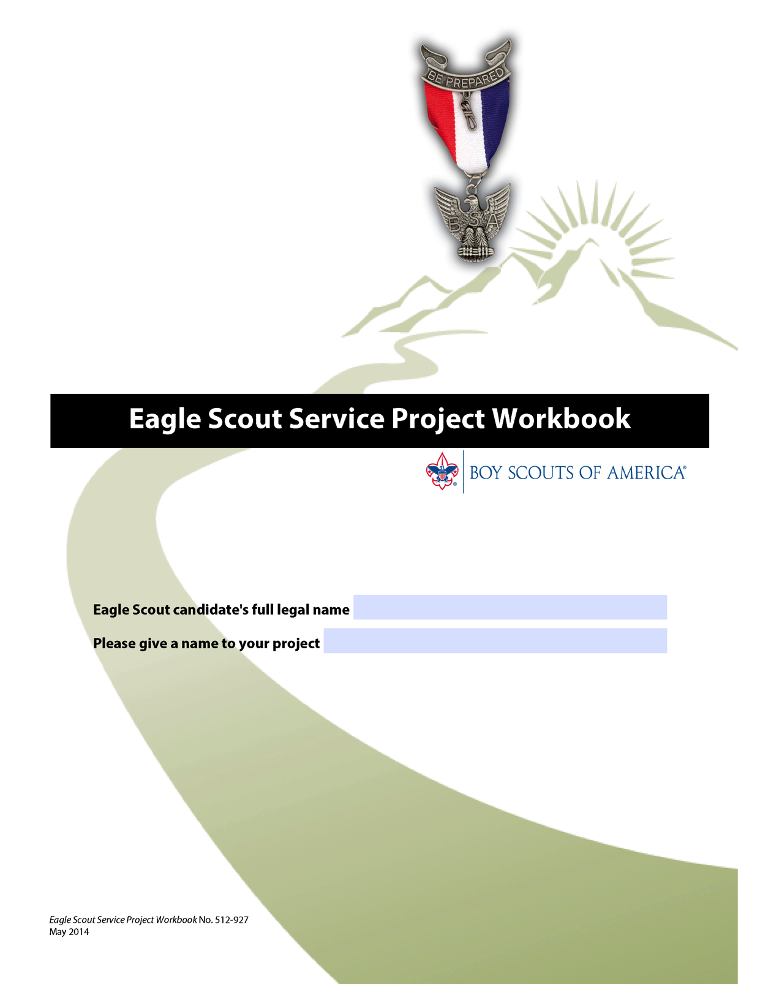
Eagle Scout Service Project Workbook 9.0.2.8
The official workbook is required.
Use of the workbook nearly ensures success:
Shows approvals obtained.
Lists important limitations.
Suggests questions.
Includes an outline for the project proposal, a more detailed project plan, and a project report.
Notes:
*
The workbook is #512-927 and is available online at https://www.scouting.org/programs/boy-scouts/advancement-and-awards/eagle-workbook-procedures/

Slide 90
Eagle Scout Service Project Workbook 9.0.2.8
Use only the official workbook – no changes or additions to the workbook are authorized.
An incomplete workbook is not the basis for project rejection.
The proposal and project report should be completed.
Completion of the project plan is strongly encouraged, but not required.
Notes:
*
Note that the word “should” is used with the proposal and report. This indicates that there may be circumstances where some of the form’s questions may not apply to certain Scouts or projects and therefore, to require all questions to be answered is unnecessary to the success of the project. However, in the majority of cases since these forms require signatures it is pretty clear that they are meant to be done,. Either way, the FIVE tests for a project proposal must be met!
The project plan is a really good idea for most scouts and can result in a better understanding of how to properly do complex planning, but isn’t necessary in all situations and since it is up to the Scout to decide whether to do or not is part of the learning process for the youth.
More information about all of this can be found by consulting the Eagle Scout Service Project Workbook itself.

Slide 91
How To Use the Workbook 9.0.2.8
Read everything first:
Introductory information
Message to Scouts and Parents or Guardians
The Project Proposal
The Project Plan
Fundraising Application
The Project Report
Navigating the Eagle Scout Service Project
Notes:
Note: It is clearly stated that when the Scout signs the proposal page they promise that they have read the entire workbook and will do their best to carry out the project!
*

Slide 92
Eagle Scout Service Project Coach 9.0.2.9
Coaches are highly recommended, but not required.
The council determines how the coach is selected.
A coach’s greatest value:
Providing advice after the proposal is approved.
Guiding the Scout during project planning and execution.
Evaluating and discussing the plan’s strengths, weaknesses, and risks.
Notes:
*
The coach’s role is to assist the youth in successfully preparing the proposal, and carrying out the project as outlined in the proposal.

Slide 93
Eagle Scout Service Project Coach 9.0.2.9
Project coach does not manage.
Has no authority to change the project.
Has no authority to withdraw approval of the project proposal.
The coach provides value in assisting the Scout in completing requirement 5.
Notes:
*

Slide 94
Fundraising 9.0.2.10
The project may not be a fundraiser.
Fundraising is only needed for funding the project.
Funds may be used only to secure materials and supplies to facilitate the project.
Submit application to the local council.
Notes:
*
Fundraising is not a requirement of the project. It only pertains when there will actually be a need for monies and materials. The next slide covers this in more detail.

Slide 95
Fundraising 9.0.2.10
No council approval is needed when funds come from:
The project beneficiary.
The Eagle candidate, their parents or guardian, or relatives.
The Eagle candidate’s unit or chartered organization.
Parents or members of the Eagle candidate’s unit.
Notes:
*

Slide 96
Fundraising 9.0.2.10
Donations are for the project beneficiary, not the BSA.
Donation documentation is provided by the project beneficiary.
Money must be deposited in a unit or beneficiary account.
Leftover funds are retained by the project beneficiary – or, if held by unit, released to the beneficiary.
Notes:
*
The beneficiary has the prerogative to donate left over funds back to the unit if it wishes to do so.

Slide 97
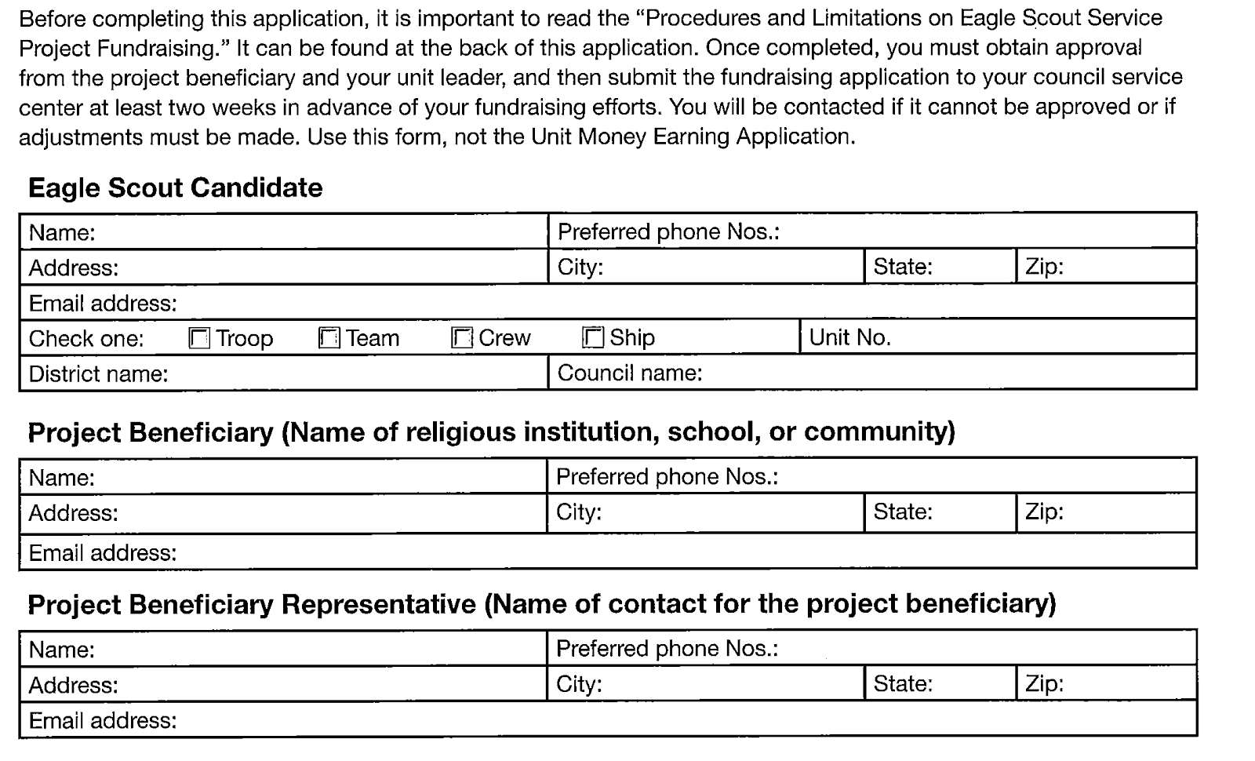
Eagle Scout Service Project Fundraising Application
Notes:
Review this briefly only to make sure everyone has seen it and knows where to find it.
*

Slide 98
Routine Labor 9.0.2.11
“Routine labor” is not normally considered appropriate for a project.
“Routine labor” defined:
Job or service that is part of Scout’s daily life.
Routine maintenance.
The test is scale and impact.
Notes:
*

Slide 99
Common Misconceptions 9.0.2.12
No minimum number of hours is required.
Only one candidate may receive credit for working on the same project.
The project need not have lasting value.
Notes:
*

Slide 100
Evaluating the Project 9.0.2.13
Evaluate impact:
Benefit to school, religious institution, or community
Leadership provided
Planning and development evidenced:
Do not require more planning than necessary.
Planning should not overshadow the project.
Notes:
*
A project that is successfully carried out and certified by the beneficiary should not be held up in a board of review because someone doesn’t think enough planning was done.

Slide 101
Evaluating the Project 9.0.2.13
The unit leader or project beneficiary may choose to not approve the project if service or impact is deemed insufficient.
Candidate may be requested to do more work.
Candidate may be requested to start over.
Candidate’s options:
Comply with request.
Decline request and submit application without final approval.
Must be given a board of review if requested.
Notes:
Instances such as this should be rare.
*

Slide 102
Evaluating the Project 9.0.2.13
Board of review should approve if:
The proposal was approved.
Planning/development was adequate.
The project was well-led and carried out to the satisfaction of the unit and project beneficiary.
Rejection is very rare.
• Requirement 5 as written was clearly not satisfied.
• Project approval may NEVER be withheld for reasons unrelated to the project.
Notes:
*

Slide 103
Time Extension for Earning Eagle 9.0.4.0
Council can approve up to 6 months. These are RARE.
Apply to national through council advancement committee if more time is needed, or to appeal a denial.
Approval is granted by the National Advancement Program Team.
Notes:
The fillable request form can be downloaded from https://filestore.scouting.org/filestore/pdf/512-077.pdf.
*

Slide 104
Time Extension for Earning Eagle 9.0.4.0
To qualify:
Must have joined, rejoined, or become active again so all requirements were able to be completed before age 18.
A circumstance precludes completion before the deadline:
Beyond control of the youth.
Severe and not the norm in the Scout’s life.
Could not have been planned or anticipated.
Notes:
*

Slide 105
Extension Request 9.0.4.1
Council advancement committee’s role:
Research the request.
Collect evidence.
Reach a decision.
Inform the scout.
Time is of the essence.
Notes:
A complete packet of information is of importance here and that the Scouts advancement records are up to date in the BSA system. Everything being well prepared will usually see a decision rendered within 2-4 weeks.
*

Slide 106
Special Needs 10.0.0.0
BSA is inclusive.
There are various accommodations for advancement.
Scouts need not join a special unit.
The severity of the disability determines the type of registration.
Notes:
Youth with physical disabilities and youth and adults with developmental or cognitive challenges are welcome in the BSA.
*

Slide 107
Registration Beyond Age of Eligibility 10.1.0.0
Permanent disability.
Disability severe enough to preclude advancement.
Council approval is necessary.
Notes:
Do not confuse permanent disabilities and registration beyond the age of eligibility with time extensions.
*

Slide 108
How to Register Beyond Age of Eligibility 10.1.0.2
Letter from the parent or guardian describing disability and its severity and permanence.
Completed youth membership application or proof of current membership.
Completed Health and Medical Record.
Signed statement from a qualified health professional attesting to the disability.
Letter from the unit leader advocating and supporting the registration.
Notes:
*
Some of the necessary forms are in the appendix of the GTA and further information is available a www.scouting.org/specialneeds.

Slide 109
How to Register Beyond Age of Eligibility 10.1.0.2
Other supporting documentation such as an Individualized Educational Plan
Council executive board or designated operating committee approves request.
Scout Executive sends approval letter to parents or guardians and unit leader.
9. Council keeps approval letter.
Notes:
*
A letter from the Scout executive or advancement committee indicating the candidate is over 18 and registered with a disability is attached to the Eagle Scout Rank Application to inform the national office as to why this individual is still registered and qualified for the rank (topic 10.2.2.4)

Slide 110
Advancement Flexibility 10.2.0.0
Youth with disabilities may qualify for limited flexibility in advancement.
Need not be registered beyond the age of eligibility.
Type of flexibility varies by program.
Notes:
*
Limited numbers of scouts may have a significant disability that could last for two years or more, but not necessarily beyond the age of 18.

Slide 111
Appendix 11.0.0.0
Reporting Merit Badge Counseling Concerns
Request for Extension of Time to Earn Eagle Scout Rank
Belated Eagle Scout Rank Application
Request for Registration Beyond the Age of Eligibility
Individual Scout Advancement Plan
Notes:
*

Slide 112
“The spirit is there in every [Scout]; it has to be discovered and brought to light.”
Lord Robert Baden-Powell
Notes:
*

