Slide 1

National Lion Pilot
The Boy Scouts of America’s pilot program
for kindergarten-age boys
For approved councils and key Lion volunteers

Slide 2
The Lion Pilot
Created by the Boy Scouts of America to address the needs of kindergarten-age boys
  Must be 5 years old by September 30, 2016 and not yet 7 years old to participate
The only approved pilot for kindergarten-age boys
Curriculum should be implemented as written to ensure validity of the pilot
Designed as an introduction to Cub Scouting
Notes:
Your evaluation is needed to provide feedback for program continuation or expansion. To support the feedback, it is important to deliver the program as designed.
Reproduction or distribution without written consent is not authorized.

Slide 3
Overview
The Lion pilot program offers kindergarten-age boys and their adult partners an experience that includes:
  Fun while achieving Scouting’s desired outcomes
  Active and fast-paced excitement
  Hands-on exploration
  Values-based and relevant content
  Focused time together as a family

Slide 4
Basic Structure
Dens of six to eight boys, plus adult partners
  Not solely a sibling program; recruit new families
  Lion guides provide support and leadership
Two den meetings per month
  Den meeting
    Usually lasts about 45 minutes
  Outing
    Field trips
    Participation in two to three pack meetings

Slide 5
Shared Leadership
Lion guide (an experienced den leader)
  Oversees the den
  Communicates with participating families
  Leads initial den meetings and outings
  Mentors adult partners as they lead den meetings and outings during the year
  Integrates with the pack and pack leadership
Adult partner
  Participates with a Lion in all meetings and activities
  Leads den meetings and/or outings as assigned

Slide 6


Lion vs. Tiger: Similarities
LION
Adult partners required
Shared leadership
Stickers and Lion badge
T-shirt and optional cap
Scout Oath and Scout Law
Family camping with pack
(No den camping)
ACTIVE and HANDS-ON!
TIGER
Adult partners required
Shared leadership
Adventure loops and Tiger badge
Cub Scout field uniform
Scout Oath and Scout Law
Family camping with pack
(No den camping)
ACTIVE and HANDS-ON!
ADULTS:
LEADERSHIP:
RECOGNITION:
UNIFORM:
OATH and LAW:
CAMPING:
FUN:

Slide 7
Lion vs. Tiger: Differences
BOBCAT:
DEN MEETINGS:
PACK MEETINGS:
FUNDRAISING:
DAY CAMP:
LION
Does not earn Bobcat
1–2 times per month
Attends a few (2–3)
Does not fundraise
No day camp
(until Tiger)
TIGER
Earns Bobcat
3-4 times per month
Attends all
Participates in fundraising
Tiger/Cub Scout day camp

Slide 8
Training
Youth Protection training
  Required for Lion guides
  Recommended and encouraged for each adult partner
Lion Guide and Parent Orientation video (2 min.)
  Required for both Lion guides and adult partners
Lion Guide and Parent Orientation PowerPoint
  Required for Lion guides
  Recommended and encouraged for each adult partner
Position-specific and Fast Start training
  Not required

Slide 9
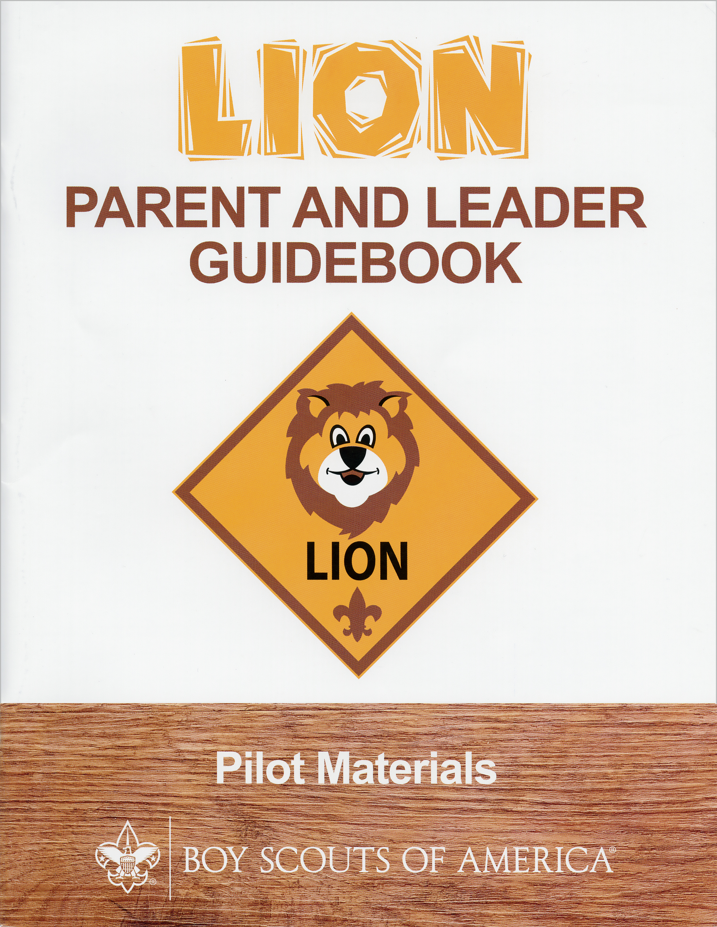
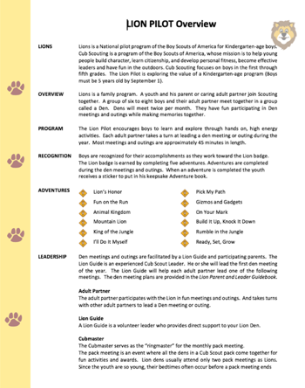

Parent/Leader Resources
Den meeting and outing plans
Program
overview
“Lion Guide and Parent Orientation” (video and PowerPoint)

Slide 10
Online Resource
Lion web page: www.scouting.org/lion
One-stop shop for parent and leader resources
  FAQs
  Program overview
  Lion Guide and Parent Orientation video (2 min.)
  Lion Guide and Parent Orientation PowerPoint
  Recruiting materials
  Contact us—Member Care at:
    972-580-2489 or MyScouting@Scouting.org

Slide 11


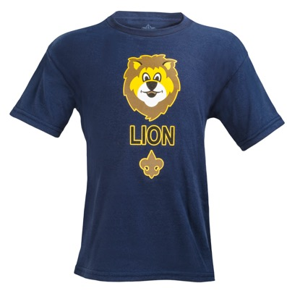

Adventure Book and Uniform
The youth Adventure Book is designed
as a memory or keepsake book
The uniform is a Lion t-shirt and an
optional cap
Adults are encouraged to wear a
Cub Scout activity shirt, Lion polo shirt,
or follow the pack’s uniform custom
Program materials kit, $9.99 retail
(Lion Parent and Leader Guidebook, Lion Adventure Book, and stickers)
T-shirt, $9.99; and optional cap, $12.99 retail

Slide 12
Adventures
Required Adventures | Elective Adventures
Lion’s Honor* | I’ll Do It Myself
Fun on the Run! | Pick My Path
Animal Kingdom | Gizmos and Gadgets
Mountain Lion | On Your Mark
King of the Jungle | Build It Up, Knock It Down
 | Rumble in the Jungle
*First meeting | Ready, Set, Grow
The Lion badge is earned by completing all five required adventures
The timing for completing adventures is at the discretion of the den

Slide 13


Recognition
Lion participants are recognized for each completed adventure with an “adventure sticker”
  No advancement report is required
  Stickers come with each Lion program kit
  Award stickers immediately
The Lion badge is earned by completing five required adventures
  The badge may be attached to the Lion cap or t-shirt
Adventures are completed during the den meetings and outings

Slide 14
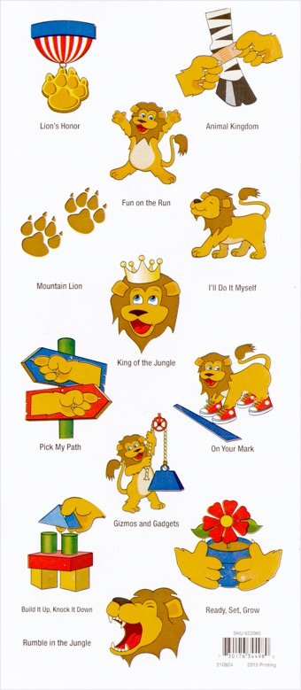
Adventure Stickers

Slide 15
Pack Participation
Lion dens may attend two to three pack meetings
  Focus their attendance on special or fun meetings
  Maintain age-appropriate expectations around meeting length, start/end times, and the typical attention span of kindergarten-age boys
Lion dens are a part of the pack, but at an introductory level
  Lion dens gain exposure to the world of Cub Scouting
  It is not appropriate for Lion dens to participate in fundraising, overnight den camping, shooting sports, or other activities geared toward older boys

Slide 16
Lion Recruitment
Councils participating in the Lion pilot are expected to actively recruit new members, not implement it solely as a sibling program
“Build an Adventure”–themed Lion recruitment materials are in development
  English, Spanish, and bilingual versions
  Assets will include:
    Fliers
    Yard signs
    Email blast templates
    Social media artwork
    Promotional video (sharable on social media channels)
Special Lion stock photos will be available for council use, but vendor and licensing rules still apply

Slide 17
Lion Registration
The standard $24 national registration fee applies
Use standard BSA youth/adult applications
  Each youth requires an adult partner
Units may charge activity fees
Lion participants count toward membership and market share, but do not count against other Journey to Excellence categories (See notes for details)
Registrar training will be available by early June
Notes:
* JTE Clarification Note:
Boys participating in the Lion pilot program will count toward your membership and market share goals. Because there is no expectation of advancement within that Lion year, nor overnight camping, nor fundraising or community service, Lion participants will not be factored into those JTE measures. It would skew your numbers downward. As a result, the organization made the determination that Lion youth participants will “count” toward membership and market share, but not factor into…negatively impact… your other JTE measures.

Slide 18
Getting Started
Recruit Lion youth and leaders for fall 2016
Adult partners complete the youth application and submit fees to the pack
Lion guides complete the adult application and submit fees to the pack
Lion guides complete required Youth Protection training
Youth Protection training is free online and available
at www.scouting.org/training/youthprotection.aspx
Although Youth Protection training is required only for Lion guides, it is suggested that all adult partners complete the training
Notes:
On the youth application, just write in the word “Lion” at the top of the form.
Then when asked grade level write in “K’.
Because this is a pilot, the standard youth application will still be used. Changes to the form will not occur / nor will a reprint be done. Your normal application will work just fine.

Slide 19
Activation Timeline
May – Aug. Recruit and train Lion guides
May – Aug. Lion merchandise delivered to
approved National Council Scout shops.
(Approved council-owned Scout shops
need to order as normal via Supply.)
Aug. – Sept. Recruit Lion youth and their adult partners
Aug. – Sept. Lion pilot begins
May 2017 Surveys, evaluations, and select
focus groups conducted by the
Pilots and Program Development Dept.

Slide 20
Pilot Evaluation
The pilot program will be assessed and evaluated throughout the year
Feedback will be requested from:
  Parents
  Lion guides
  Cubmasters
  Councils
For the pilot to be valid, it is important to deliver the curriculum and program as written

Slide 21
Council Support
Lion web page (public-facing) 5/2
Merchandise available for Scout shops 5/2
National Supply customer service 5/2
Member Care customer service: MyScouting@Scouting.org 5/2
For council use only: lion.pilot@scouting.org 5/2
Lion Guide and Parent Orientation video 5/13
Lion Guide and Parent Orientation PowerPoint 5/23
Promotional video 5/23
Marketing and recruitment materials 5/23
Photography assets available for council use 5/23
Spark Session at the National Annual Meeting 5/26
Exhibit booth at the National Annual Meeting 5/25–5/27
Registrar training Early June

Slide 22
Pilot Development
Program materials were developed based on the input and experience of early pilot councils, then further enhanced by the National Council
The team included experts in child development, curriculum design, and education, working in conjunction with the Boy Scouts of America
Many of the developers also worked on the new Cub Scouting curriculum and are active Scouting volunteers

Slide 23
National Lion Pilot
The Boy Scouts of America’s pilot program
for kindergarten-age boys

