Slide 1
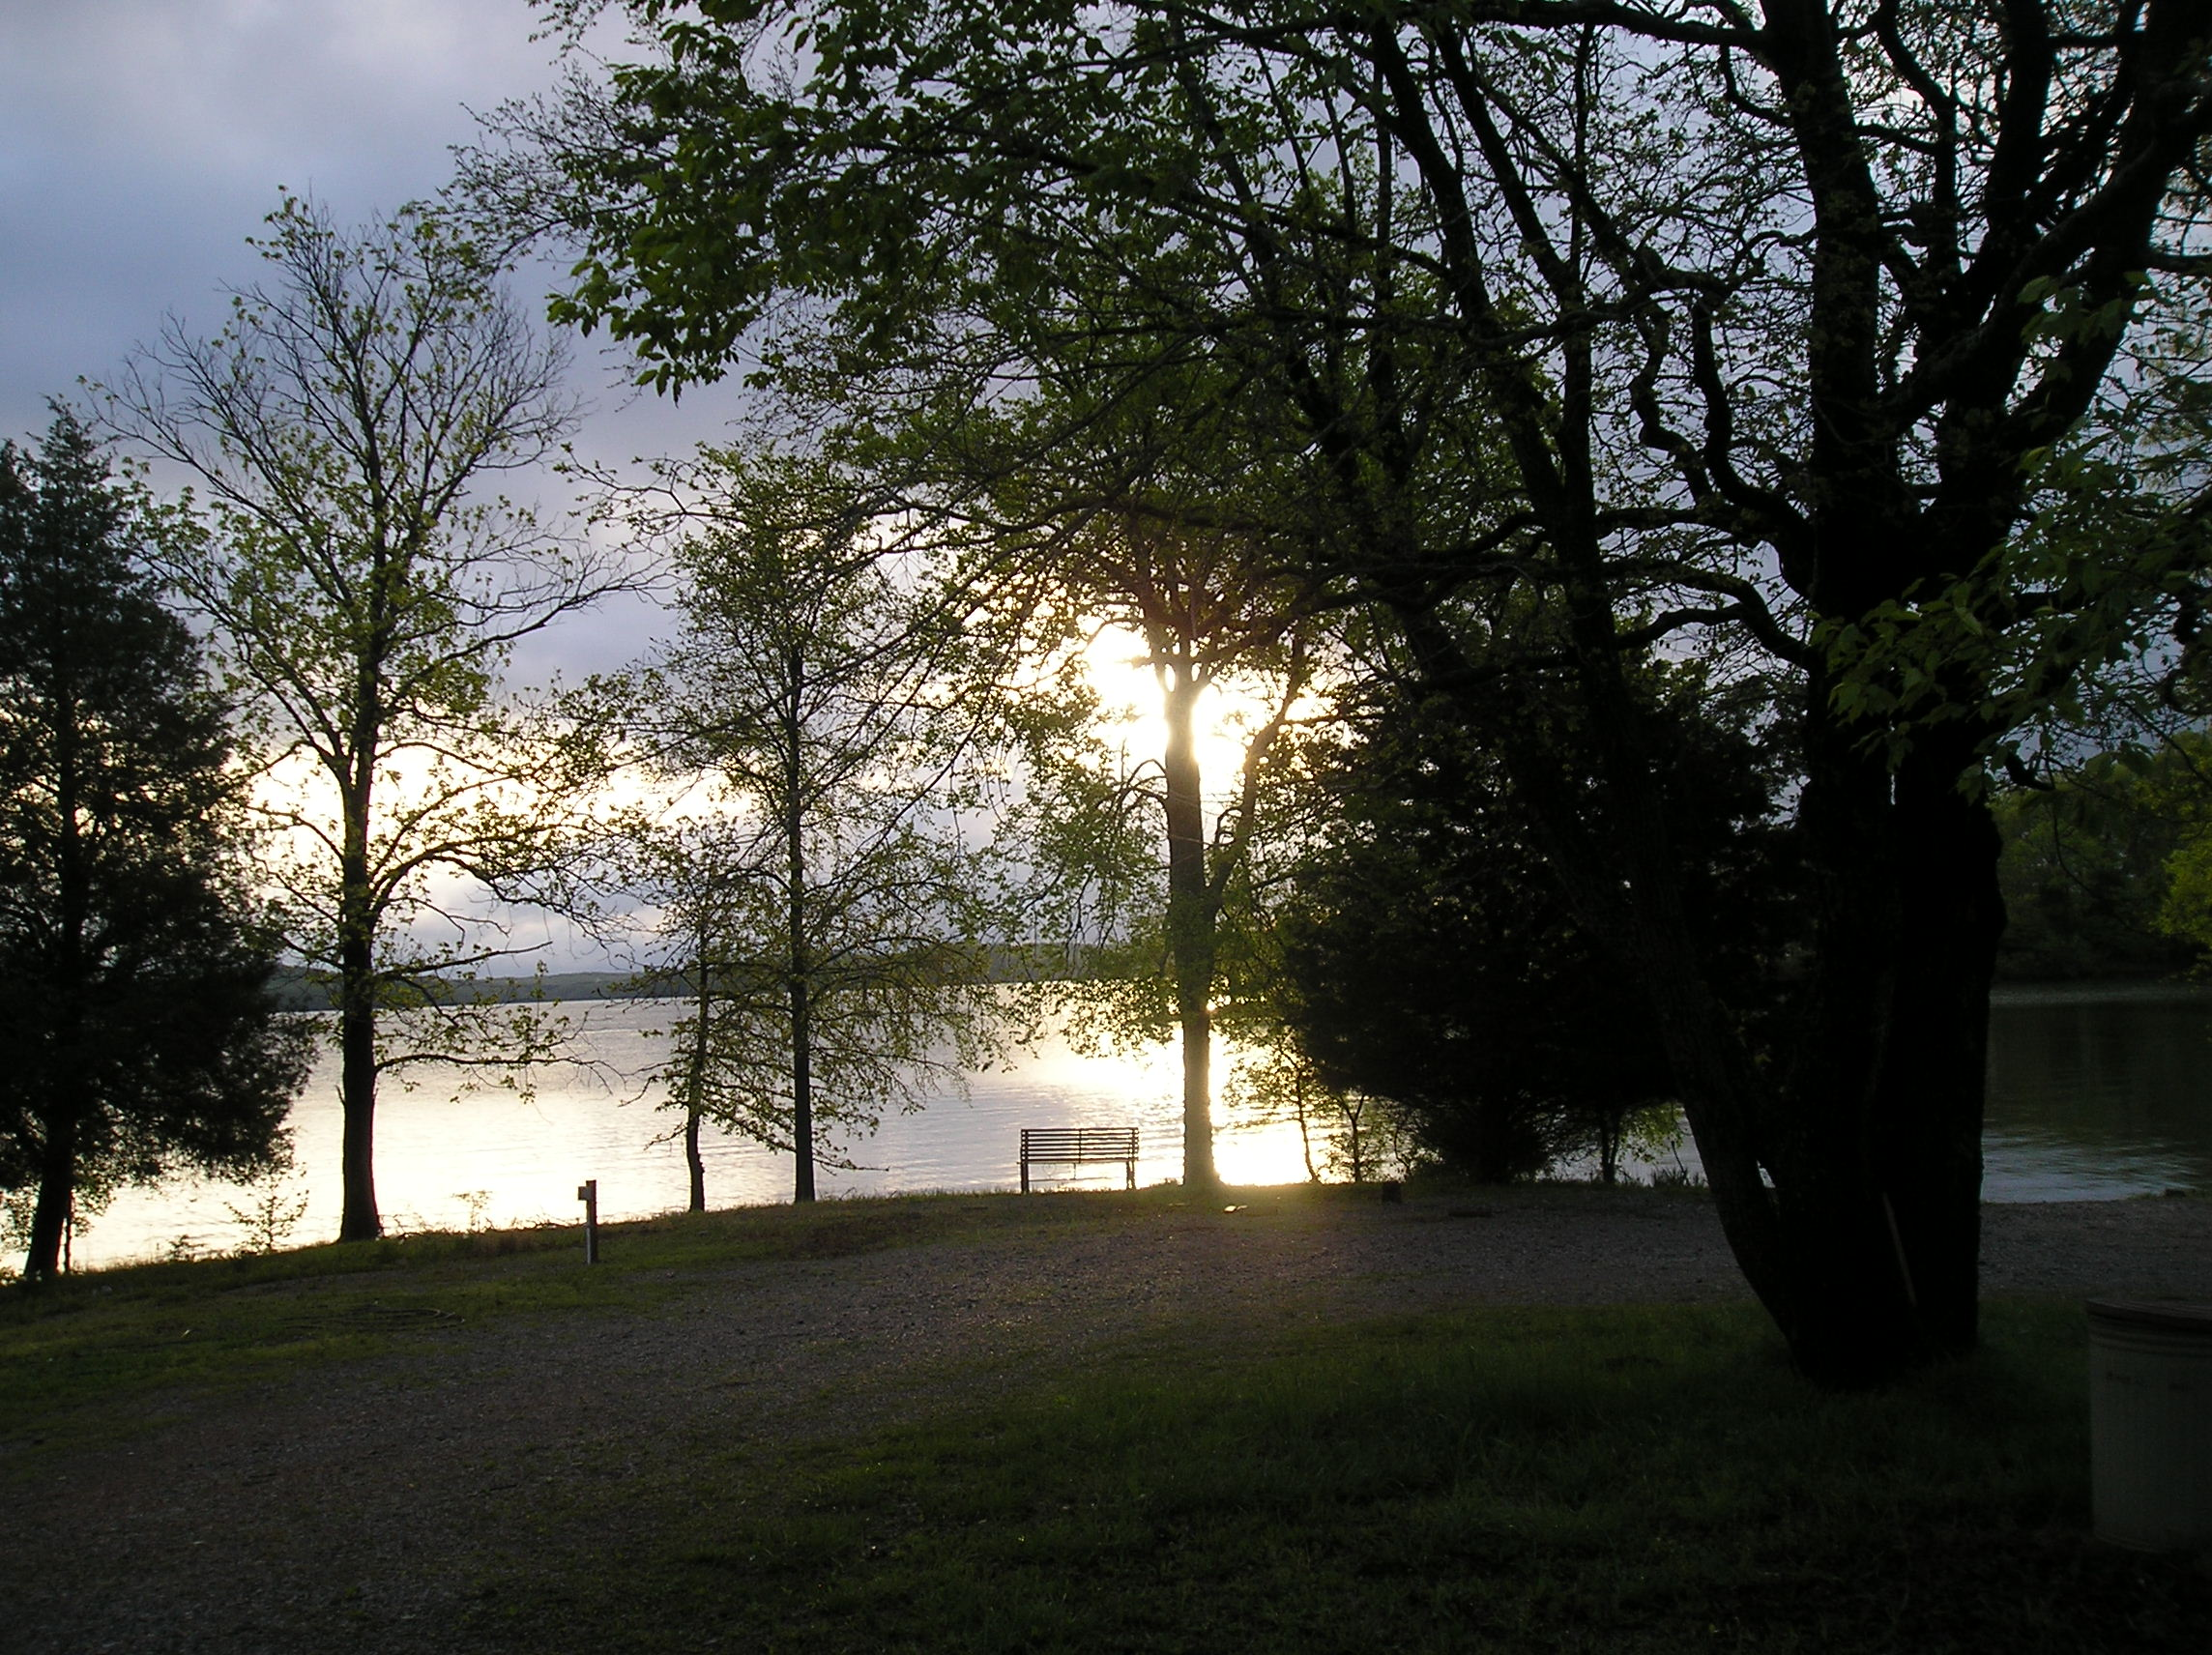
Camp Roy C. Manchester @ Pfeffer Scout Reservation

Slide 2
B
OHIO RIVER
Kentucky Lake
Lake Barkley
Land Between The Lakes
CAMP ROY C. MANCHESTER
PFEFFER SCOUT RESERVATION
LINCOLN HERITAGE COUNCIL, BSA
KENTUCKY LAKE & LAKE BARKLEY

Slide 3
KENTUCKY LAKE
160,000 ACRES OF WATER in Western Kentucky
2300 Miles of Shoreline
184 Miles Long
Adjacent And Connected To Lake Barkley
57,000 Acres
1,004 Miles of Shoreline
134 Miles Long
LBL 170,000 Acres
Wildlife Area

Slide 4
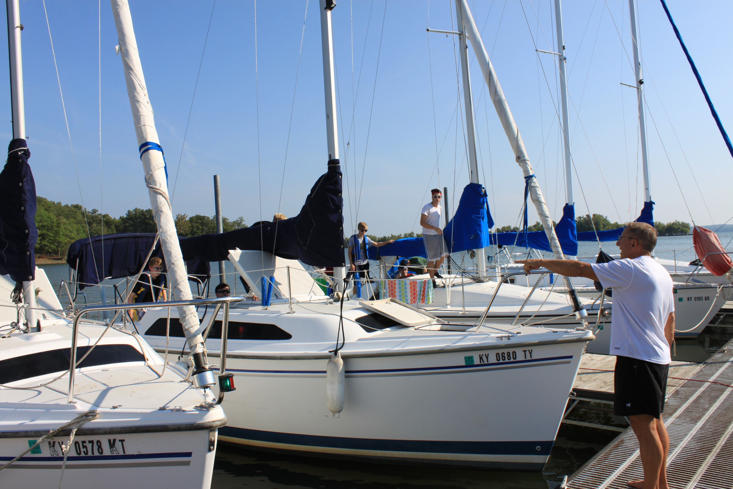
Spring, Summer & Fall Opportunities
Summer Camp
Canoeing
Kayaking
Small Boat Sailing
Aqua Finns
Catalina 14’s
Small Boat Sailing Merit Badge
Cruising Trips
Spring & Fall Activities
Canoeing
Kayaking
Weekend Sailing Trips

Slide 5
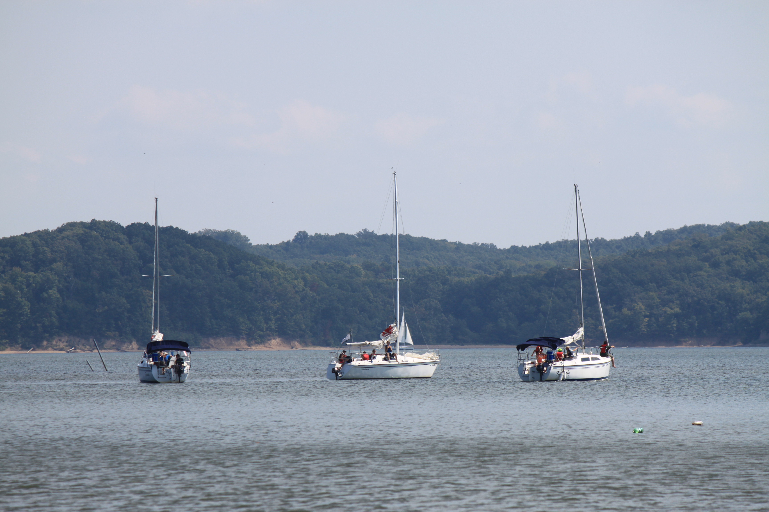
Aquatics Program 25 Foot Cruising Sailboats

Slide 6
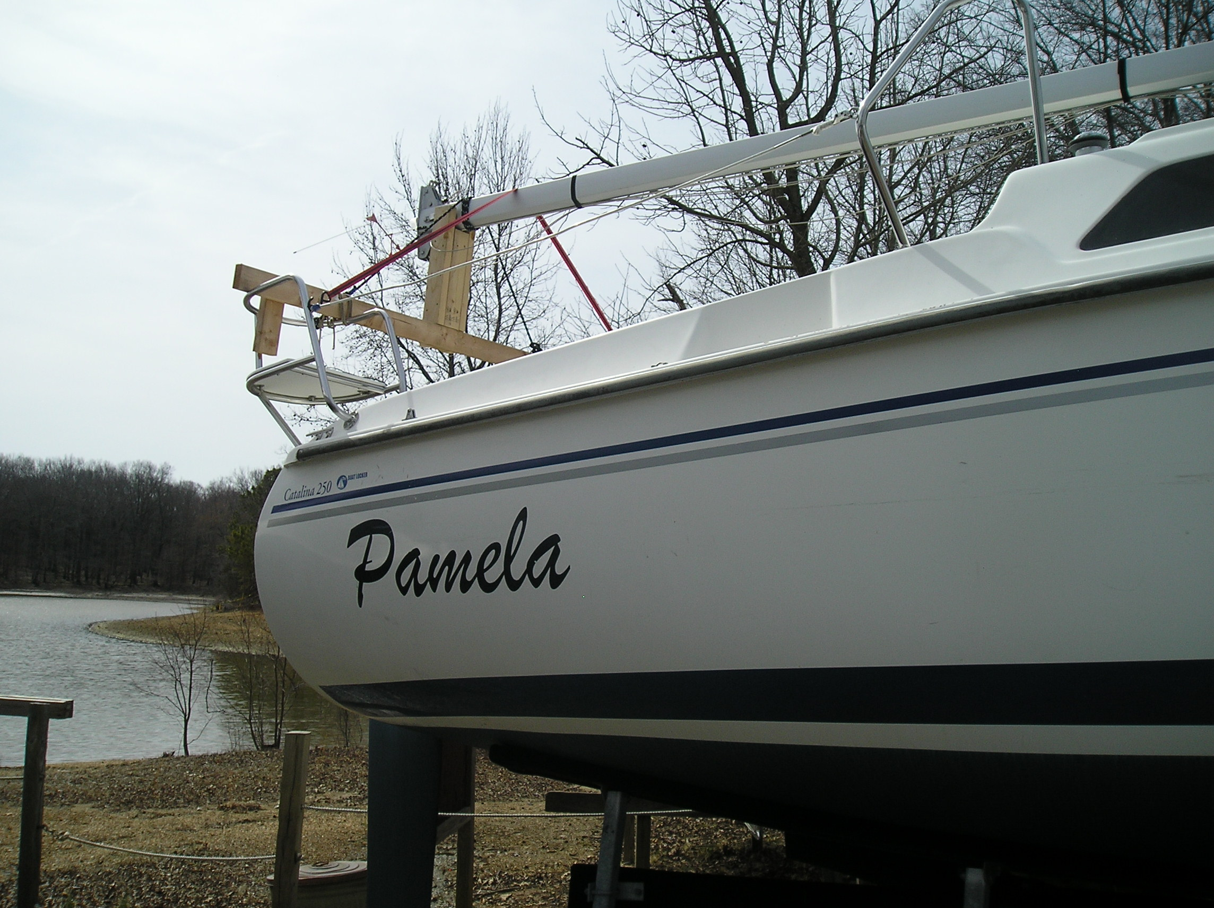
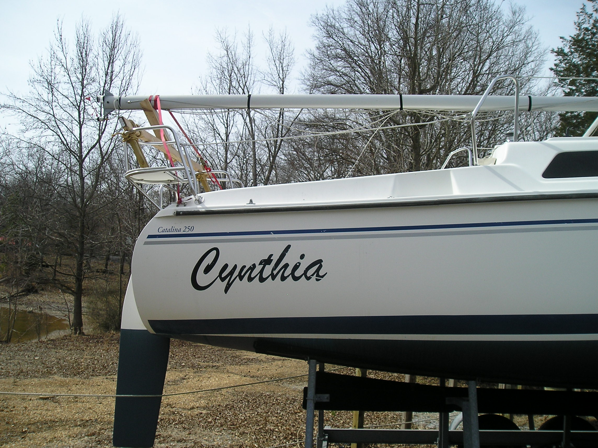
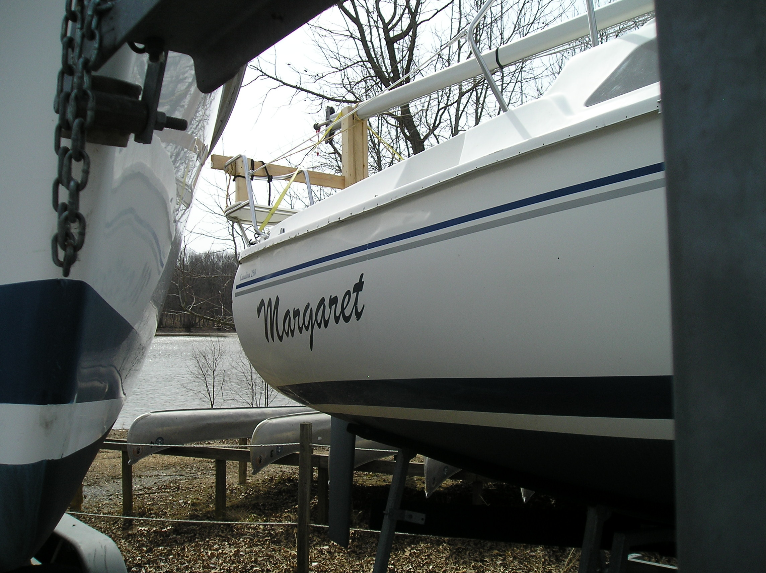
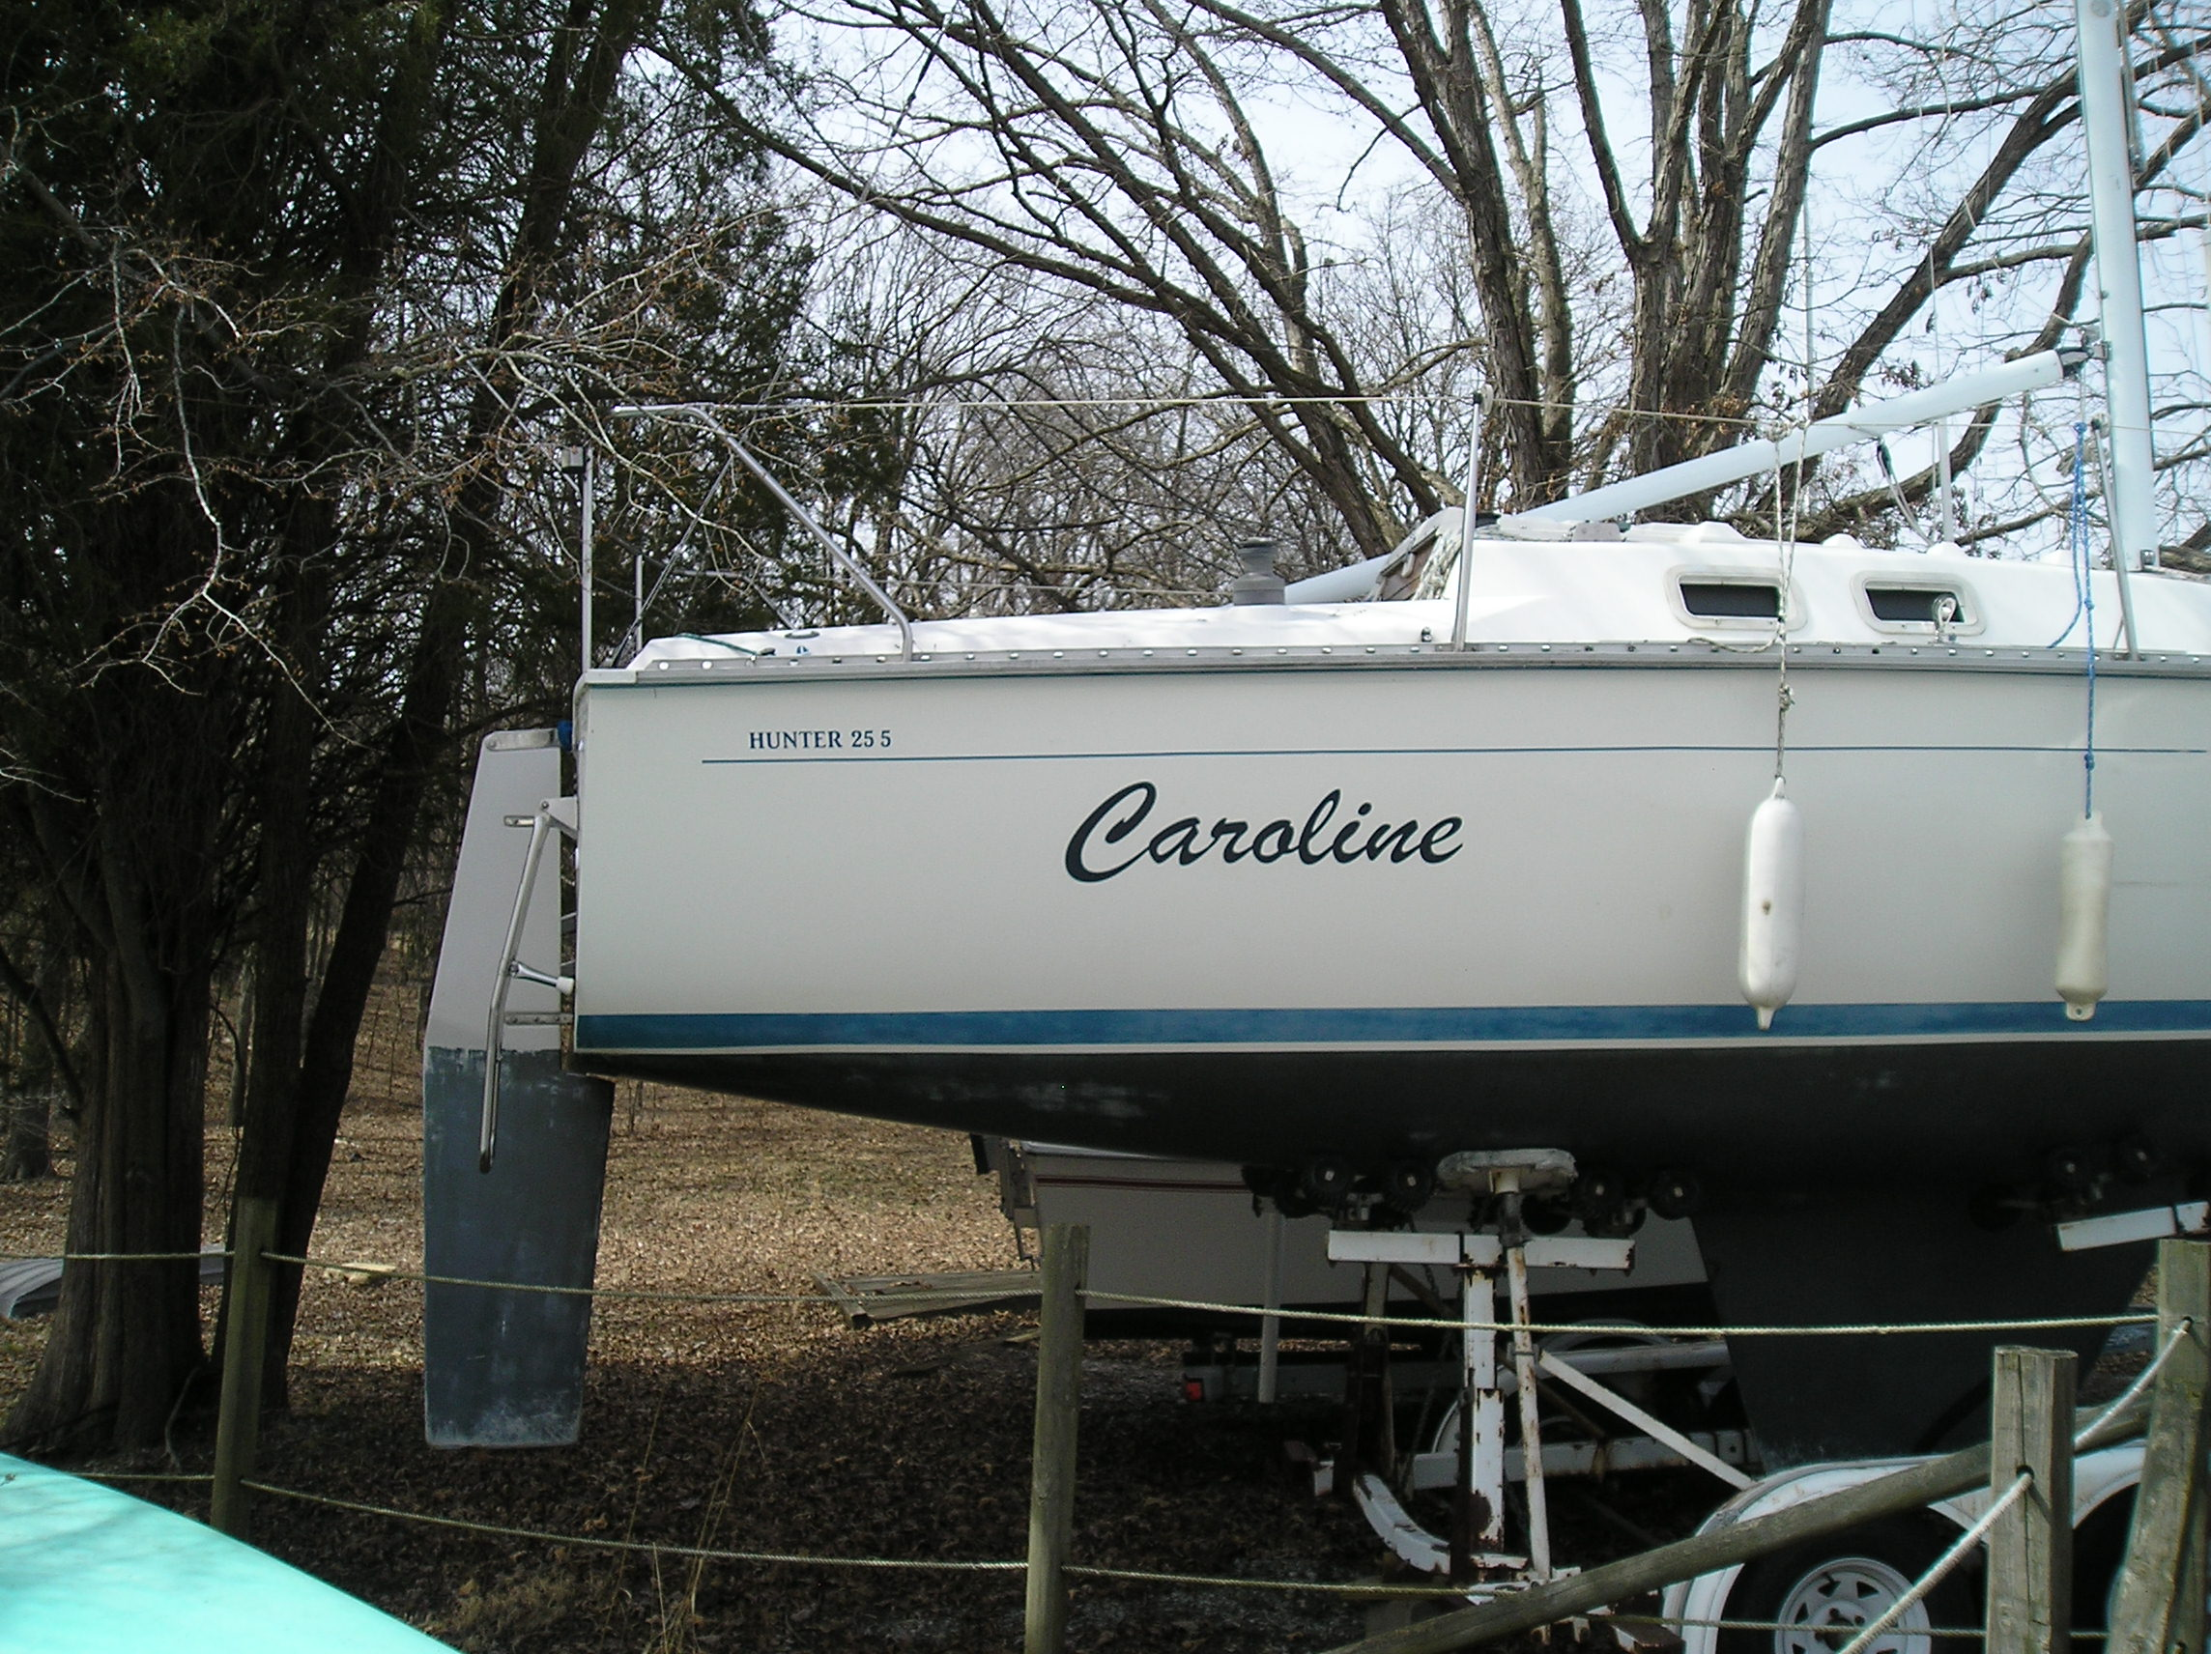
Catalina & Hunter 25’s

Slide 7
Catalina 14.2’s

Slide 8
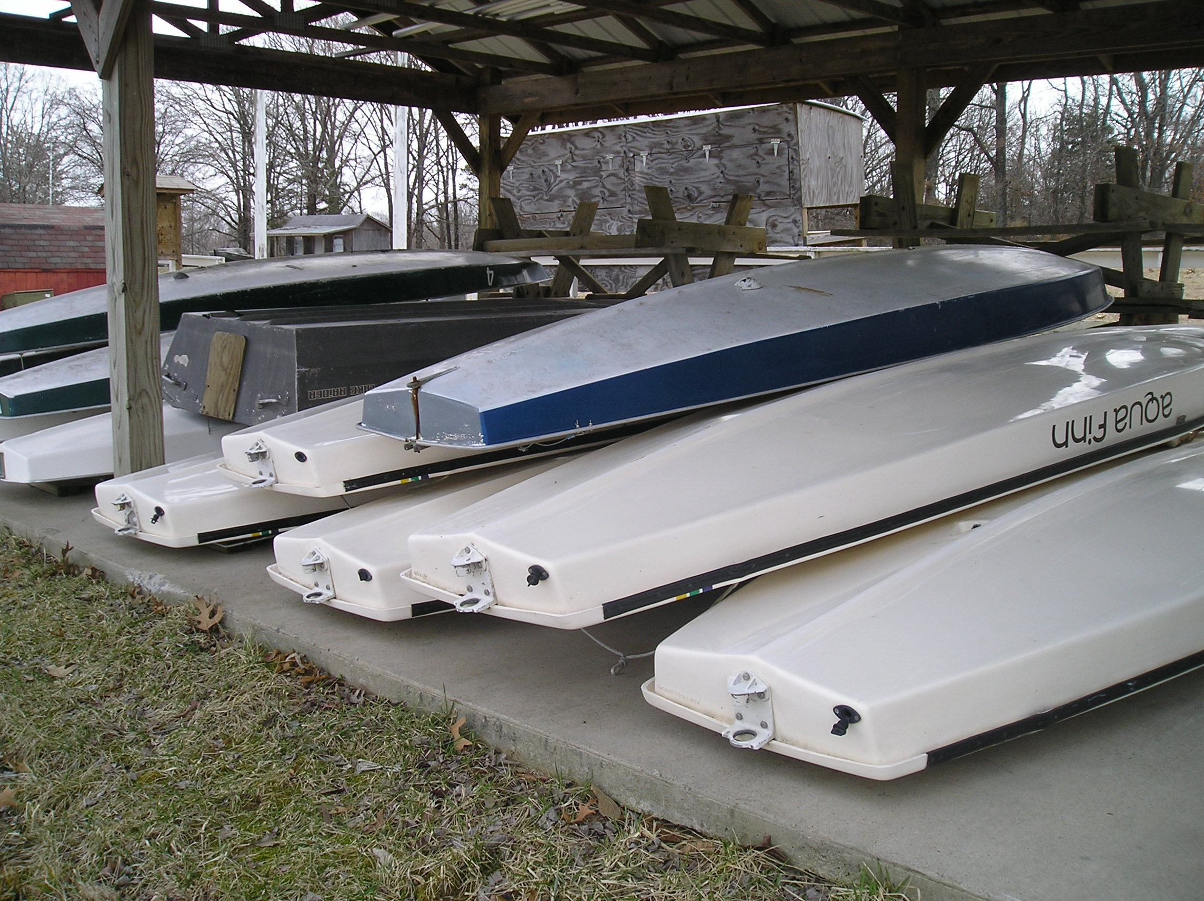
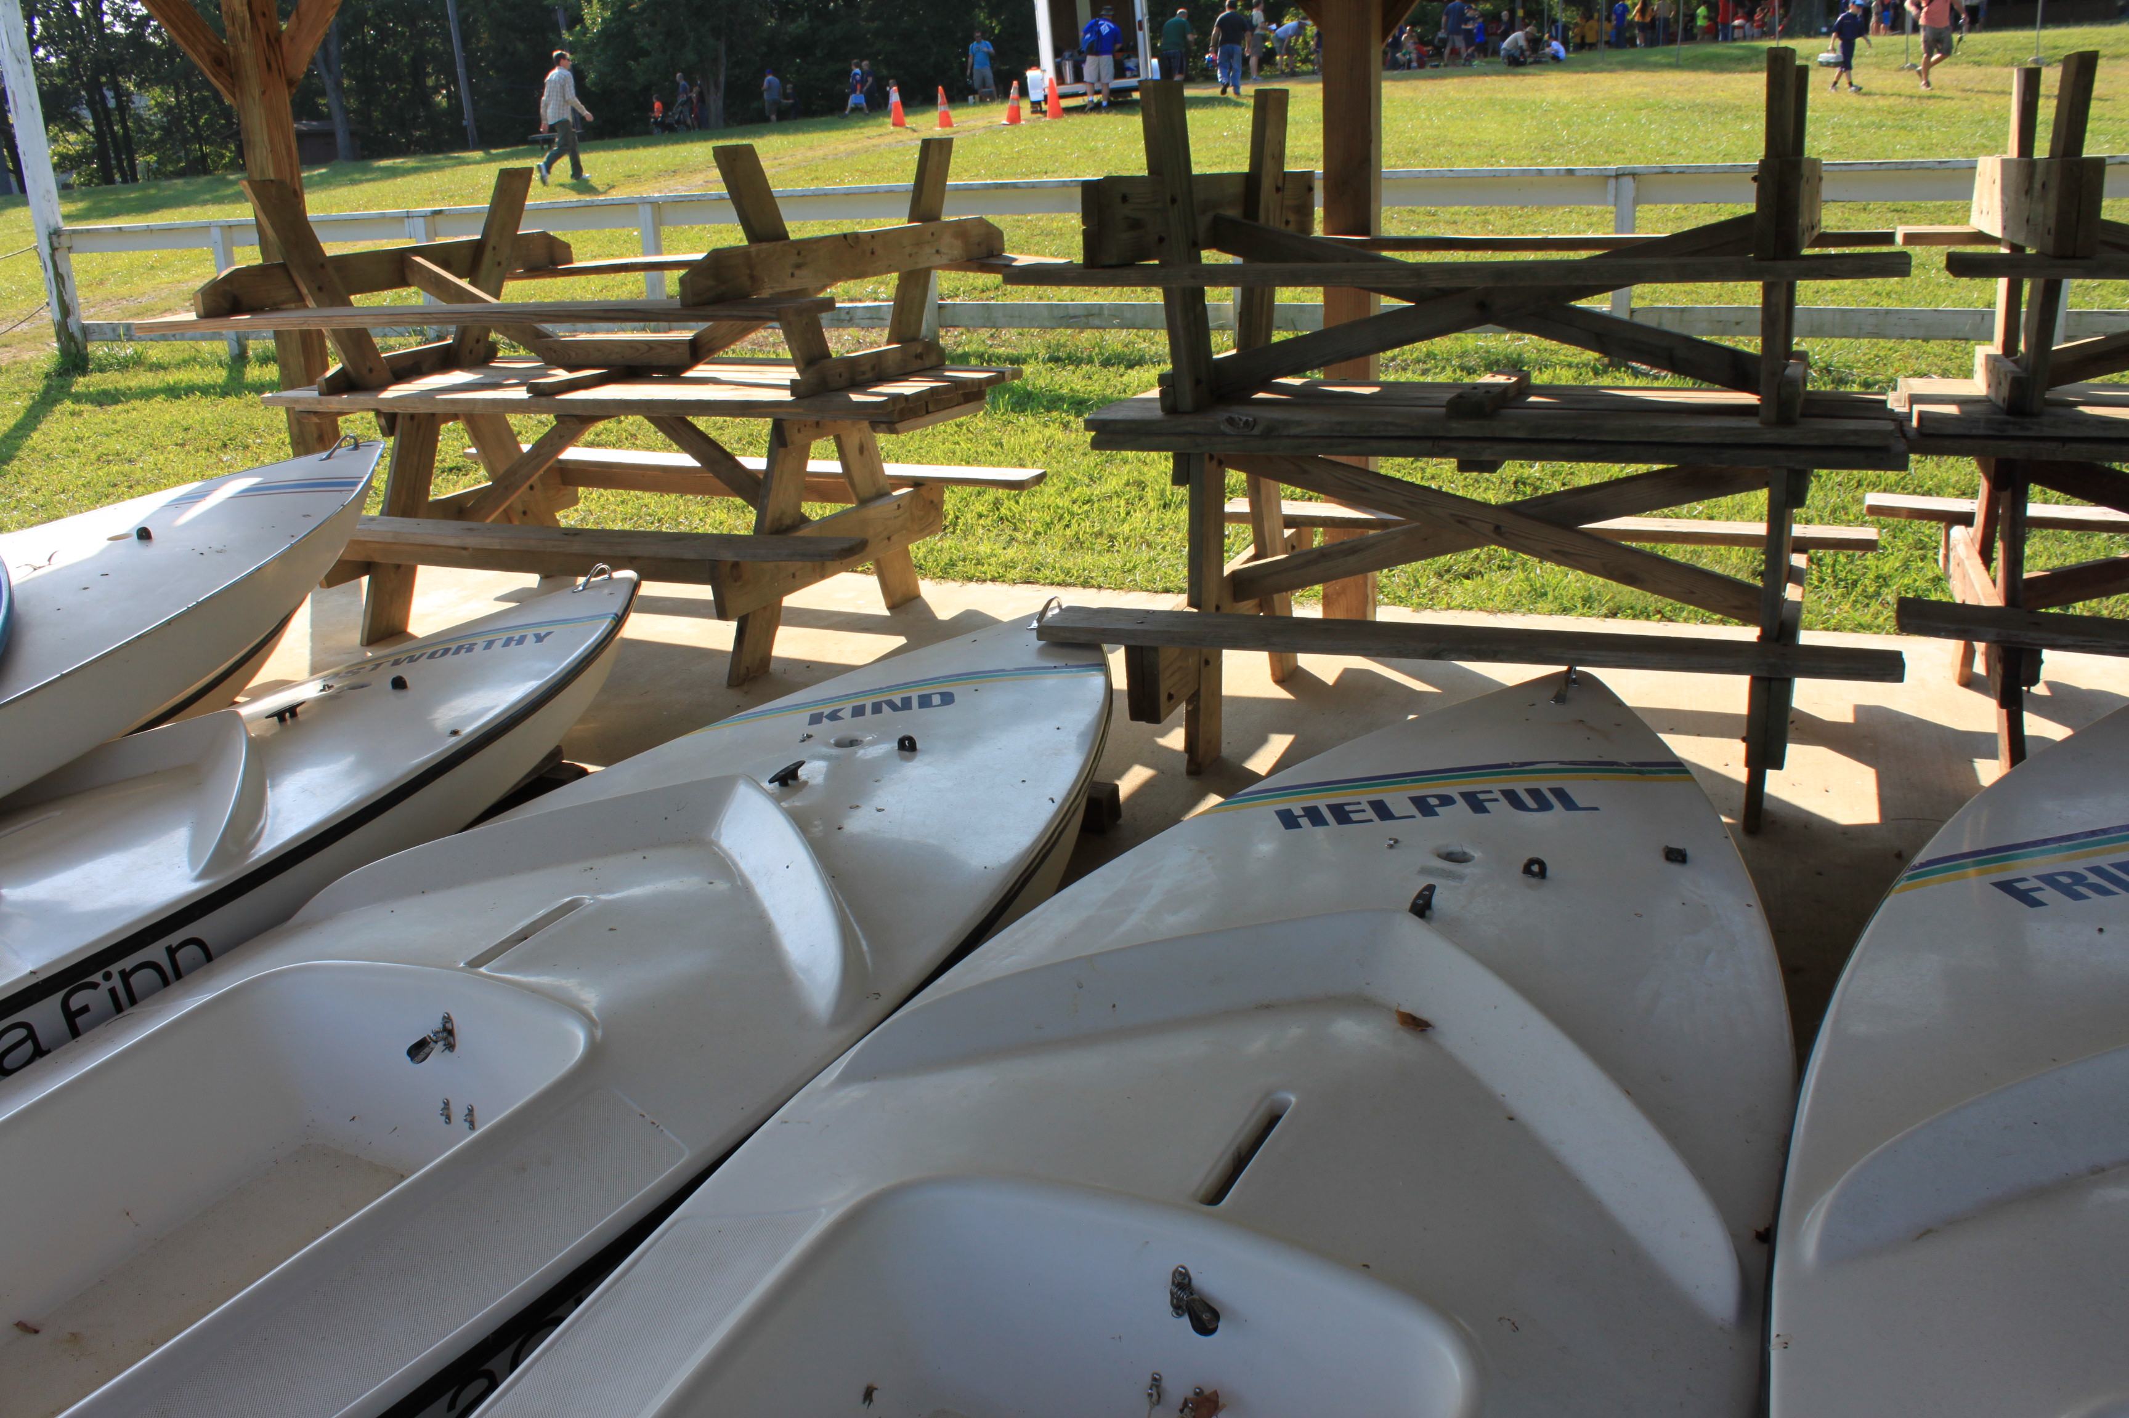
Aqua Finn Sailboats

Slide 9
CANOES & KAYAKS

Slide 10
Other Water Craft
4 Personal Watercraft
2 Ski Boats
4 Jon Boats

Slide 11
Training / Review Sessions Prior to Trip Departure

Slide 14
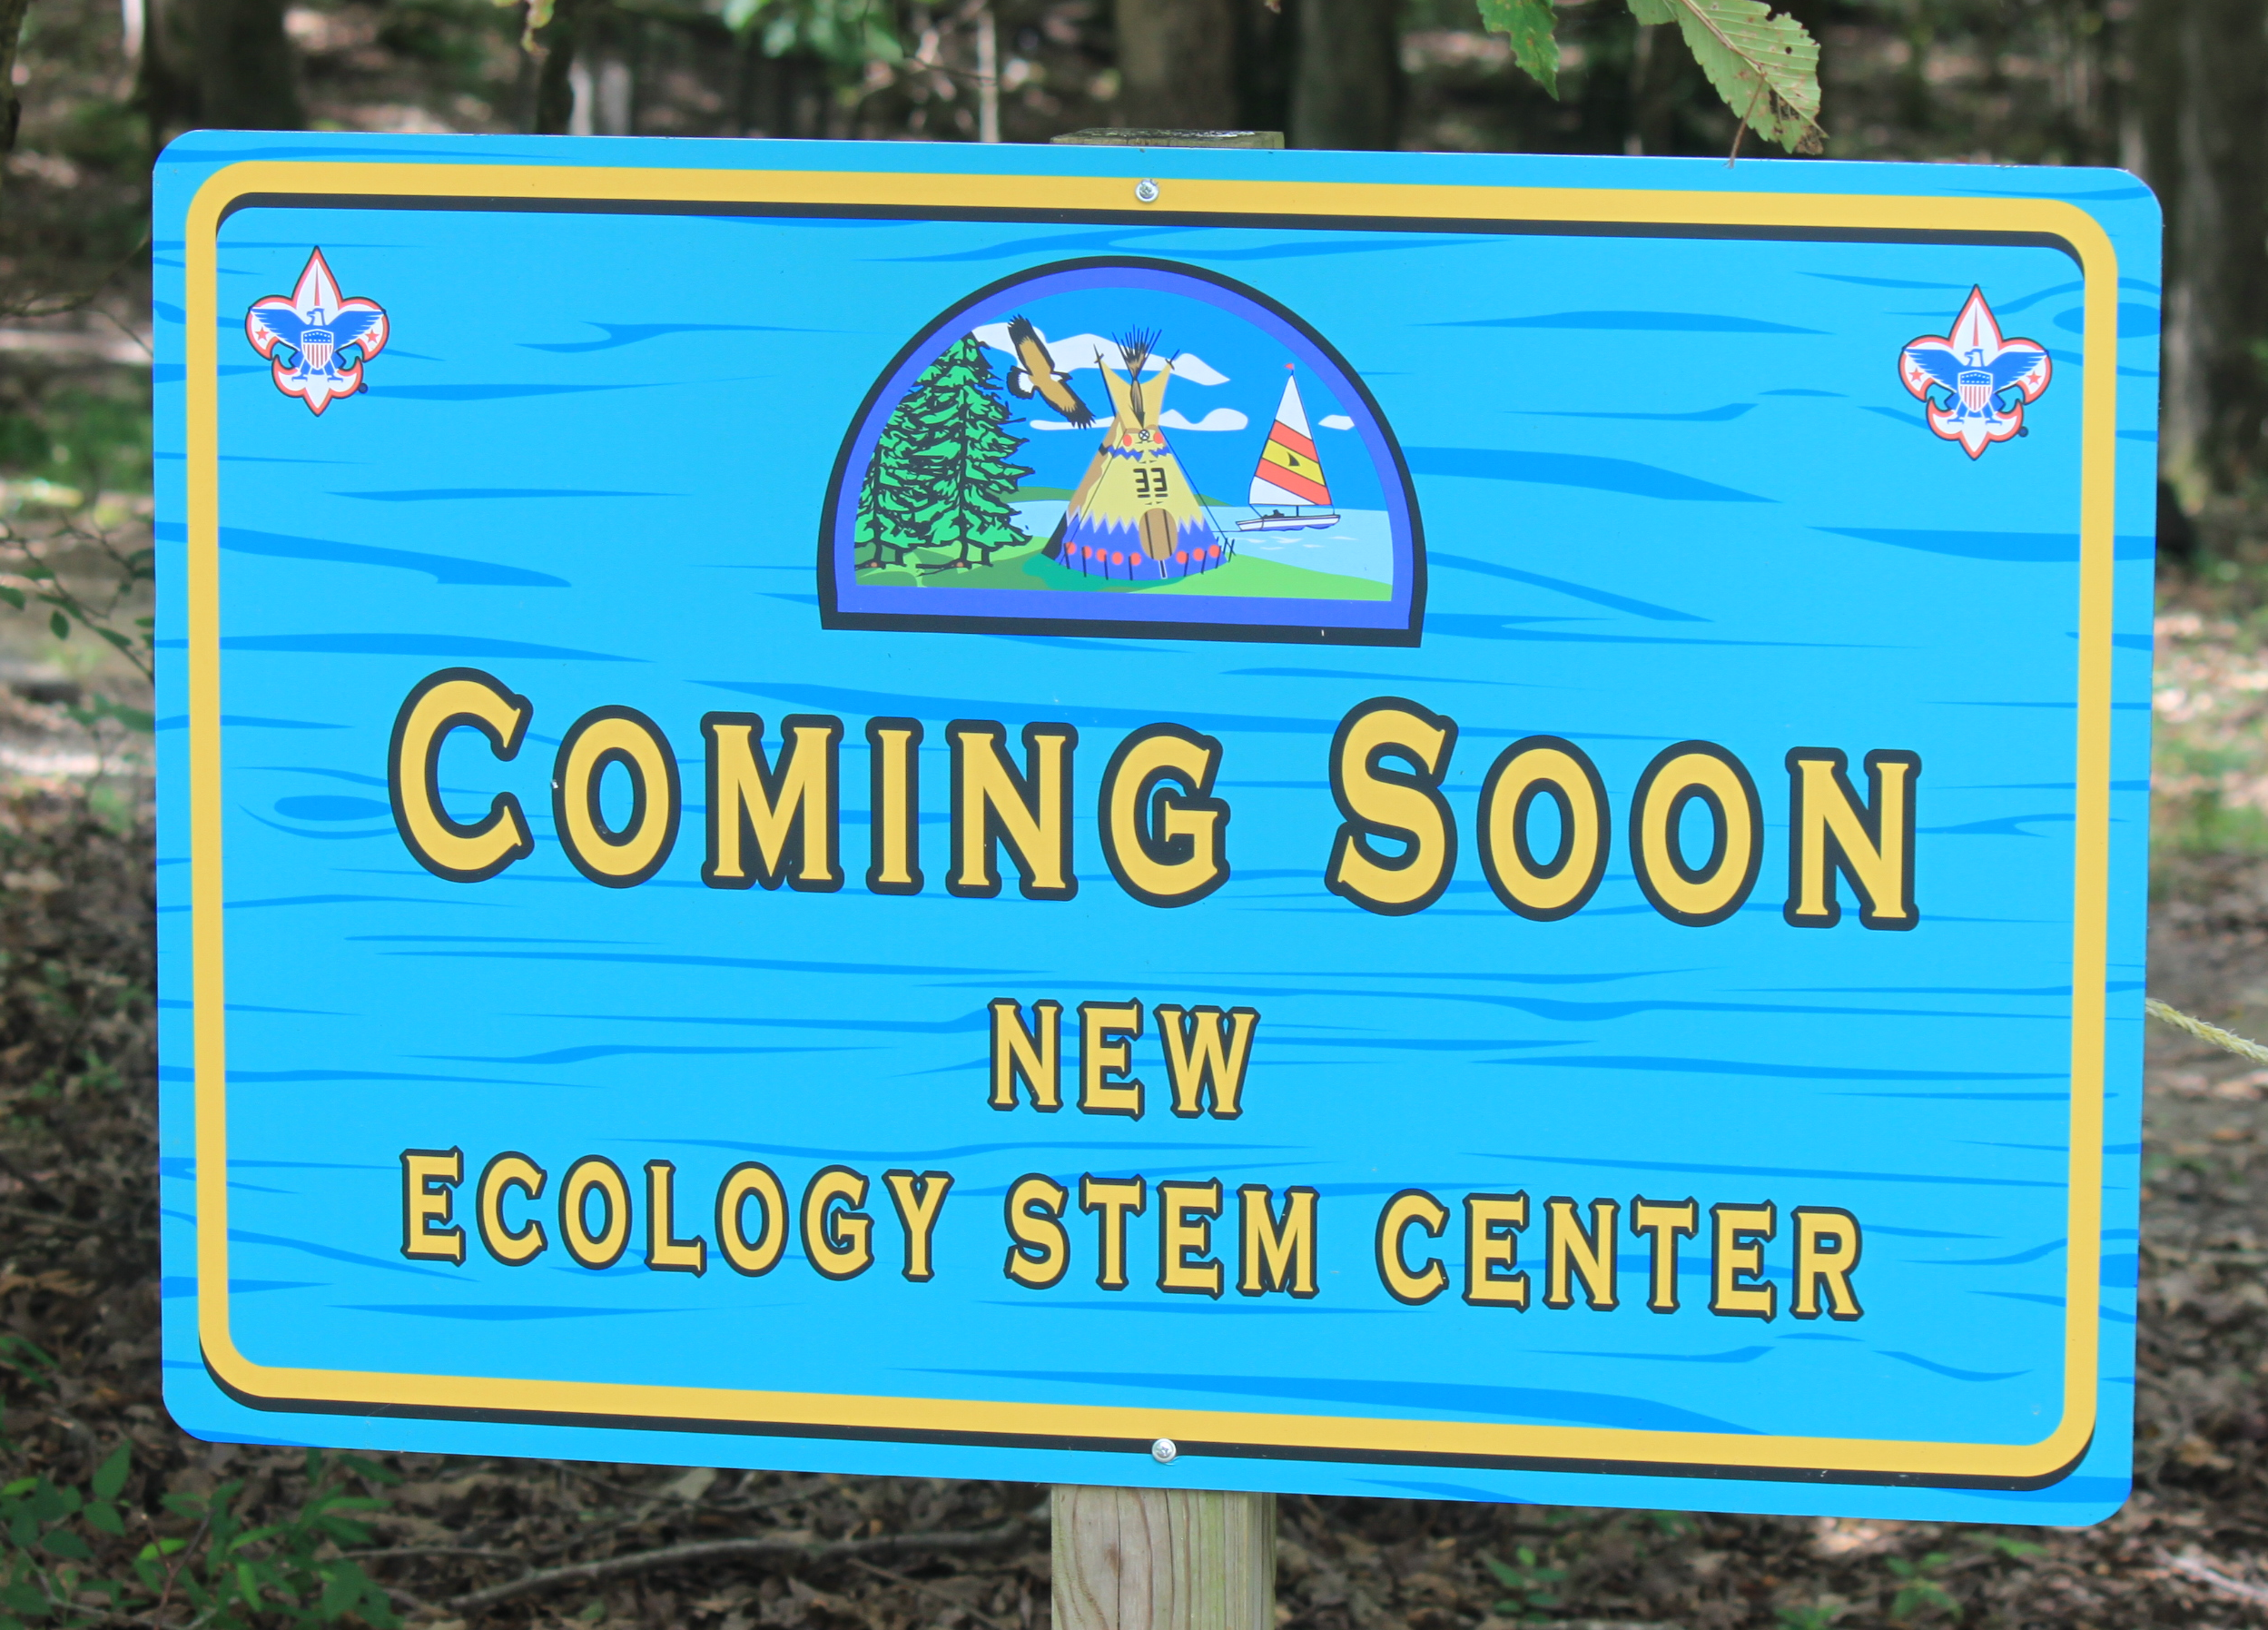
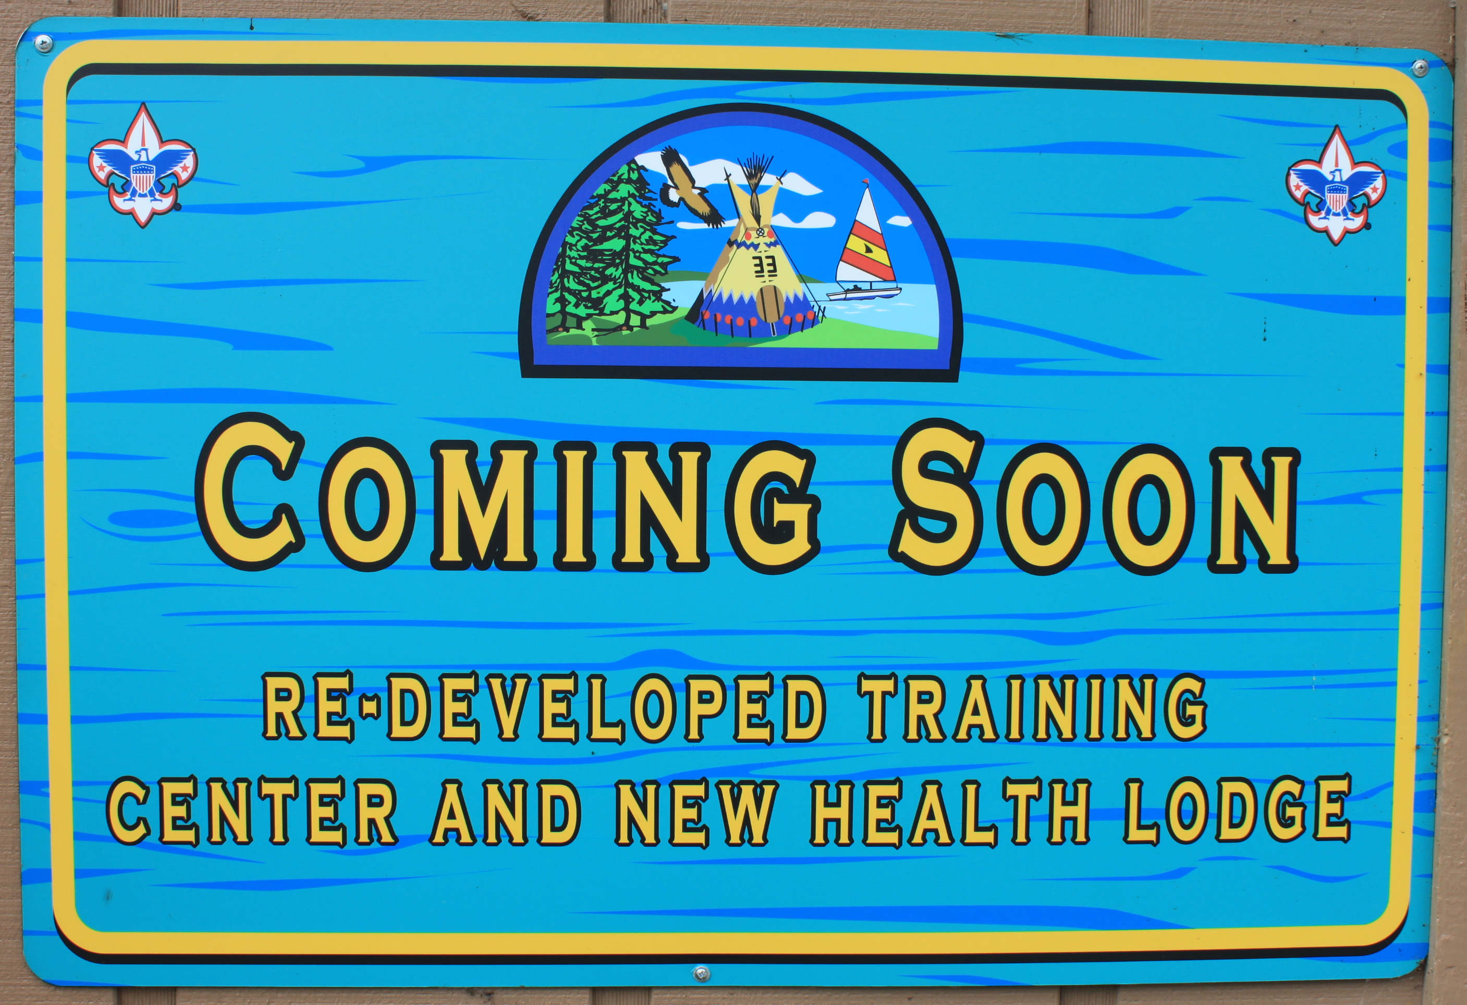
COMING NEW FACILITIES

Slide 15
Boating Opportunities
Canoeing
Kayaking
Personal Watercraft (Jet Skis)
Day Sailboats
Aqua Finns
Catalina 14’s
Cruising Sailboats
Hunter 25’s West Wight Potter
Catalina 25’s
Beneteau 23

Slide 16
Roy C. Manchester Waterfront

Slide 17
Sailboat Dock

Slide 19
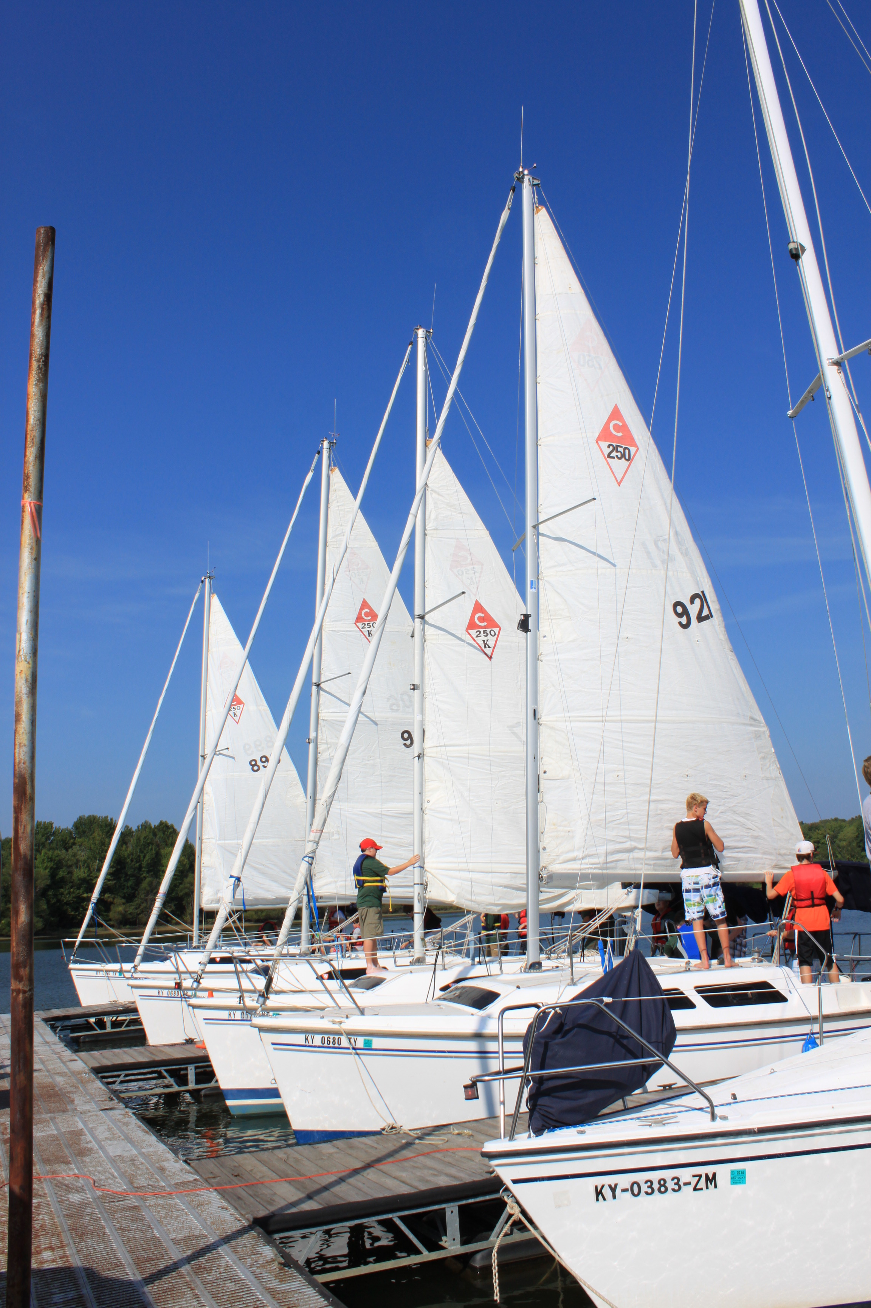

Slide 21
Spring / Fall Boating Opportunities

Slide 22
Weekend Sailing Opportunities for Troops

Slide 23
Heading Out!

Slide 24
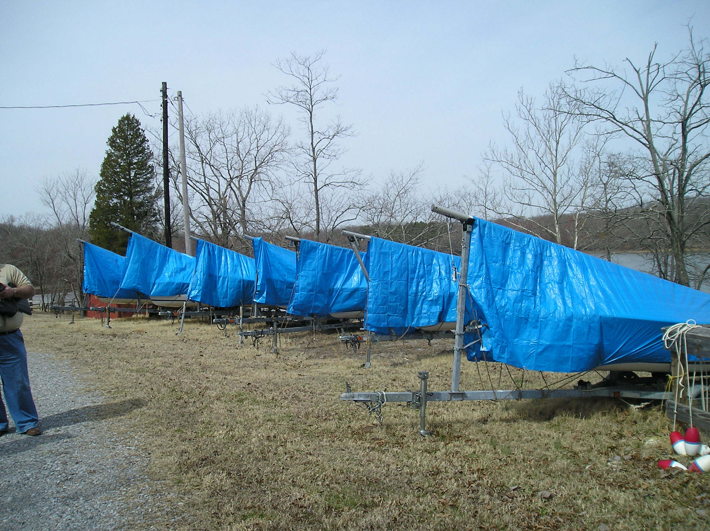
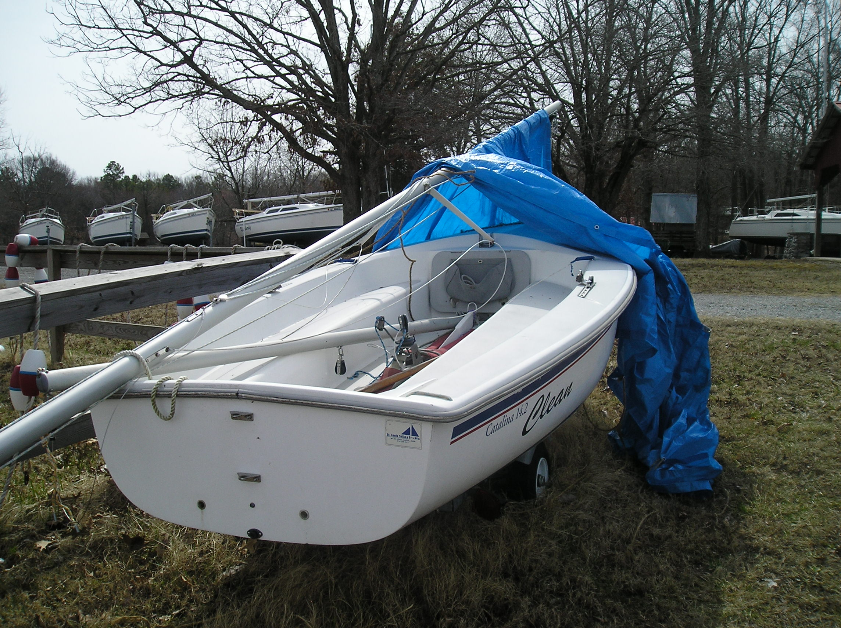
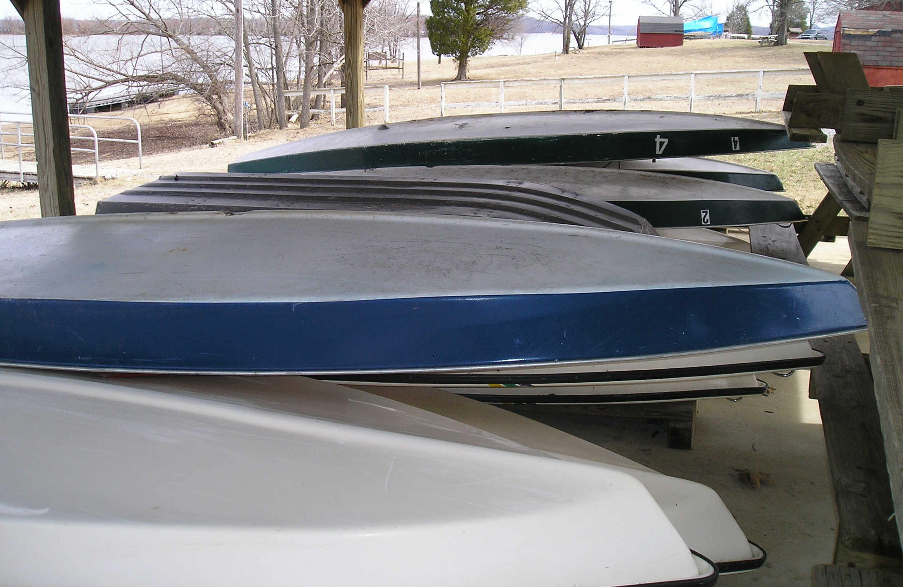

Slide 25
11 Canoes

Slide 26
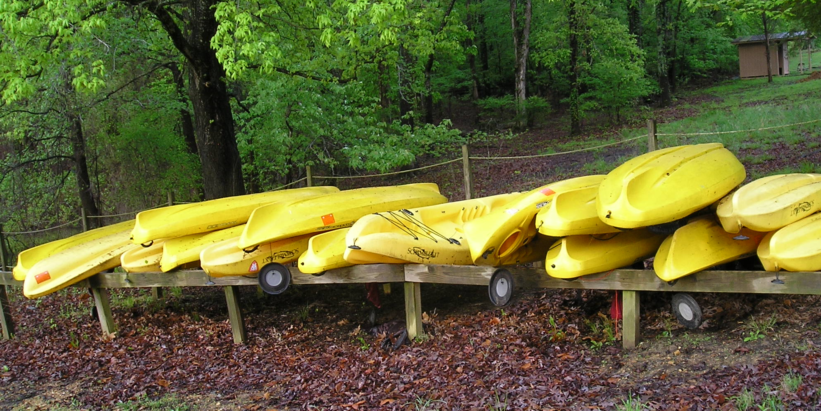
16 Kayaks

Slide 27
