Slide 1
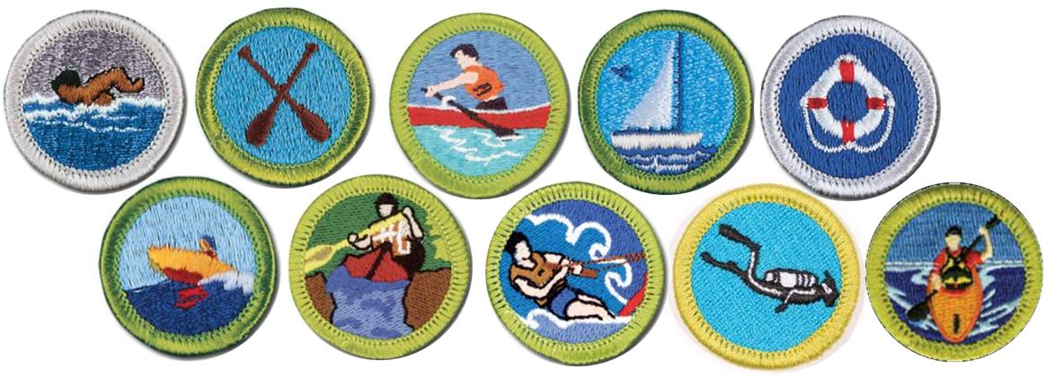
Aquatics Merit Badges
Cal Banning- Aquatics Liaison- Merit Badge Maintenance Task Force

Slide 2
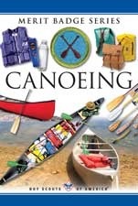
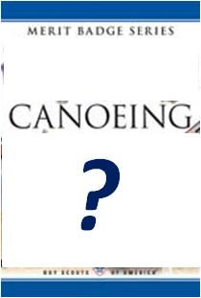
Merit Badge History
1930 … 1952 1962 1968 1977 1989
2004- Present
New Digital
Stay current!
www.scouting.org
www.scoutstuff.org
Notes:
Merit Badge History- Canoeing Example- Possible new digital MB Candidate

Slide 3
Of ALL merit badges, First Aid ranks first in popularity with 80,716 per year. Numbers and ranks for aquatics merit badges are:
Swimming 71,821 2
Kayaking 34,054 20
Canoeing 29,461 21
Lifesaving 23,983 25
Small-Boat Sailing 15,092 39
Motor Boating 9,880 61
Rowing 9,995 58
Water Sports 3,389 106
Whitewater 2,888 115
Scuba Diving 2,135 124
2015 statistics
Notes:
1st Aid first in popularity, Swimming second. First seven are in top half. Others low because special equipment and settings are needed. Kayaking, new in 2012, moved quickly toward top. Details not important. Point from this slide is that something is wrong if the waterfront at camp is not highly popular.
(Numbers rounded to closest 100.)

Slide 4
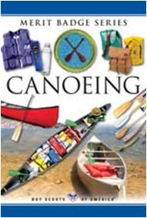
Boy Scout Program: Merit Badges
Each subject supported by pamphlet.
Requirements aimed at 12 year old.
Scout learns basic safety & recreational skills, e.g. is able to make a boat move where he wants with reasonable efficiency.
Skills basic, not expert.
For example, Whitewater MB limited to class II flowing water.
Instruction times not specified, only that boy meets requirement performance standard.
Typical MB classes at summer camps meet two hours a day for 5 days.
Notes:
Scope of Merit Badges

Slide 5
Aquatics Merit Badges
The Process
The Aquatics Task Force had direct interface with the Merit Badge Maintenance Task Force (MBMTF).
Cal Banning is the Aquatics Task Force Liaison and Member of the Merit Badge Maintenance Task Force.
Within the Aquatics Task Force there is a Lead SME (Subject Matter Expert) assigned for each Aquatics MB.
Each Aquatics Merit Badge is on a 2 Year Review Cycle
Each Lead SME assigns support for MB Review and update.
The Aquatics Task Force reviews changes prior to presentation to the MBMTF.
Notes:
Discussion of MB Maintenance & Revision Process

Slide 6
Aquatics Merit Badge Lead SME’s
Swimming Jay Fox
Kayaking Richard Thomas
Canoeing Richard Thomas
Lifesaving David Bell
S Boat Sailing Trey Shupert
Motorboating Steve Terrell
Rowing Steve Terrell
Water Sports Jeff Cannon
Whitewater Richard Thomas
Scuba Diving Joe Angelo / Steve Willis
Notes:
Lead SME’s for Each Aquatics MB

Slide 7
LAST REVISION NEXT REVIEW
Swimming* 2014 2018
Kayaking 2013 2017
Canoeing 2014 2018
Lifesaving* 2015 2017
Small-Boat Sailing 2013 2018
Motorboating Rev. Submitted 2018
Rowing 2013 2018
Water Sports 2014 2018
Whitewater Rev. Submitted 2018
Scuba Diving 2013 2017 *Digital MB
Notes:
Latest Revision & Next Scheduled Review for each MB

Slide 8
Digital Merit Badges
Notes:
As part of Eagle required MB’s both Swimming and Lifesaving Digital MB’s were completed in 2015. Based on popularity, both Canoeing and Kayaking are candidates going forward.

Slide 9
Aquatics Merit Badge- Input & Feedback
Canoeing
Kayaking
Lifesaving
Motorboating
Rowing
SCUBA
Small Boat Sailing
Swimming
Water Sports
Whitewater
Notes:
One by one, solicit feedback from Workshop Participants.

Slide 10
Thank You – For Further Feedback or Questions
Contact Cal Banning
Email: cabann54@hotmail.com Phone: (817) 312-4380

