Slide 1
International Service Team (IST)
Volunteer Experience at
World Scout Jamborees (WSJ)
Jay Eidson
23rd WSJ Japan BSA IST Commissioner

Slide 2
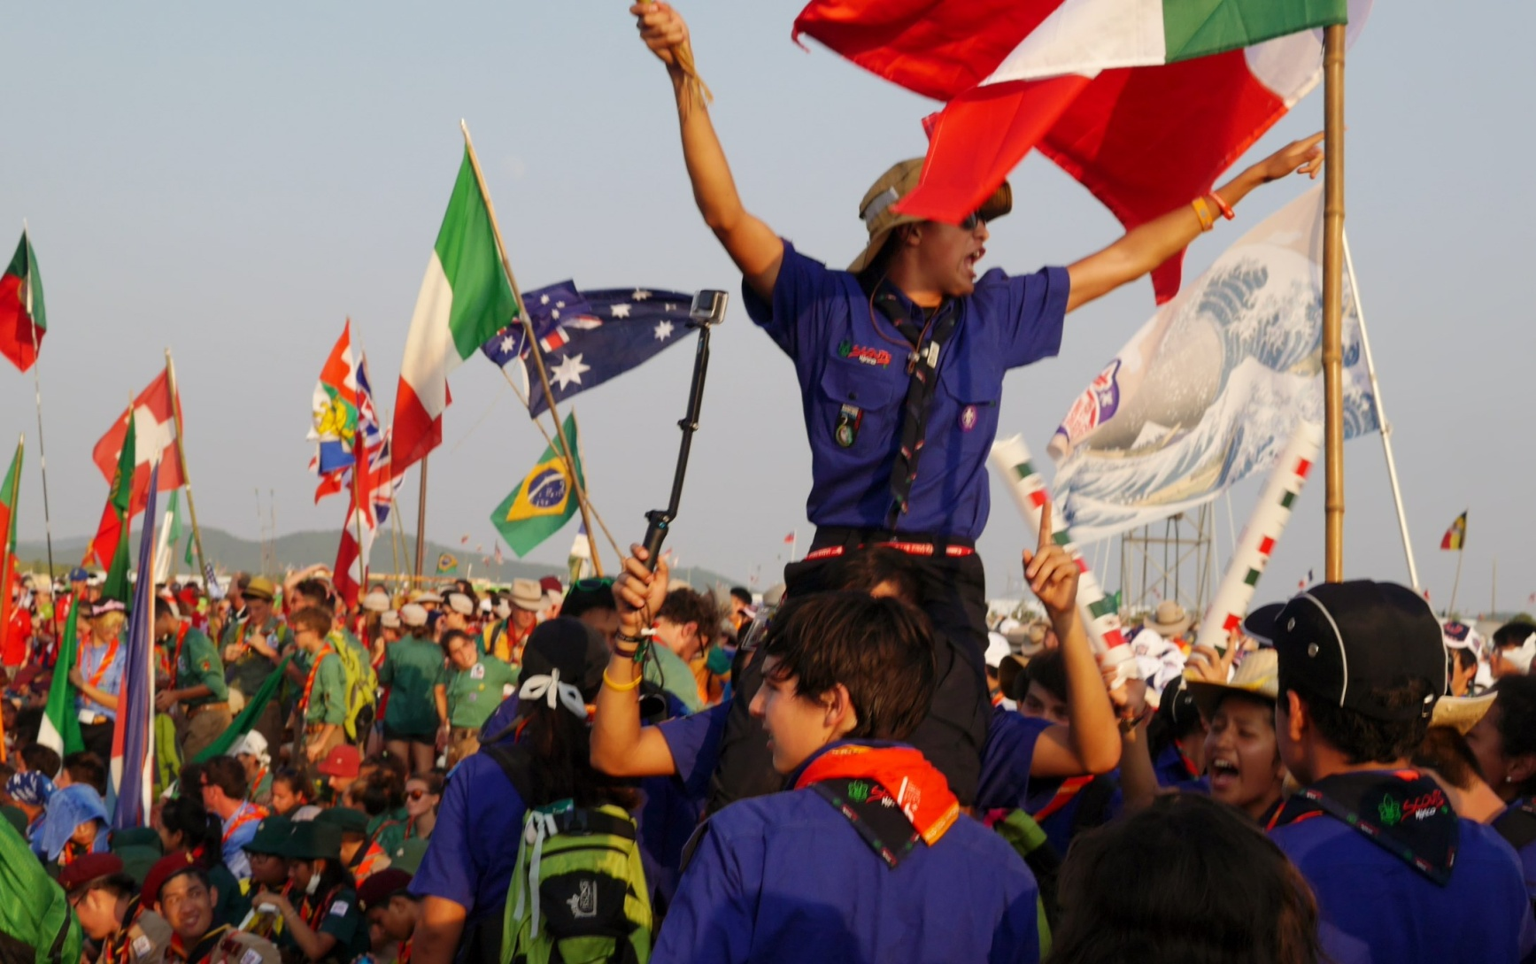
WSJs – unique experience, opportunity of a lifetime !

Slide 3
WSJs – Background Info
Held under auspices of WOSM (World Organization of Scouting Movement)
Management of participation done through National Scout Organizations (NSO), eg BSA for USA
WSJs normally take place once every 4 years
Known by Number & Country(ies), eg: 22nd WSJ, Sweden; 23rd WSJ, Japan; 24th WSJ, North America
Host Country forms multinational Organizing Committee of representatives from NSOs
3 languages: English, French, & that of host country

Slide 4
IST – dual citizens
IST are assigned by -- and work for -- Organizing Committee of host country (Japan in 2015), but are also part of the sponsoring NSO’s contingent (BSA members registered as youth, unit leaders, and staff) so may have duties specific to the sponsoring NSO
BSA IST first vetted by local Council, then National
Must accept to work assigned position & not switch without permission – will be checked!
Reports in through IST management team for all work-related issues, but …..
Reports in through sponsoring NSO (BSA) for all other issues (registration, housing, uniforms, transportation)

Slide 5
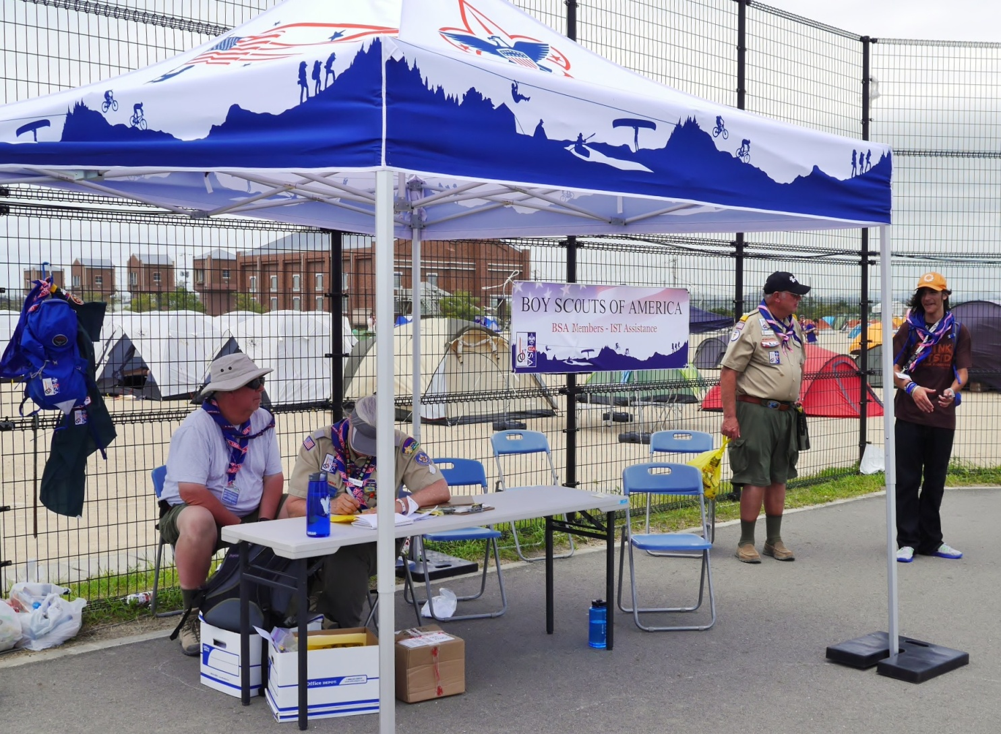
23rd WSJ BSA IST Commissioner role created for front-line support

Slide 6
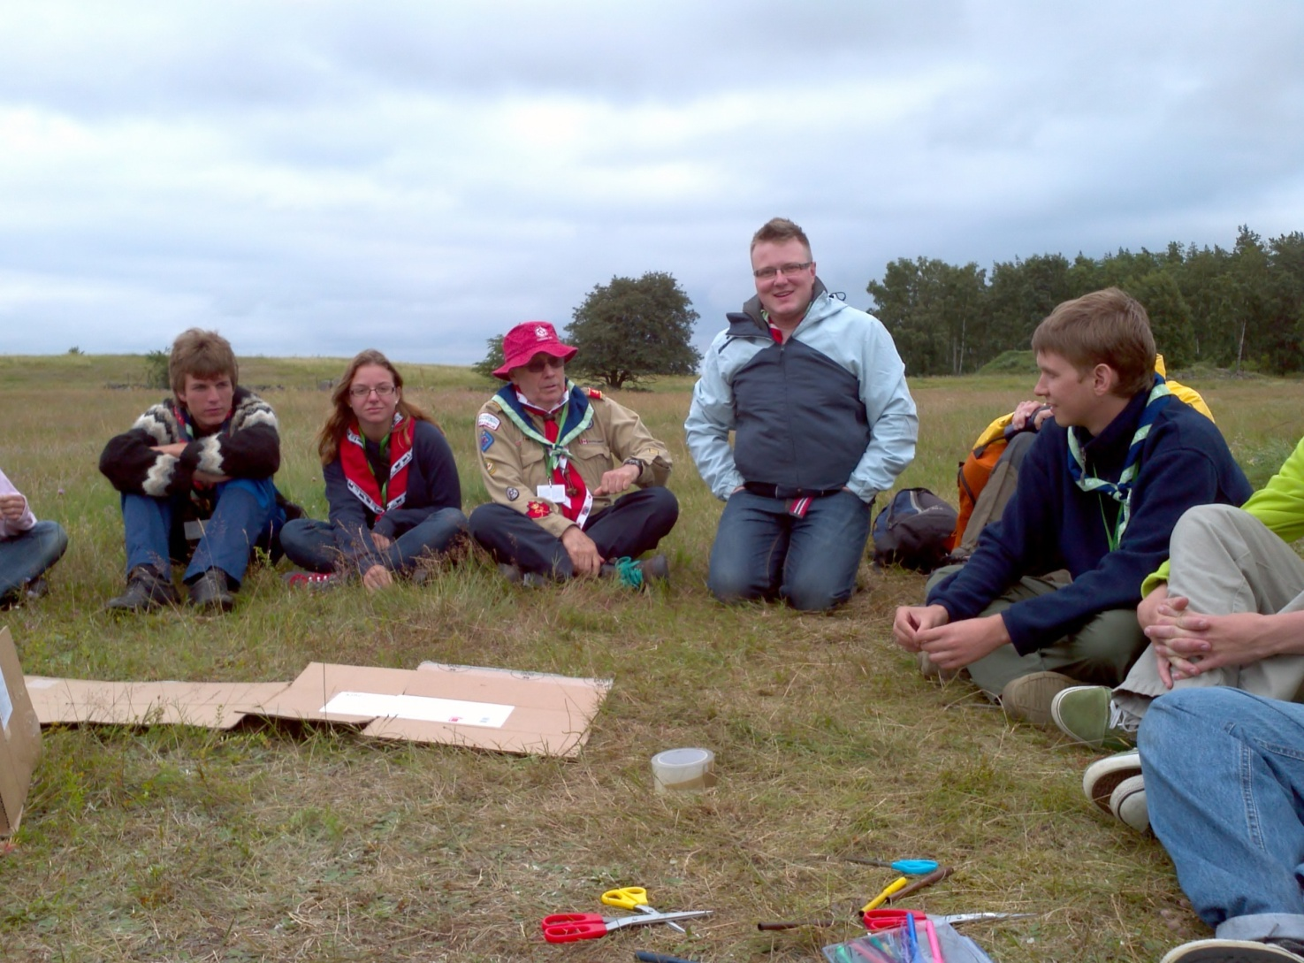
IST training & teambuilding before participants arrive

Slide 7
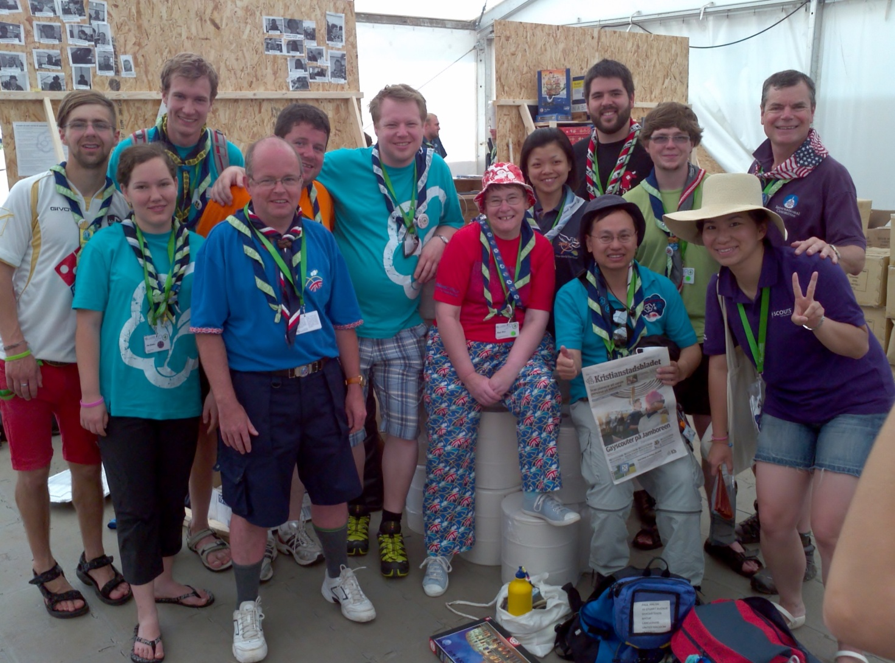
Work alongside Scouters from all over the world

Slide 8
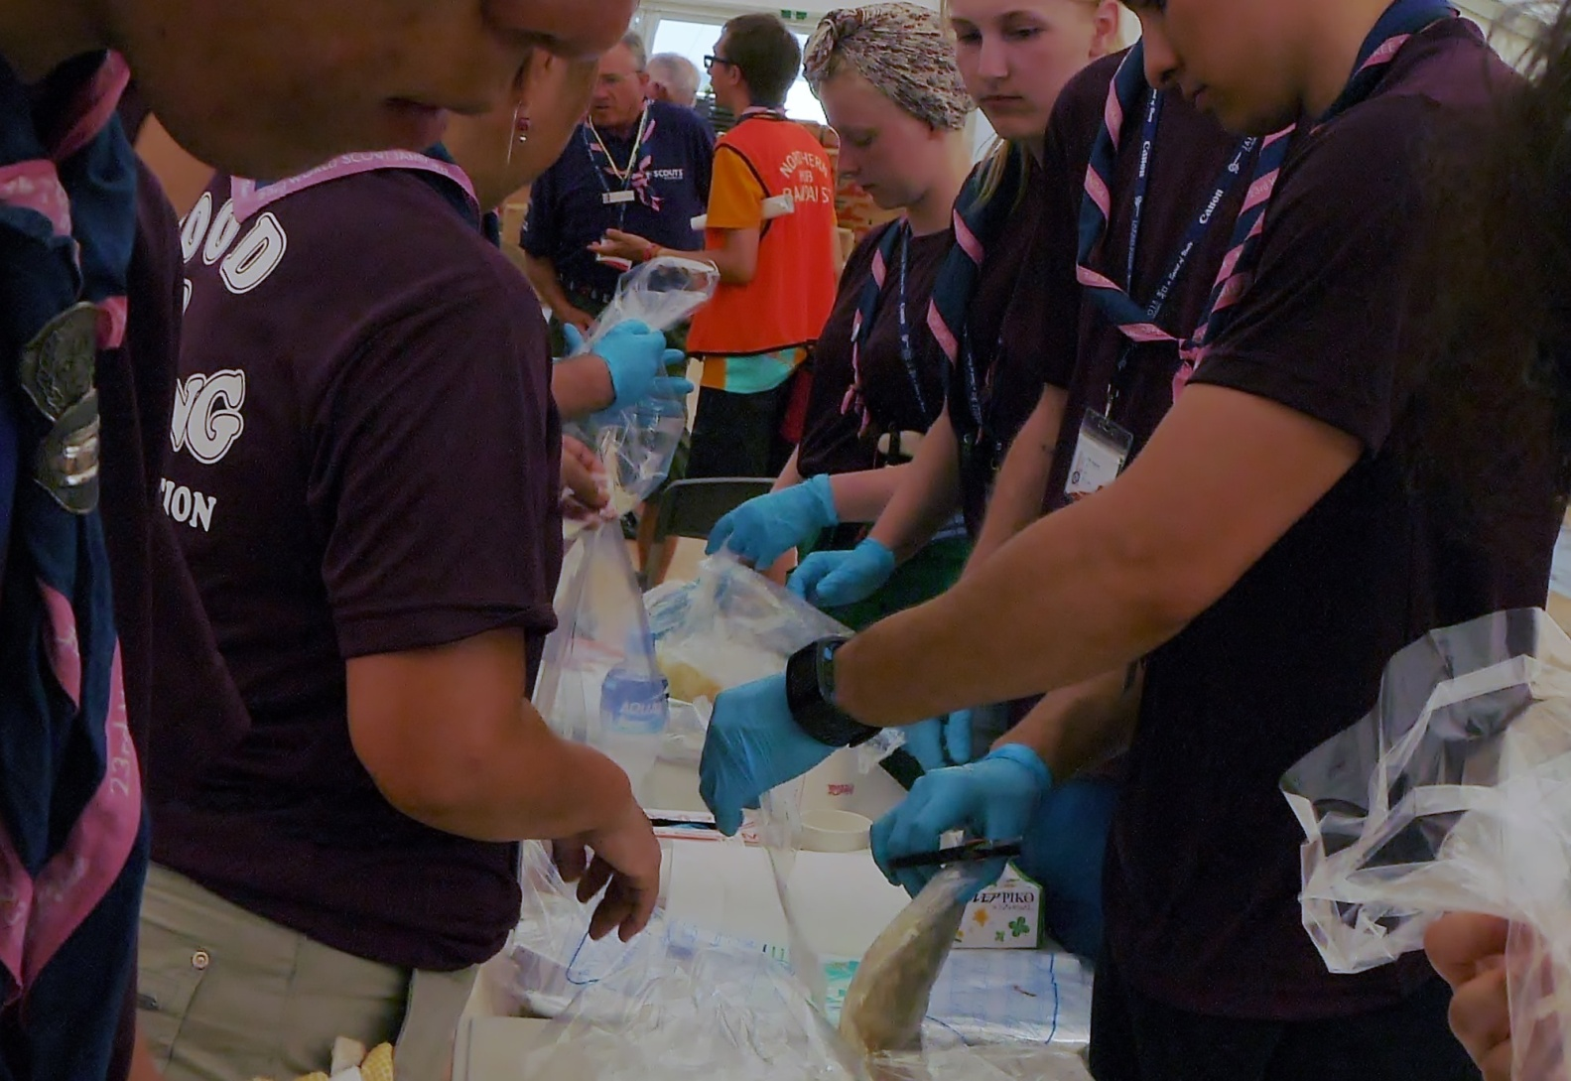
Participant food distribution is one of many critically important IST functions

Slide 9
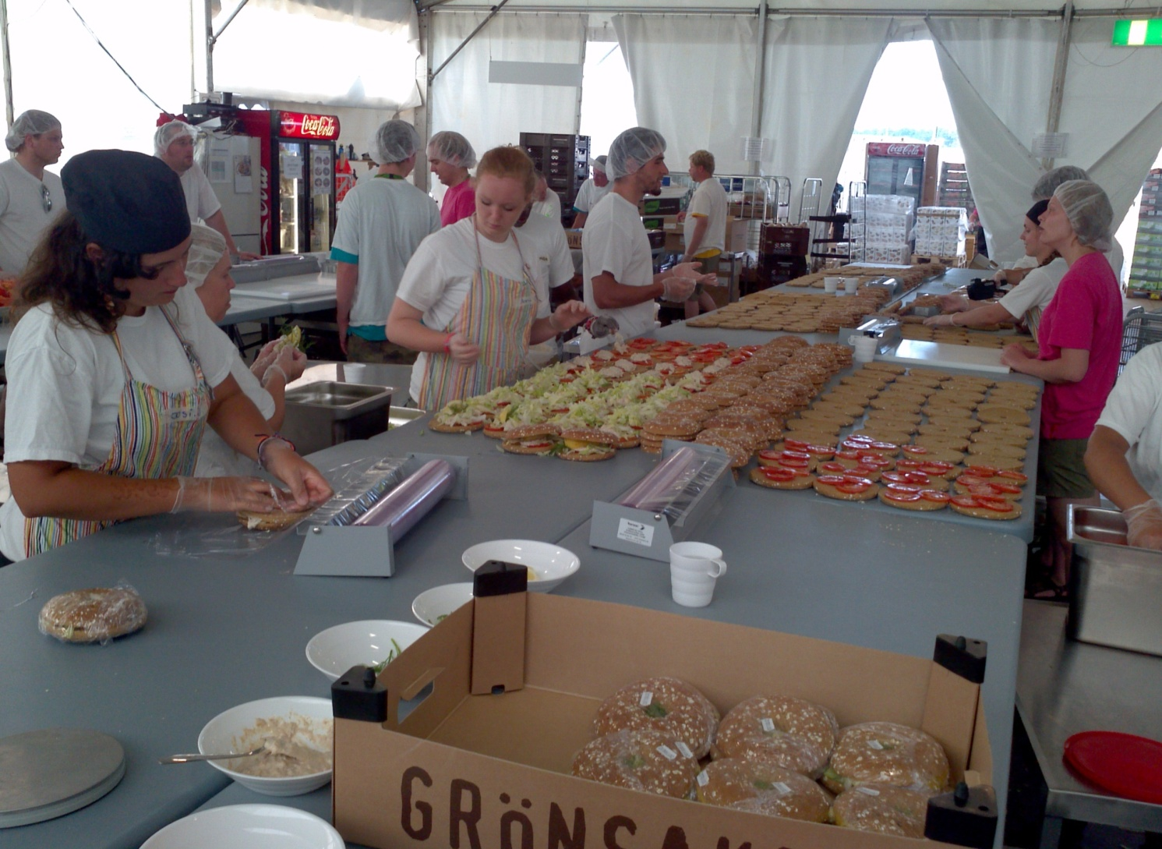
… and IST Food Service is another

Slide 10
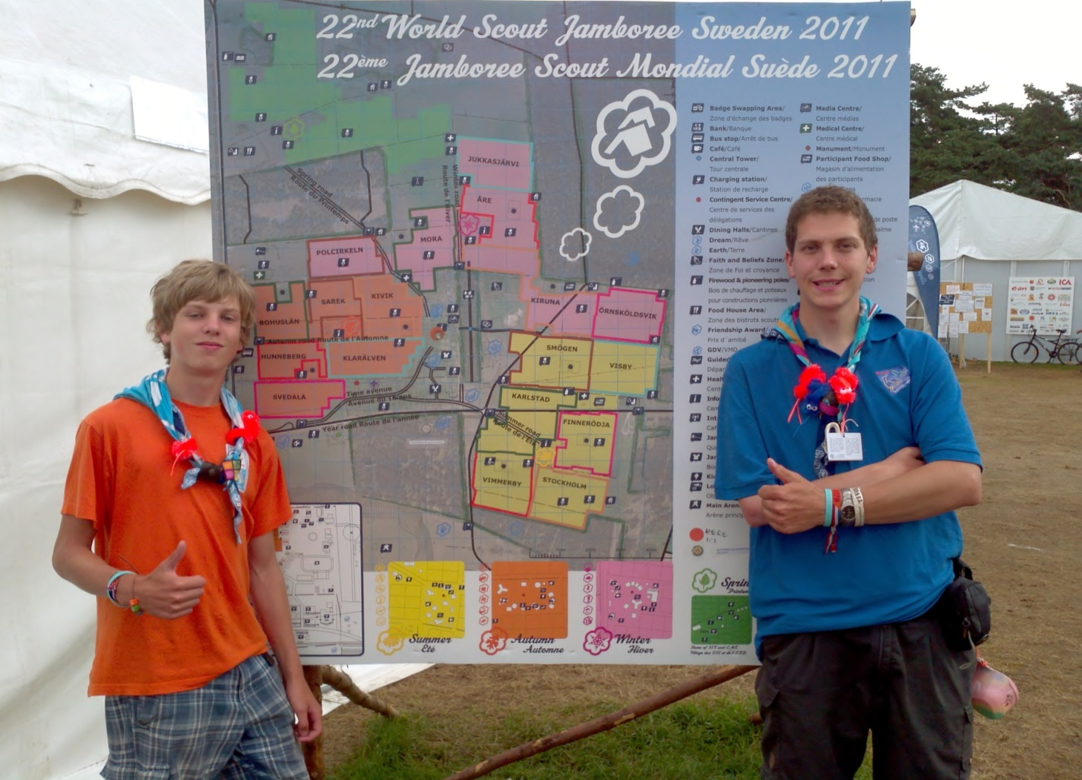
Learn camp layout – IST Subcamp may be far away from program venues & contingents (your kids/ home units)

Slide 11
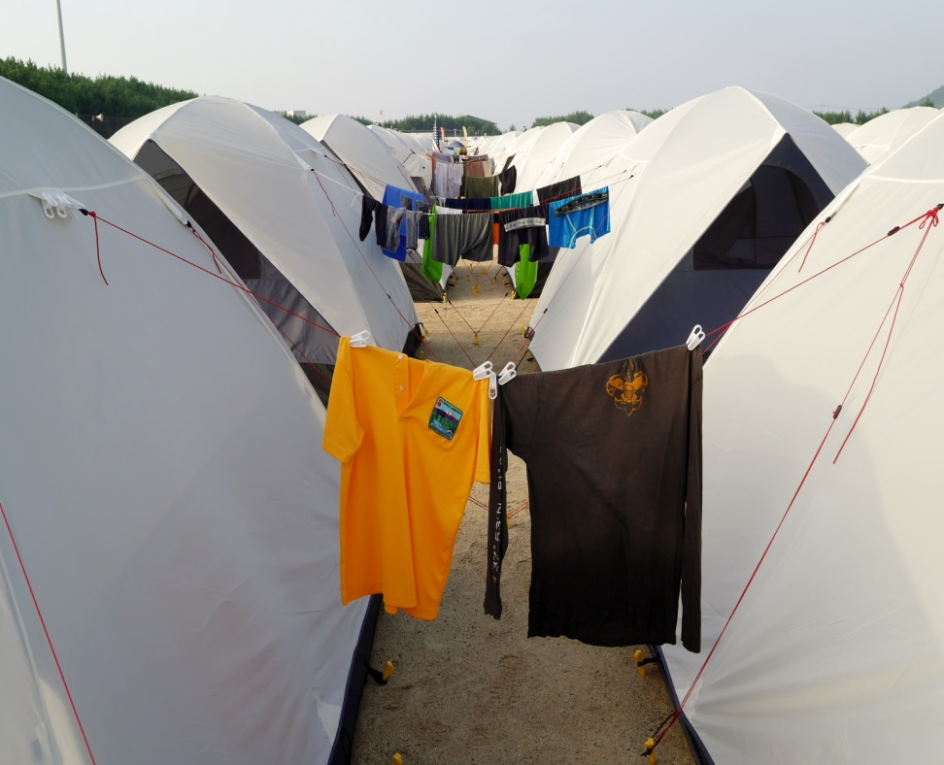
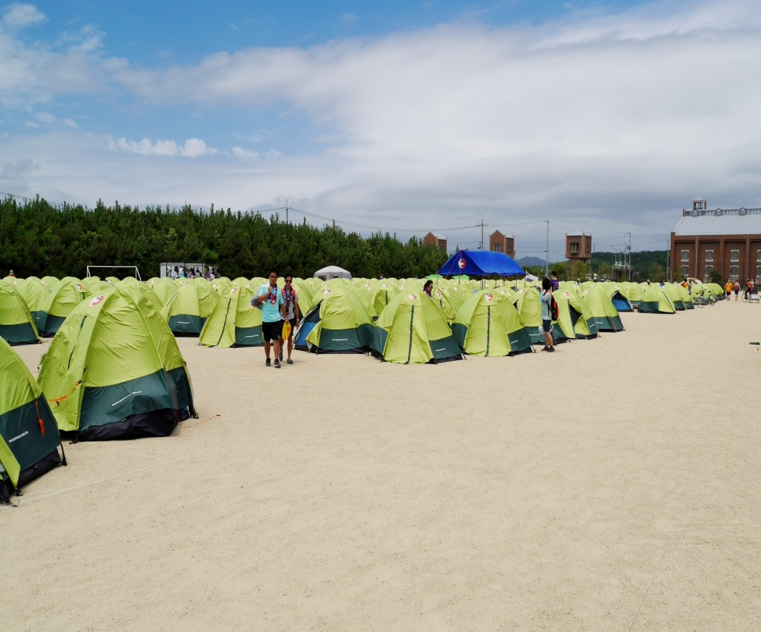
IST Subcamp (tent city)

Slide 12
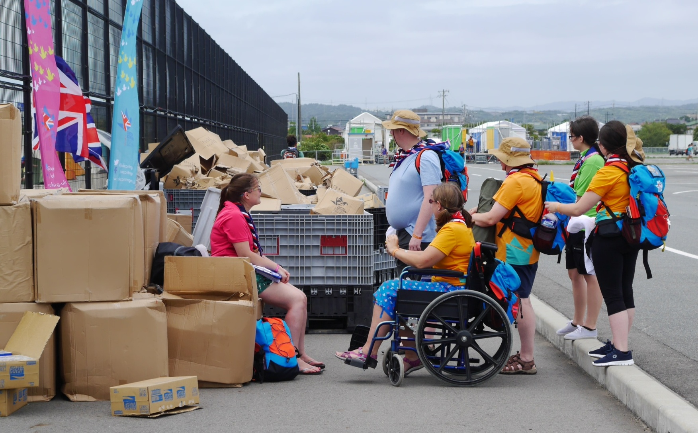
Hygiene facilities, garbage & recycling, & handicap access are some of the logistical challenges

Slide 13
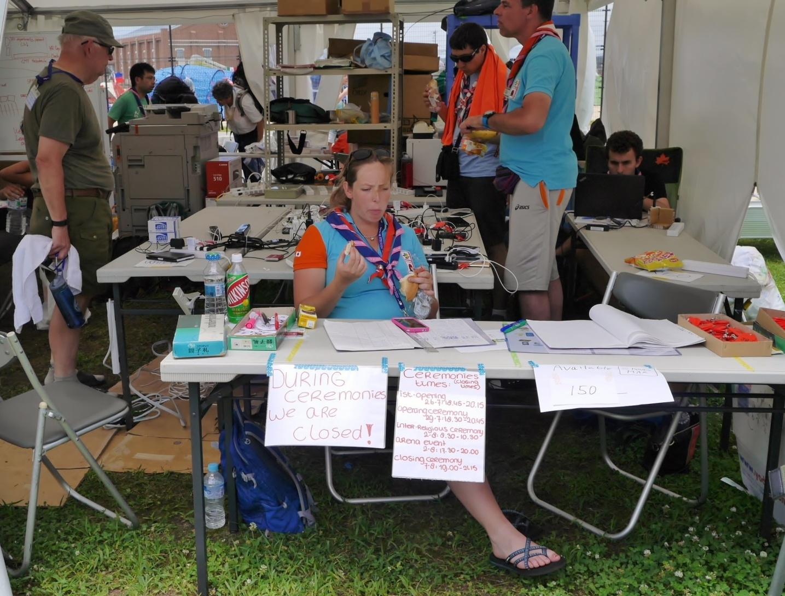
Adequate recharging facilities are a perennial challenge

Slide 14
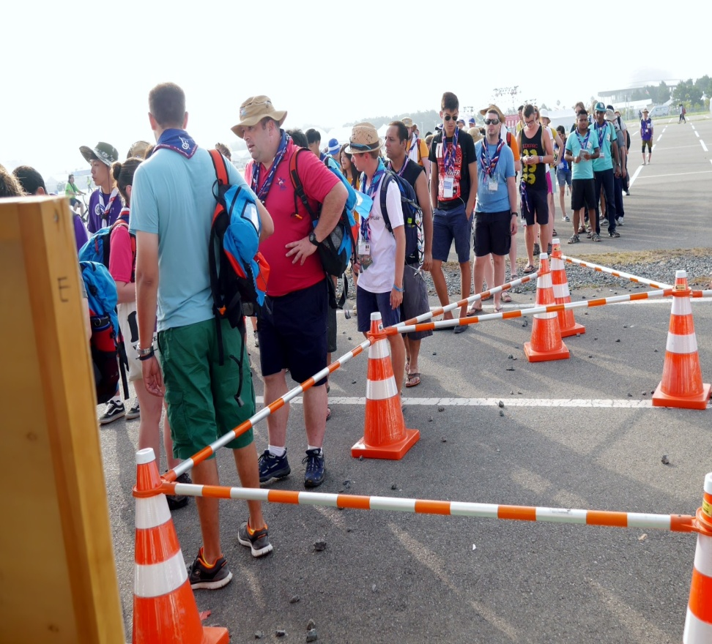
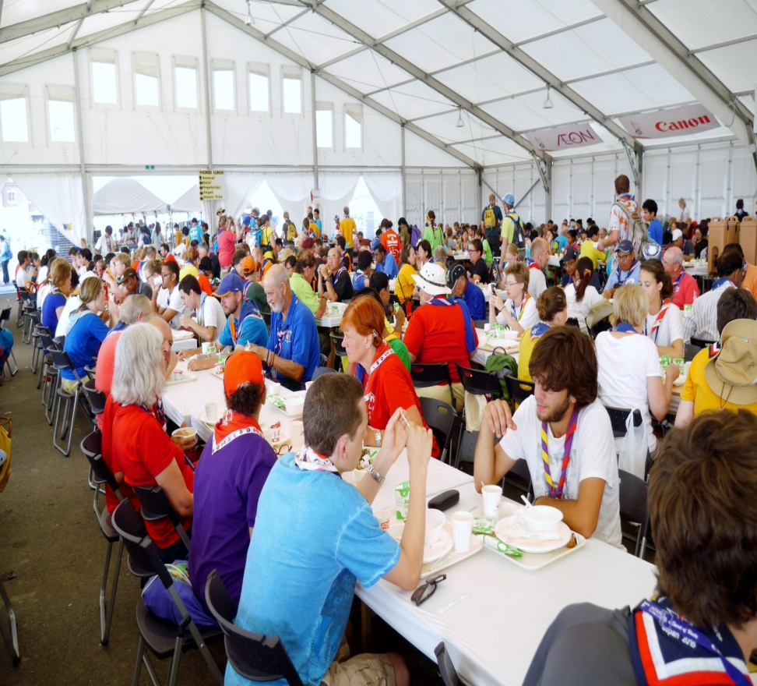
IST dining hall crowds at peak times

Slide 15
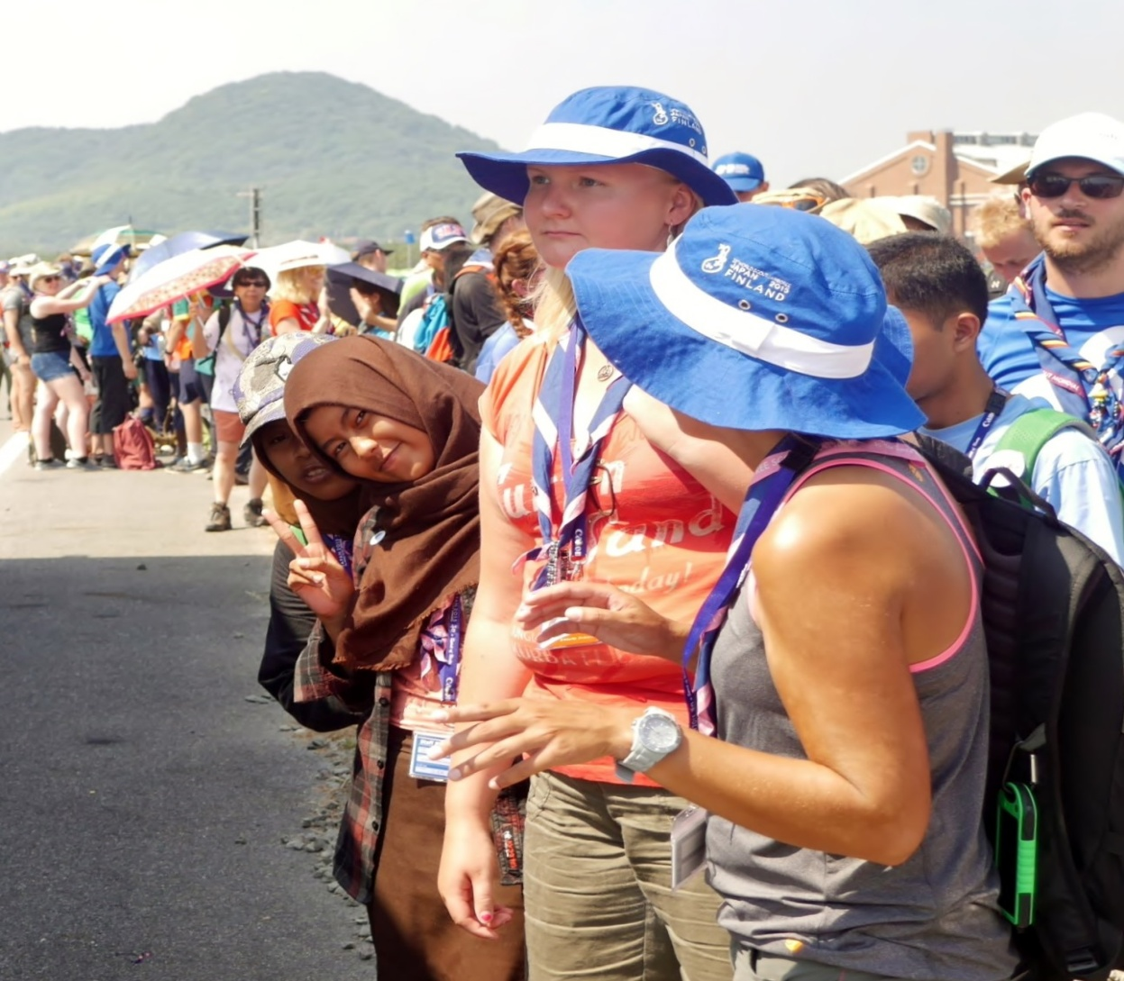
Bus transportation ‘into town’ provided for IST during time off – and here’s the queue

Slide 16
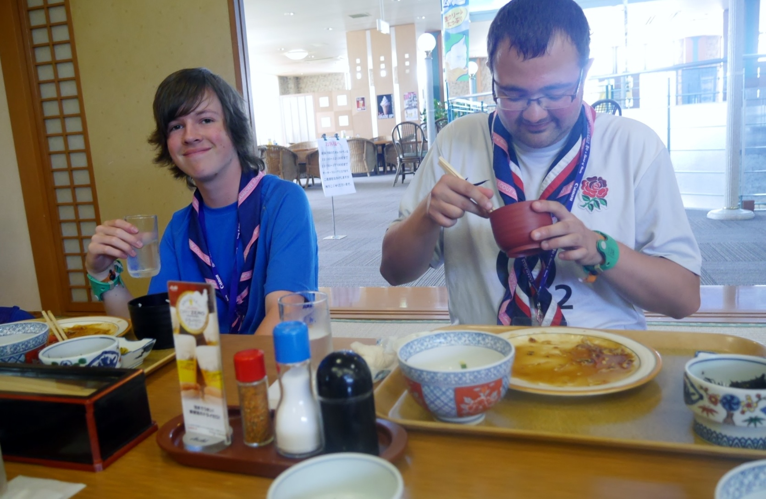
Optional offsite activities available to IST during time off ($$)

Slide 17
Tips of the Trade: “Be Prepared”
Register early and be sure to check your email mailbox and both the host website and BSA’s website often as most communication is provided electronically
Learn:
  ‘the WOSM/WSJ lingo’
  Foreign language
  Metric system
  24 hour clock
  Necker color code system (CMT, IST, Participant, …)
  National flags and national neckers
Bring lots to trade:
  Neckers
  Caps
  T-shirts
  Patches
  Belts

