Slide 1
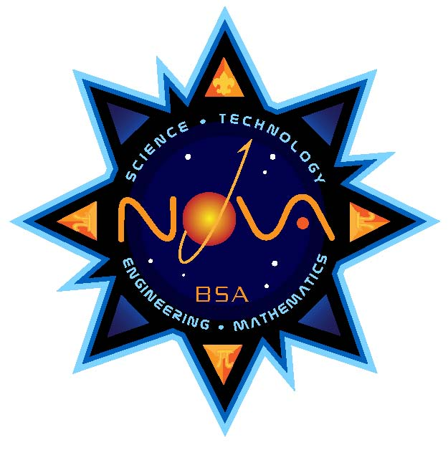
STEM/NOVA Webinar
Welcome to the
Notes:
Welcome to the STEM/Nova webinar. Today we will discuss a program that is two years in the making.

Slide 2
What Is Nova?
Notes:
In 2010, Exxon Mobil donated $3 million to the Boy Scouts of America to create a STEM initiative. The BSA has created the Nova Awards program. The Nova Awards are designed to enhance interest in the STEM fields while making it fun for youth to learn. The series of Nova Awards integrates many existing advancements from Scouting. The Supernova Awards challenge Scouting youth who have a greater interest in the STEM fields to experiment, understand the outcomes of these experiments, and present their findings to their Supernova mentor. These awards can earned by Cub Scouts, Boy Scouts, and Venturers.

Slide 3
VS.
counselors
mentors
Notes:
In the Nova and Supernova awards, there are references to counselors and mentors. We use the word “counselor” for the adult working with the Nova candidates. Parents and unit leaders may serve as Nova counselors even if they have little or no background in STEM.
A “mentor,” on the other hand, is ideally someone who has successfully negotiated a STEM career path or has other subject matter expertise (such as hobbies or other special training) and is willing to share accumulated wisdom and experience.

Slide 4
Youth Protection Guidelines
Notes:
Youth Protection Guidelines
All Nova counselors and Supernova mentors must be registered
with the Boy Scouts of America (unless you are working with your
own child) and must have current Youth Protection training and
certification. Meetings must follow Youth Protection guidelines,
with at least two Scouts or adults present at any meetings.

Slide 5
STEM is FUN!
Be safe!
Encourage youth.
Age makes a difference.
Group size.
There is no time limit.
Know your youth!
Notes:
- STEM-related activities and Nova awards are designed to be fun. We want to build confidence and communicate that career opportunities in STEM fields are attainable, fulfilling, and interesting.
- All experiments or projects should be conducted using the highest level of safety protocol and should always be under the supervision of a qualified, responsible adult.
The goal is to encourage youth to stretch and grow, yet not frustrate them or turn them off of STEM activities by making them too hard. We have tried to address this within the scope of the requirements for each age group, but you will be the one assessing your youth’s readiness.
- How do you know what is expected at any given age? There can be a very broad range of abilities and knowledge among youth of the same age. Some of this may depend on where they live, their school system, or their socioeconomic background. The awards have been designed to take this into account.
- We recommend no more than a den- or patrol-size group (maximum of eight to 10).
- There is no set amount of time or number of sessions other than aging out of a specific program.
- The best advice is to know the youth you are working with.

Slide 6
Nova Award
Cub Scout:
Science Everywhere
Tech Talk
Swing!
1-2-3 Go!
Boy Scout:
Shoot!
Start Your Engines
Whoosh!
Designed to Crunch
Venturing:
Launch!
Power Up
Hang On!
Numbers Don’t Lie
Notes:
The Nova Award is presented for understanding the basics of STEM.
Nova activities are basic and designed to spark interest in STEM.
They are straightforward to complete and have a quick “reward” of the Nova patch for the first category earned and a pi (π) pin to attach to the Nova patch for each additional category earned.

Slide 7
HELP
Hints
Requirements
Notes:
In the counselor sections, you will see pages with requirements and help hints. All help hints are in colored boxes.

Slide 8
Supernova Awards
Dr. Sally Ride
Bronze medal
Wright Brothers
Silver medal
(Must be a registered Venturer)
Dr. Albert Einstein
Gold medal
(Must be a registered Venturer)
Venturer
Dr. Bernard Harris
Bronze medal
Thomas Alva Edison
Silver medal
Boy Scout
Dr. Luis W. Alvarez
Wolf/Bear Cub Scout
Bronze medal
Cub Scout
Dr. Charles H. Townes
Webelos Scout
Bronze medal
Notes:
For more in-depth knowledge of STEM Scouts, can work on their Supernova Award.
Completing the requirements takes more work and includes some research.
Most Supernova activities will take several weeks or months to complete.
They get more difficult as the youth works up through the awards.
To work on any level award you must be registered in that program.
After completion, Scouts will fill out their Supernova application found on www.scouting.org.
Let’s break down the levels of the awards.

Slide 9
Supernova Awards
Dr. Luis W. Alvarez
Wolf/Bear Cub Scout
Bronze medal
Cub Scout
Dr. Charles H. Townes
Webelos Scout
Bronze medal
Notes:
Cub Scout
There are two awards on the Cub Scout level. The Dr. Luis W. Alvarez Award is designed for Wolf and Bear Cub Scouts, and the Dr. Charles H. Townes Award is designed for Webelos Scouts. The Alvarez Award and the Townes Award do no have a Nova Awards–related prerequisite.

Slide 10
Supernova Awards
Dr. Bernard Harris
Bronze medal
Thomas Alva Edison
Silver medal
Boy Scout
Dr. Luis W. Alvarez
Wolf/Bear Cub Scout
Bronze medal
Cub Scout
Dr. Charles H. Townes
Webelos Scout
Bronze medal
Notes:
Boy Scout
There are two levels to the Boy Scout Supernovas. The Dr. Bernard Harris Award leads to the Thomas Alva Edison Award.

Slide 11
Supernova Awards
Dr. Sally Ride
Bronze medal
Wright Brothers
Silver medal
(Must be a registered Venturer)
Venturer
Dr. Bernard Harris
Bronze medal
Thomas Alva Edison
Silver medal
Boy Scout
Dr. Luis W. Alvarez
Wolf/Bear Cub Scout
Bronze medal
Cub Scout
Dr. Charles H. Townes
Webelos Scout
Bronze medal
Notes:
Venturing
Within Venturing there are three different levels. The youth must have completed either the Harris Award or the Dr. Sally Ride Award to move on to the Wright Brothers Award.

Slide 12
Supernova Awards
Dr. Sally Ride
Bronze medal
Wright Brothers
Silver medal
(Must be a registered Venturer)
Dr. Albert Einstein
Gold medal
(Must be a registered Venturer)
Venturer
Dr. Bernard Harris
Bronze medal
Thomas Alva Edison
Silver medal
Boy Scout
Dr. Luis W. Alvarez
Wolf/Bear Cub Scout
Bronze medal
Cub Scout
Dr. Charles H. Townes
Webelos Scout
Bronze medal
Notes:
Gold Level
The last award is the Dr. Albert Einstein Award.
As you can see, the awards accumulate to this award.

Slide 13
Notes:
There is a requirements book for each BSA program, and each book includes Nova requirements, Supernova requirements, and a counselor/mentor section.

Slide 14
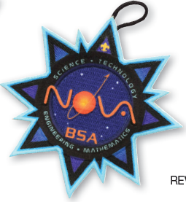
Supplies: Local Scout Shop OR www.scoutstuff.org
Notes:
You can find all requirement books, emblems, pins, medals, and other STEM-related products at your local Scout shop or at www.scoutstuff.org.

Slide 15
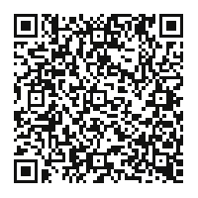
For more information:
Facebook under
Nova Award, BSA
www.scouting.org/stem
Notes:
For more information, we have two websites that you can visit. On www.scouting.org/stem we have much of the information that is in this webinar, along with the requirements, council support, and some cool links for youth to check out. We also have a Facebook page where we are posting the most up-to-date information. Many are using the page to exchange ideas on how to execute the program.

Slide 16
Questions?
Thank you for your time today.
If you have more questions after today, please email program.content@scouting.org or call 972-580-2185
Notes:
We will take questions now.

